Slide 1

GLOBAL ANIME
MARKET REPORT
2024
Global,Regional,CountryAnalysis

Slide 2

INTRODUCTION
Anime is a term used to describe animation that originated in Japan. The cultural distinction in how characters look and act matches Japanese society and culture and becomes the distinguishing aspect of anime. Anime is the animation of everything and anything that has the necessary features of being Japanese. Anime has been around for almost a century. The technical aspects of generating cartoons and Anime are the same. For example, Tom and Jerry are cartoons, whereas Pokemon are Anime, despite the shows being created using the same software. As a result, while all Anime is a cartoon, not all cartoons are Anime. Anime is also defined by character characteristics such as big, lovable eyes, petite noses, etc. Bright lighting and precise angles with quick camera movements add to the excitement of watching Anime and are distinguishing characteristics of this animation. Anime is utilized to tell stories from various walks of life, whether supernatural, sci-fi, thrillers, or non-fiction. Anime has always been popular in Japan, but it gained international recognition following the success of Pokemon and Dragon Ball Z. Anime was made for both youngsters and adults. Animators are experimenting with new plots and digital technology to increase the anime business. The growth of technology and software has allowed animation artists to improve their figures' appearance, action, and aesthetics.

Slide 3


KEY INSIGHTS
MARKET SIZE
USD 28.8 billion
2023
20₋23
CAGR 10.20%
2030

Slide 4

REVENUE MARKET SHARE BY SEGMENTS 2022
T.V
Movie Video
Merchandising Music Pachinko
Live Entertainment Internet Distribution
Type Segment
Comics Computer Based
Origin Segment

Slide 5
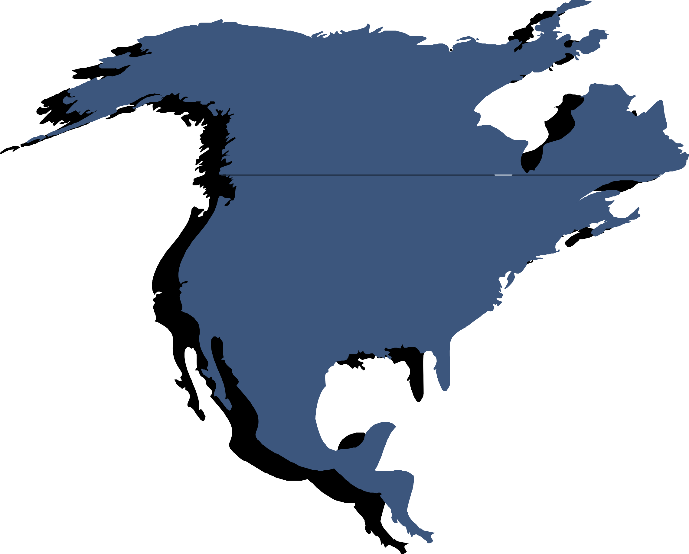
Global Anime Market Revenue share for 2022
North America

Slide 6

Growing New Technologies to Propel Market Growth
Drivers
Lack of Anime Artists to Restrict Market Growth
Restraints

Slide 7

AUTHOR'S PERSPECTIVE
The Global Anime Market is witnessing significant growth in the near future.
Individuals' increased desire to collect products related to their favourite anime series is expected to boost market expansion.
Internet distribution is the fastest-growing category over the forecast period.
Online streaming services and digital distribution methods have proven critical in reaching global audiences across borders.
Computer-generated animation grows in popularity as technology progresses, providing spectators with novel visual experiences.

Slide 8




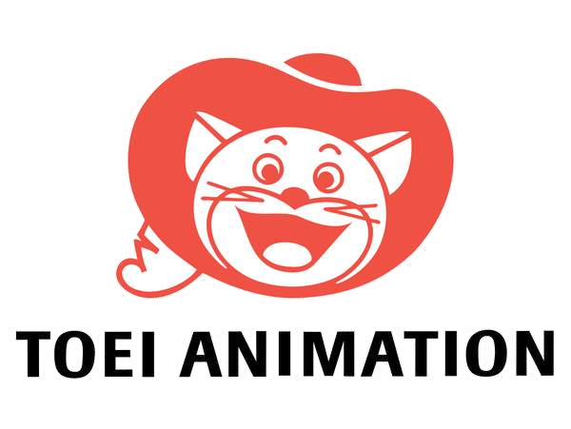









KEY PLAYERS

Slide 9


Contact us
For Full Report
COGNITIVE MARKET RESEARCH
Tel: + 1 312 - 376 - 8303 | + 44 020 - 8123 - 0732
India: ( + 91 ) 983 - 496 - 8611
sales@ cognitivemarketresearch. com
Access the Full Report : http://tinyurl.com/ys5tyhzd
Please visit our website:
https://www.cognitivemarketresearch.com

