Slide 1
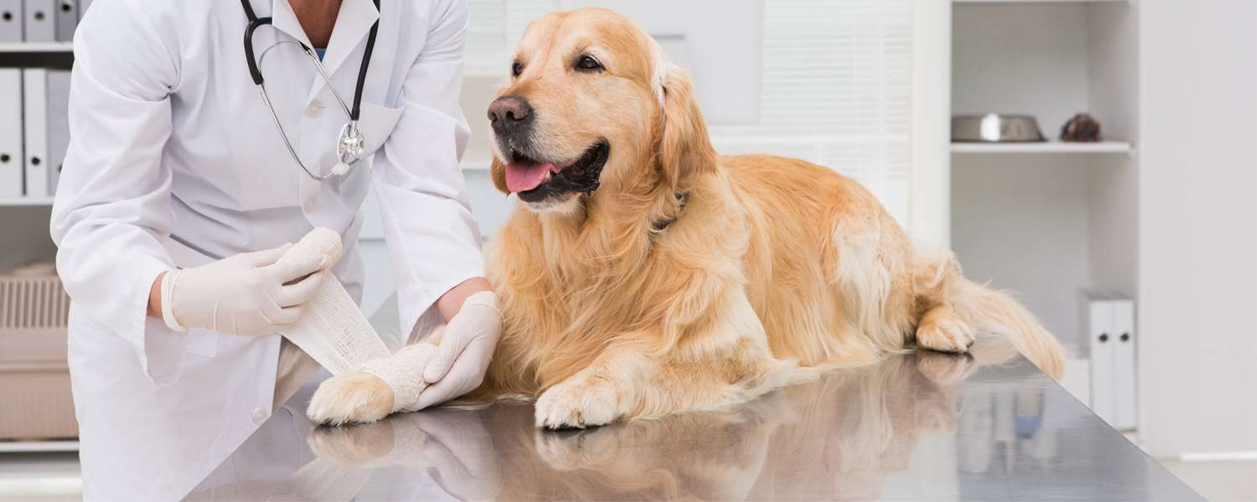
GLOBAL
ANIMAL WOUND CARE
MARKET REPORT 2024
Global,Regional,CountryAnalysis

Slide 2
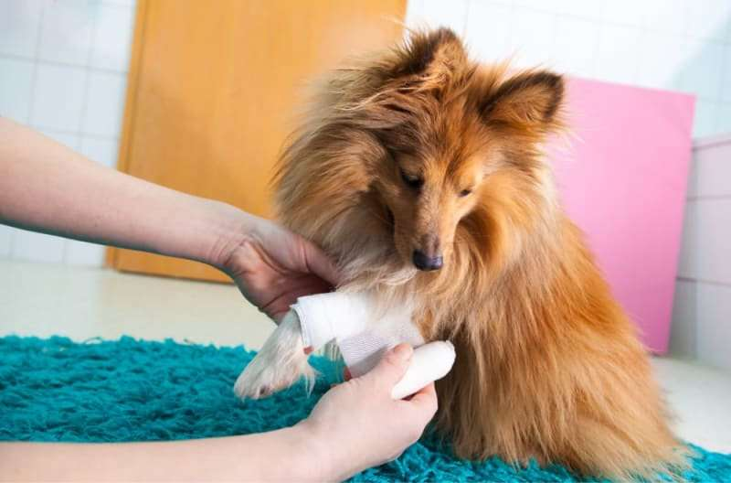
INTRODUCTION
Animal wound care is the process of giving injured animals medical attention and care. It entails evaluating the wound, cleaning it, using the proper therapies, and keeping an eye on the healing process. Animal wound care primarily aims to aid the restoration of normal tissue function, minimize pain and discomfort, promote healing, and prevent infection.

Slide 3
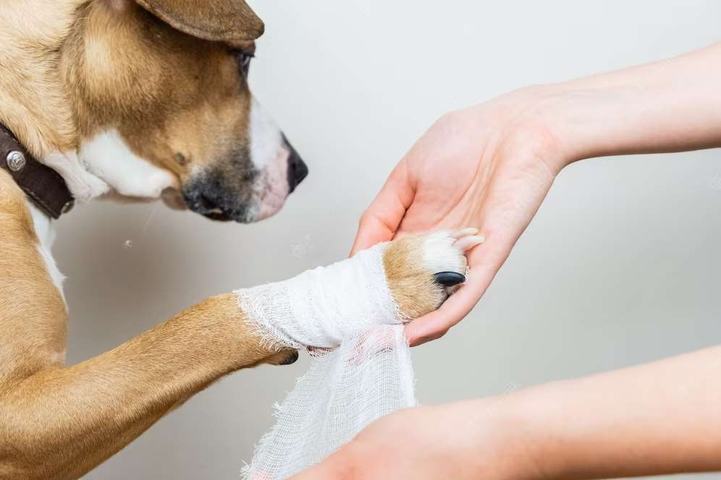

KEY INSIGHTS
MARKET SIZE
1.04 Billion
2022
FORECAST
1.83 Billion
2030
2023-
2030
CAGR
7.3%

Slide 4
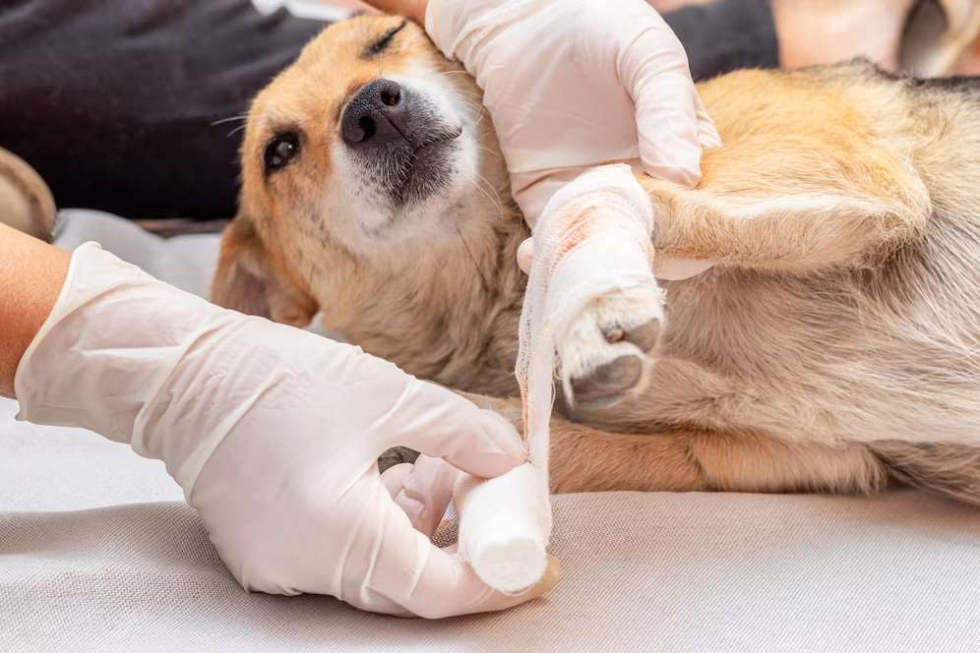



REVENUE MARKET SHARE BY SEGMENTS 2022
By Product: Surgical Wound Care Products (Dominating), Advanced Wound Care Products, Traditional Wound Care Products, and Therapy Devices
By Animal: Companion Animal, and Livestock
By End Users: Hospitals & Clinics, and Homecare

Slide 5

GLOBAL ANIMAL WOUND CARE MARKET REVENUE SHARE FOR 2022
North America
32.29%

Slide 6
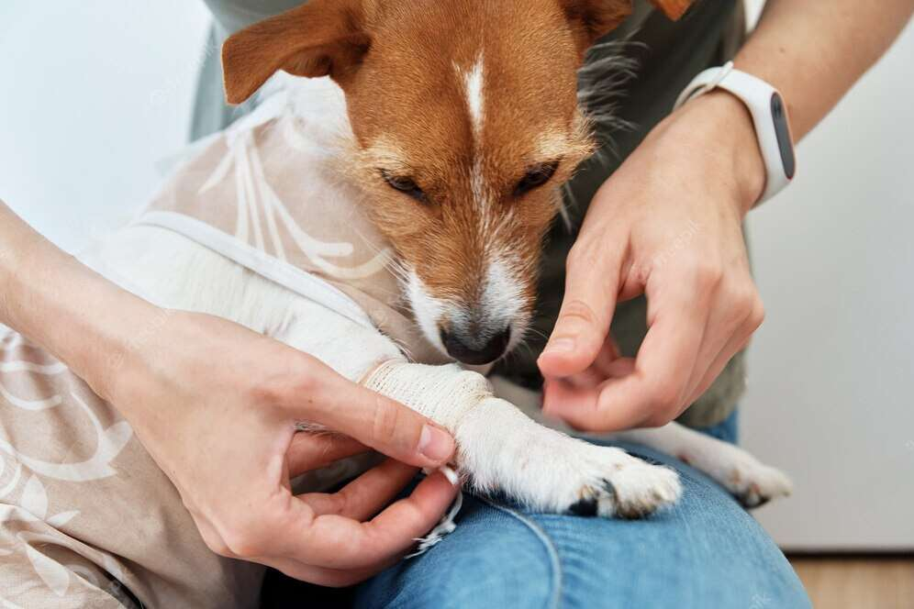
  The growing number of pet parents
  Increasing spending capacity
Drivers
Restraints
Rising pet care costs

Slide 7
AUTHOR'S PERSPECTIVE
  The animal wound care market is growing, due to increasing demand for high-quality wound care products for animals.
  Also, growing awareness of animal welfare, advancements in technology, and the development of new products are also contributing to the growth of the market.

Slide 8
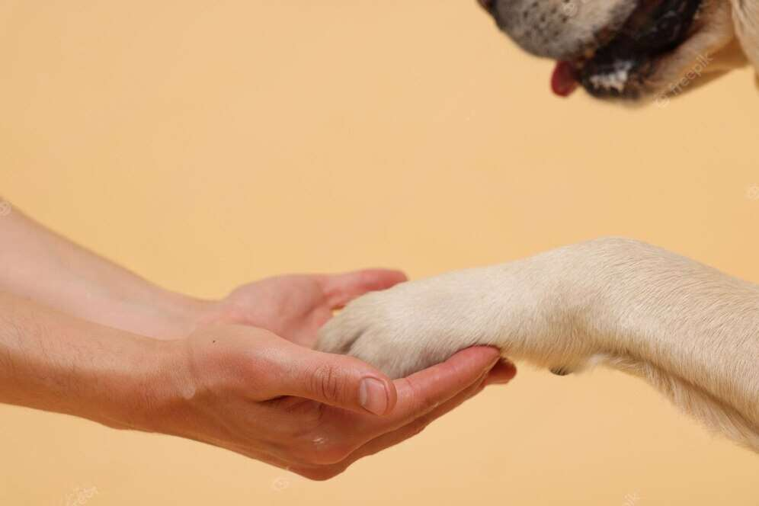

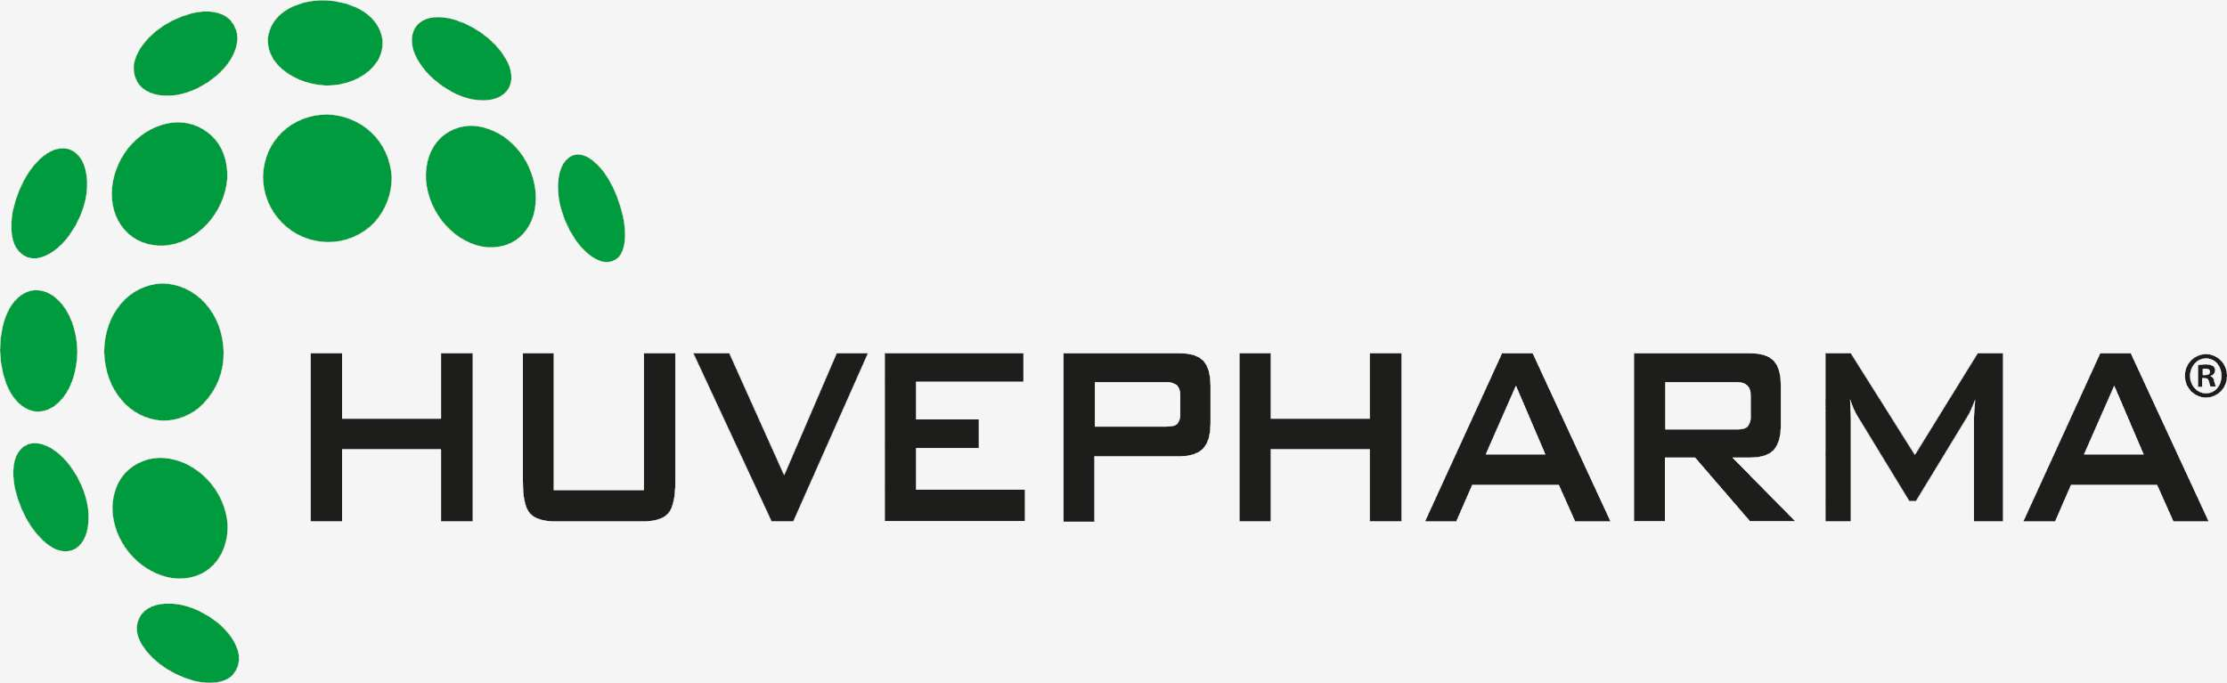


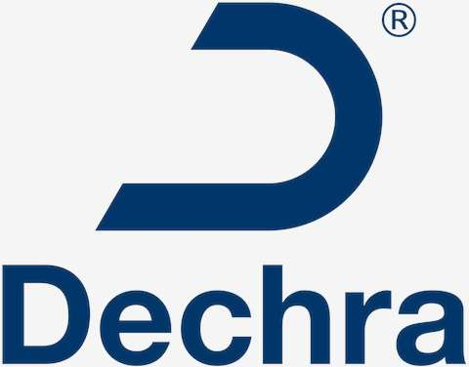



KEY PLAYERS

Slide 9


For Full Report
Contact us
COGNITIVE MARKET RESEARCH
Tel: +1 312-376-8303 | +44 020-8123-0732
India: (+91) 983-496-8611
sales@cognitivemarketresearch.com
Access the Full Report : https://shorturl.at/auLXY
Please visit our website:
https://www.cognitivemarketresearch.com

