Slide 1
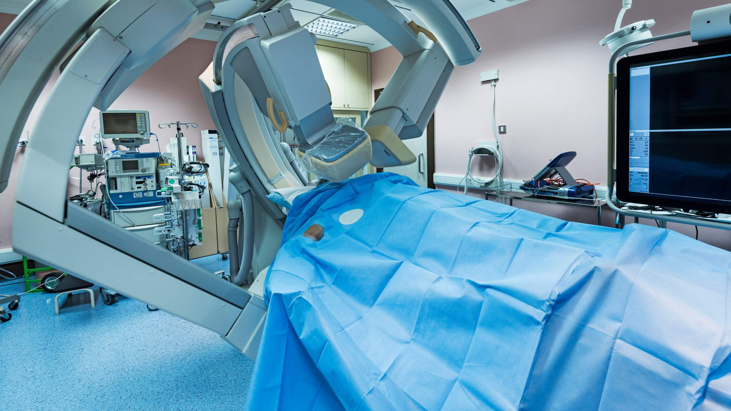
ANGIOGRAPHY EQUIPMENT
MARKET REPORT 2024

Slide 2
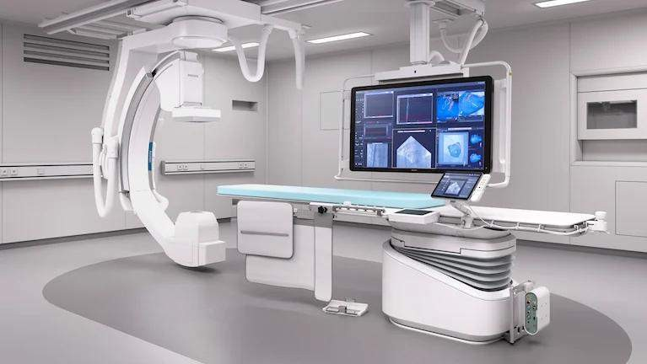
INTRODUCTION
Angiography equipment is mainly a medical condition, clarifying equipment for countering blood vessels and their flow in the arteries, veins, and heart chambers and is used to anticipate internally of an individual. An angiography system composes a patient table, an x-ray tube, and a detector suspended for video images of the body as a contradiction median is driven. Some machines include a committed operating table for together performance of the surgery.

Slide 3
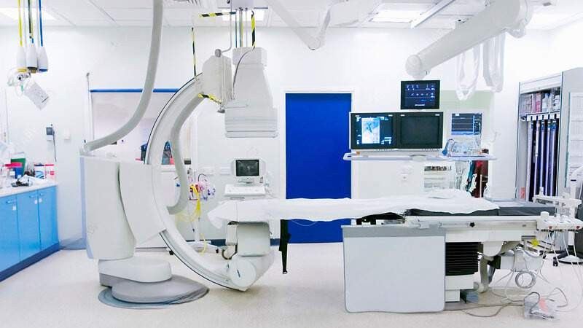





KEY INSIGHTS
MARKET SIZE
12.21 Billion
2022
FORECAST
17.61 Billion
2030
2023-
2030
CAGR 5.3%

Slide 4
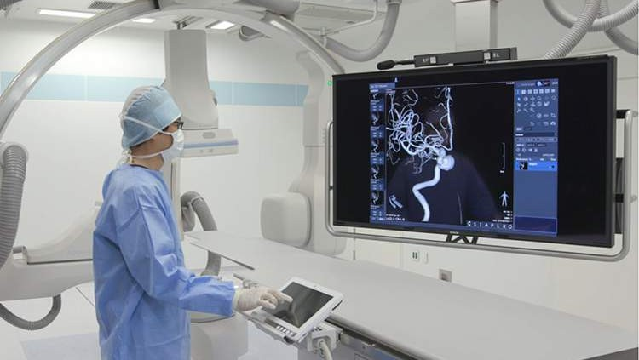


REVENUE MARKET SHARE BY SEGMENTS 2022
By Product: Angiography systems, Balloons, Catheters, Guidewire, Angiography accessories, Contrast media, and Vascular closure devices. (dominated product: Angiography systems)
By Technology: CT, X-ray, and MRA (dominated technology: X-ray)
By Application: Therapeutic, Diagnostic (dominated application: Diagnostic)

Slide 5

Europe
GLOBAL ANGIOGRAPHY EǪUIPMENT MARKET REVENUE SHARE FOR 2022
33.5%

Slide 6
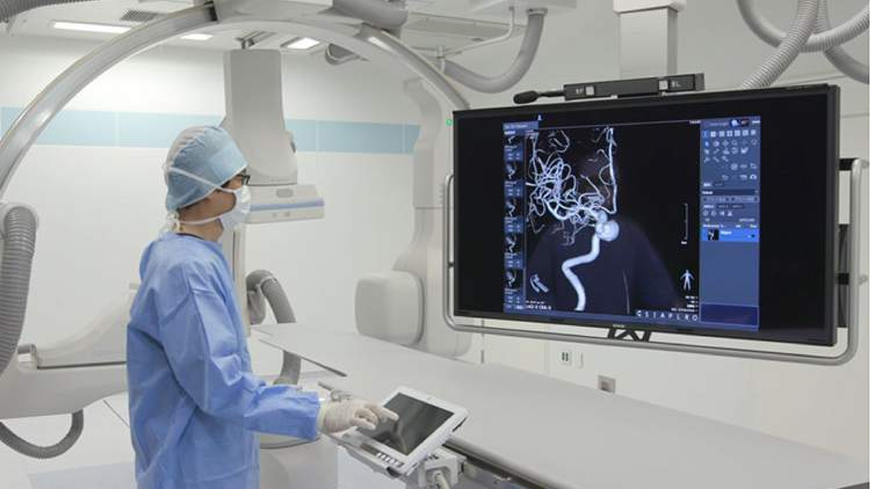
Technological advancements Growing healthcare
infrastructure in the
Drivers
angiography equipment market
Increasing technology-
_{Restraints} related difficulties of
angiography equipment

Slide 7

AUTHOR'S PERSPECTIVE
The market for angiography equipment is expected to boost in upcoming years due to Increasing demand for innovative products like flat-panel detectors and MRI scanners.
In 2023, the Angiography System segment accounted for noticeable share of global Angiography Equipment Market and is projected to experience significant growth in the near future.

Slide 8




KEY PLAYERS

Slide 9


Contact us
For Full Report
COGNITIVE MARKET RESEARCH
Tel: + 1 312 - 376 - 8303 | + 44 020 - 8123 - 0732
India: ( + 91 ) 983 - 496 - 8611
sales@ cognitivemarketresearch. com
Access the Full Report : http://tinyurl.com/2swph5c9
Please visit our website:
https://www.cognitivemarketresearch.com

