Slide 1

ANDROGENS & ANABOLIC STEROIDS MARKET REPORT

Slide 2



INTRODUCTION
Androgens and anabolic steroids are the synthetic derivatives of testosterone hormone. Testosterone is a male sex hormone that plays a crucial role in the growth and reproduction process in an individual. Anabolic steroids are used in the treatment of hormonal problems, such as delayed puberty in males or loss of muscle caused by diseases like cancer or HIV.

Slide 3
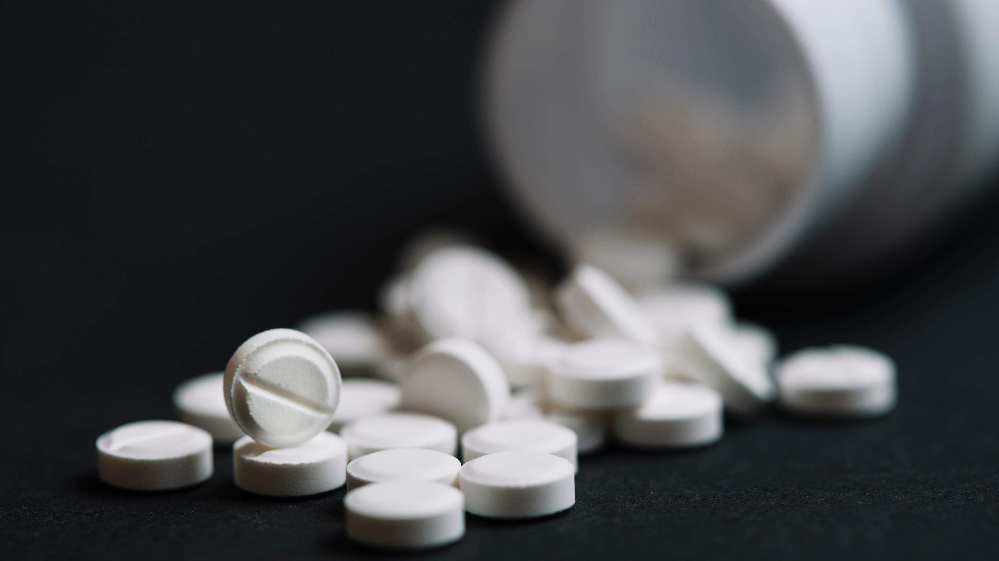
MARKET SIZE s52.63 Bn
2022
KEY INSIGHTS
FORECAST s124.18 Bn
2030
CAGR 10.3%
2023-
2030

Slide 4

REVENUE MARKET SHARE BY SEGMENTS 2022
Modes of Administration
Ingredients
Oral : 41.0%
Protein: 29.8%
Application
Distribution Channel
Anabolic: 42.3%
Offline: 68.9%

Slide 5
Global Androgens & Anabolic Steroids Market Revenue share for 2022
North America: 36.1%

Slide 6
Drivers
Steep growth in the prevalence of hypogonadism is the primary factor responsible for the growth of androgens and anabolic steroids market
Androgens and anabolic steroids, if not used properly may cause adverse effects on an individual, hindering its growth across the globe
Restraints

Slide 7
Author's
Perspective
Oral segment has highest share owing to its convenience, and cost effectiveness. Moreover, it is widely preferred by patient due to its non-invasiveness nature and is highly patient-compliance
Anabolic application accounts for highest share in the market which is attributed to its high use in the treatment of hormonal problems, delayed puberty, and muscle loss. It is also used as a mainstay of therapy for hypoplastic anaemias due to leukemia, kidney failure or aplastic anaemia.

Slide 8
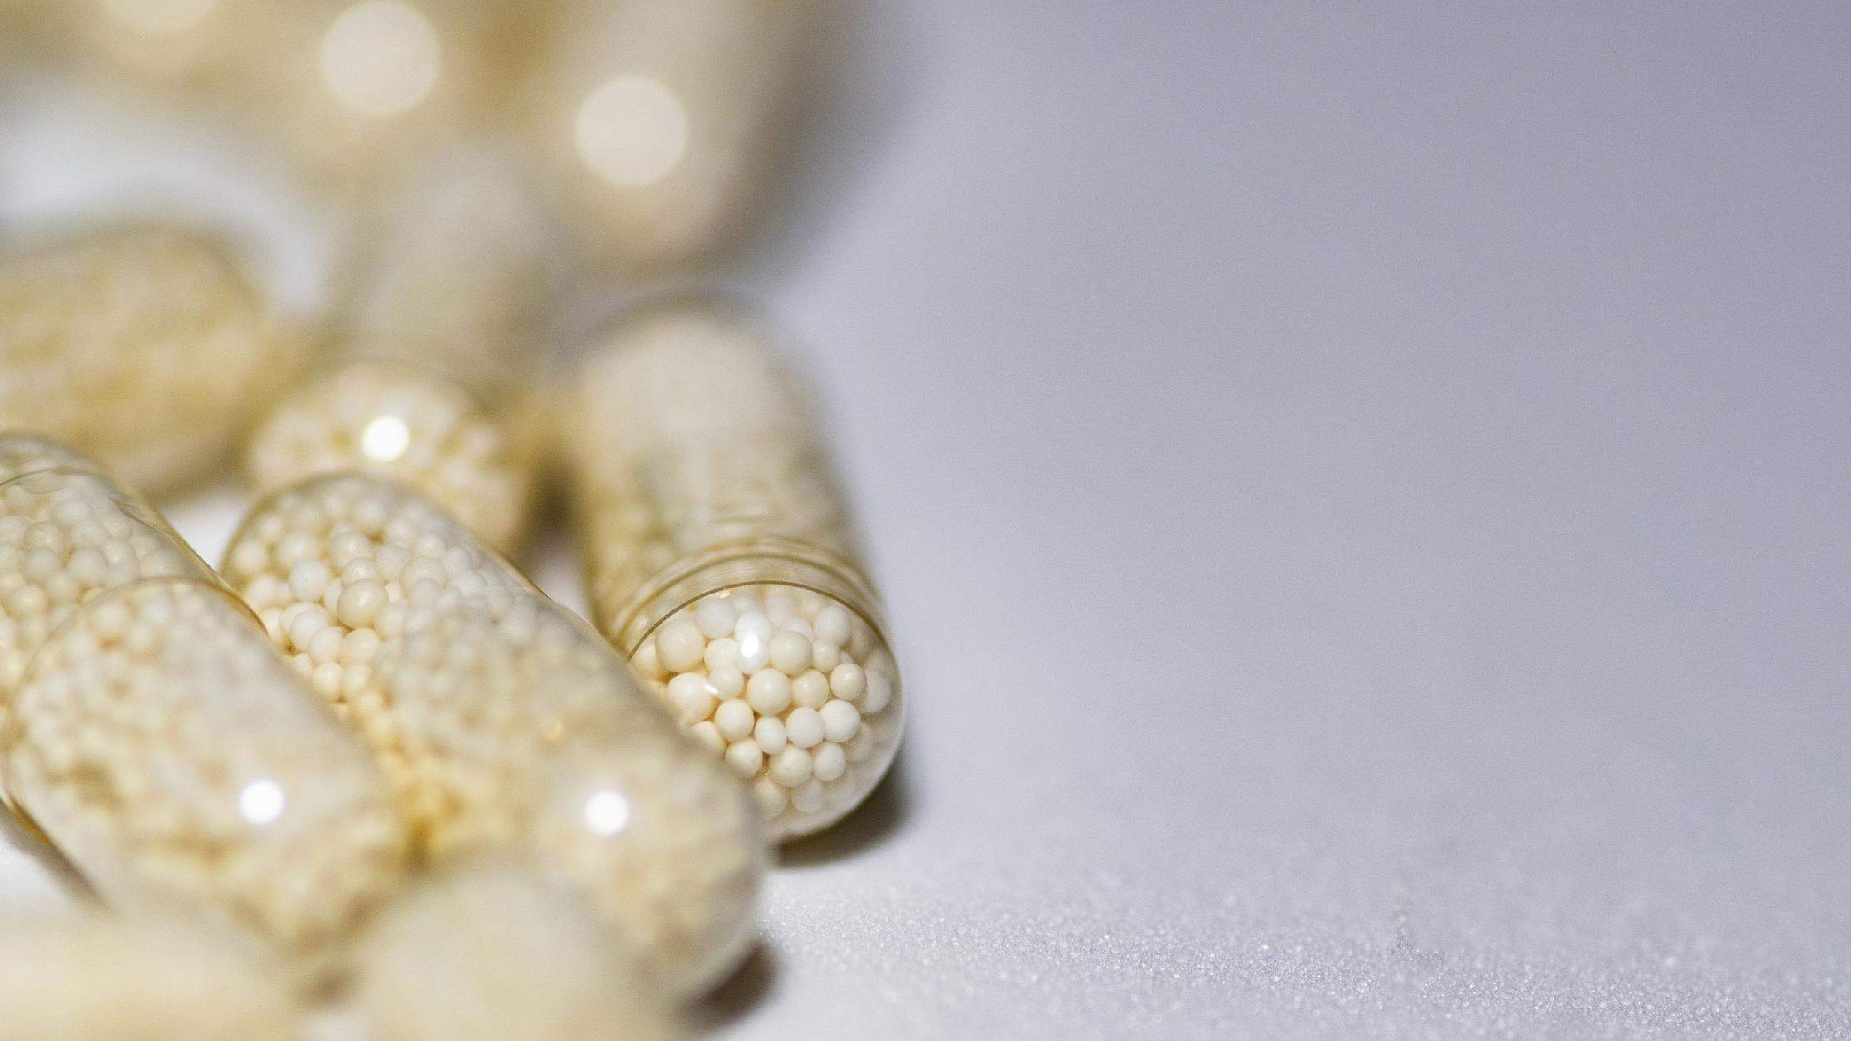
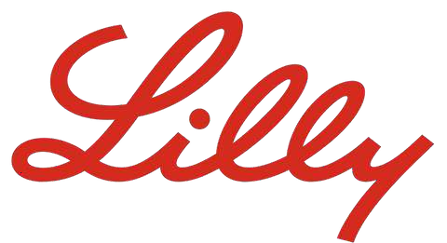

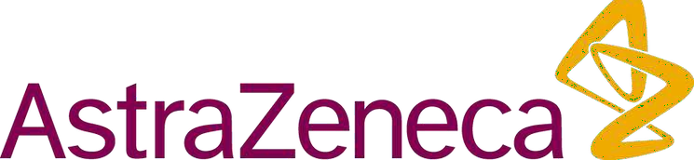
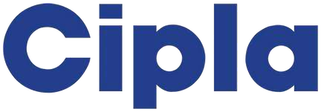
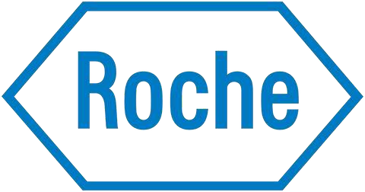


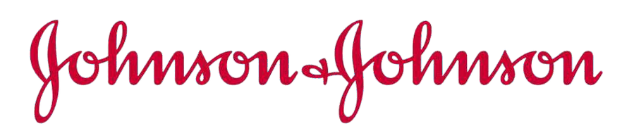
Key Players

Slide 9

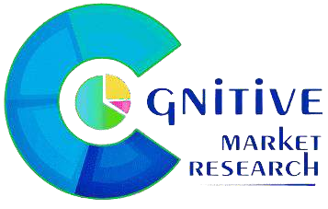
Contact us
For Full Report
COGNITIVE MARKET RESEARCH
Tel: + 1 312 - 376 - 8303 | + 44 020 - 8123 - 0732
India: ( + 91 ) 983 - 496 - 8611
sales@ cognitivemarketresearch. com
Access the Full Report : https://rb.gy/oqwhk
Please visit our website:
https://www.cognitivemarketresearch.com

