Slide 1

GLOBAL
AMPHIBIOUS ATV
MARKET REPORT 2024
Global,Regional,CountryAnalysis

Slide 2

INTRODUCTION
ATV stands for all-terrain vehicle, which is a motorized off-highway vehicle with low-pressure or non-pneumatic tires, a seat that is meant to be straddled by the driver, and handlebars for steering. An amphibious ATV is a four to eight-wheeler built for a single rider that can travel on land and water.

Slide 3


KEY INSIGHTS
MARKET SIZE
USD 87.63 Million
2017
FORECAST
USD 186.92 Million
2029
CAGR
9.20%
2023- 2030

Slide 4
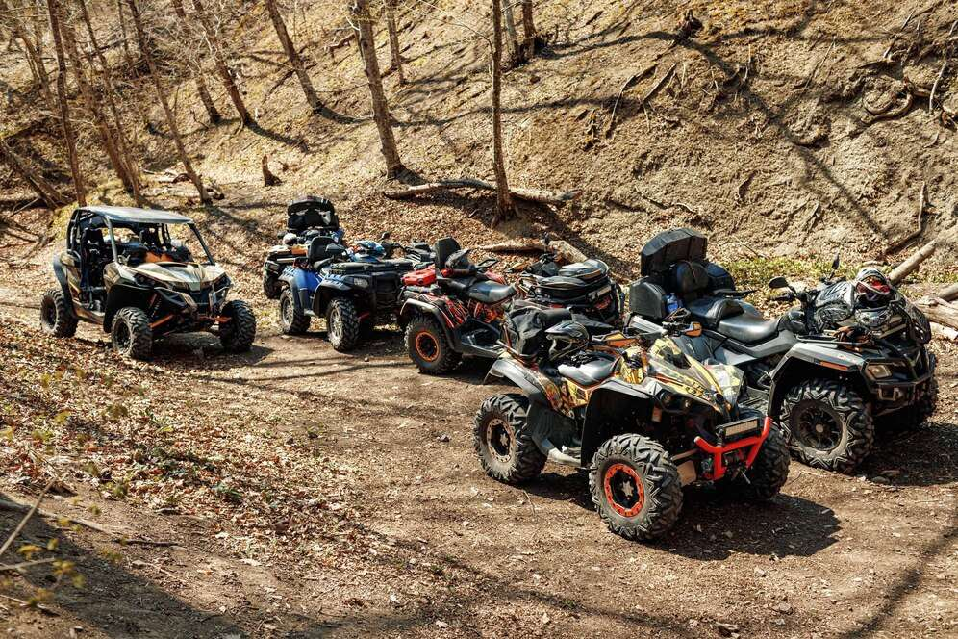
REVENUE MARKET SHARE BY SEGMENTS 2022
6x6
USD 75.73 Million
By type
Surveillance & Rescue
USD 36.73 Million
By application
Defense
USD 110.04 Million
End Use Segment

Slide 5

Global Amphibious ATV Market Revenue share for 2022
North America
USD 70.26 Million

Slide 6
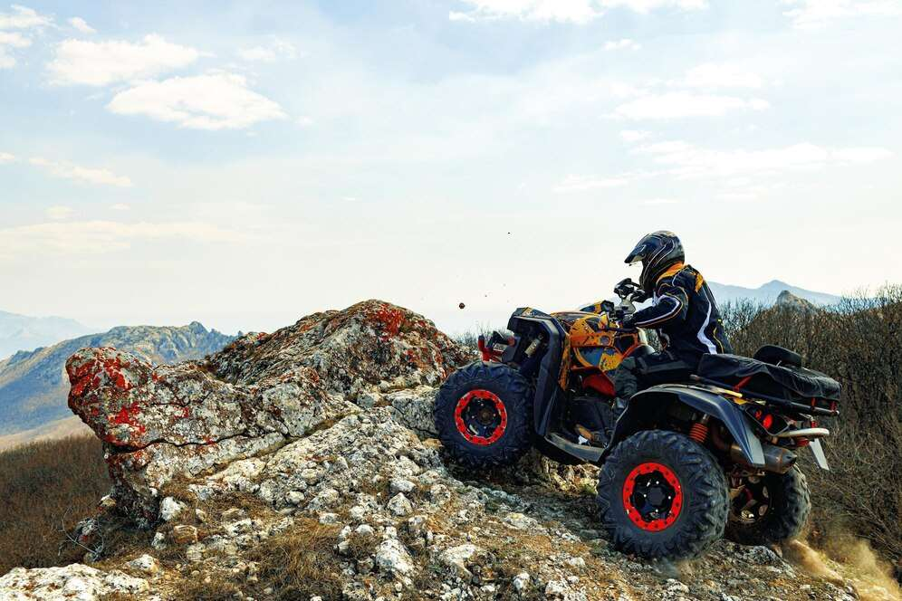
Growing inclination toward sports and recreational activities
Drivers
Restraints
High Initial Cost

Slide 7

AUTHOR'S PERSPECTIVE
  The Global Amphibious ATV Market revenue in 2017: USD 87.63 Million
  6x6 held for largest share of total revenue generated in 2020
  Water Transportation held maximum share of Amphibious ATV market in 2020
  Defense held maximum share of Amphibious ATV market in 2020
  Rising usage of amphibious ATVs in rescue operations and growing inclination toward sports and recreational activities stimulates the growth of the amphibious ATVs market
  The high initial cost can hamper the growth of the amphibious ATVs market
  The growing tourism sector is expected to provide enormous growth opportunities for the growth of the amphibious ATVs market

Slide 8







KEY PLAYERS

Slide 9


For Full Report
Contact us
COGNITIVE MARKET RESEARCH
Tel: +1 312-376-8303 | +44 020-8123-0732
India: (+91) 983-496-8611
sales@cognitivemarketresearch.com
Access the Full Report : https://tinyurl.com/yyzxnnvr
Please visit our website:
https://www.cognitivemarketresearch.com

