Slide 1



ALTERNATIVE PROTEIN MARKET REPORT

Slide 2
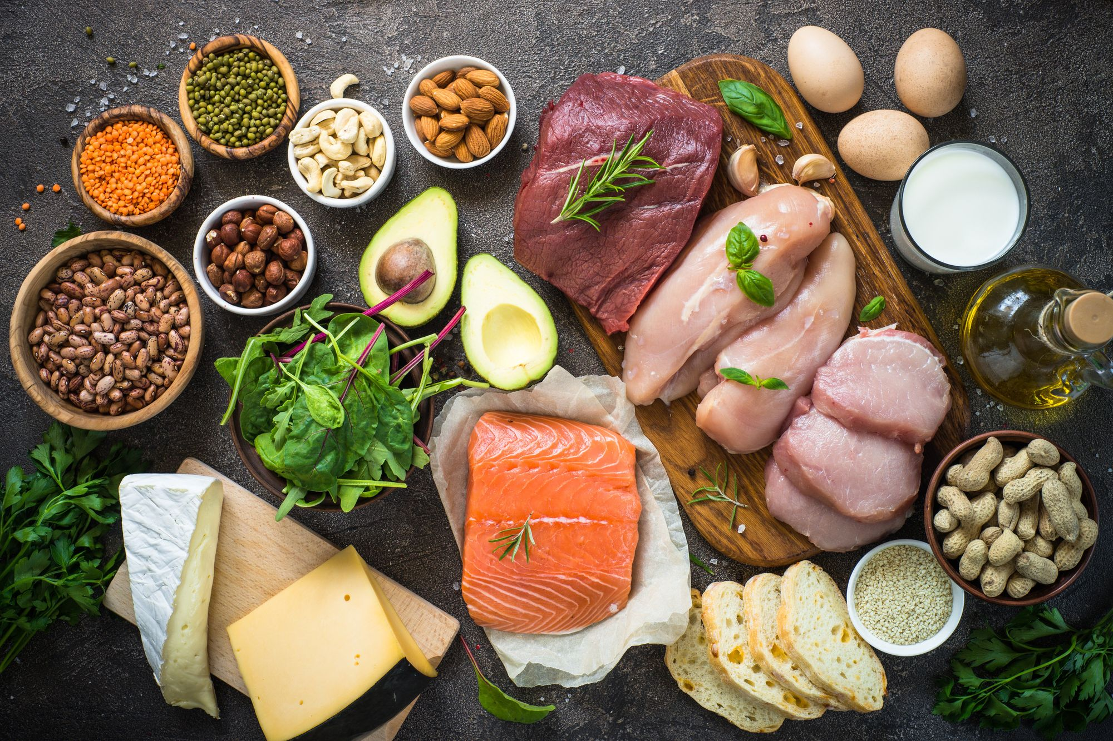

INTRODUCTION
Alternative proteins are the broader concept which are produced from plants or animal cells, or even by using fermentation process. The final products are similar in taste to that of conventional animal products in relatively cheaper prices. Alternative proteins consume less inputs, such as land and water, and generates less amount of harmful gas emission. Thus, alternative proteins help us to lead a better way to feed the world.

Slide 3
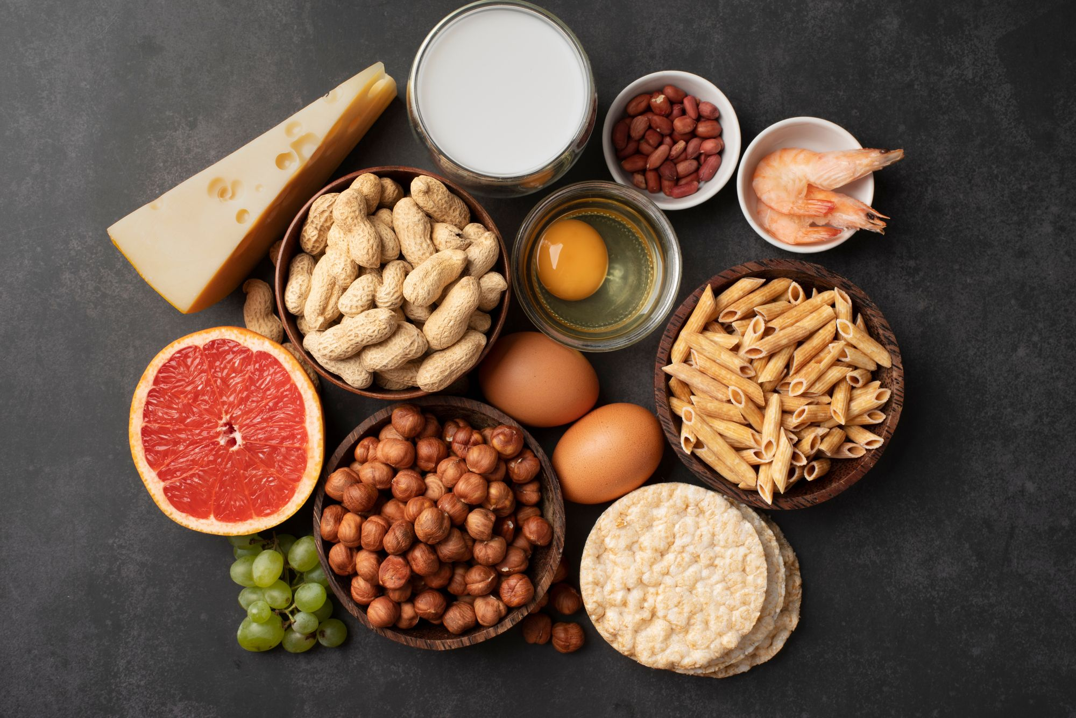
KEY INSIGHTS
MARKET SIZE
$51.28 Bn
2022
Forecast
$130.47 Bn
2030
2022-
2030
CAGR
19.6%

Slide 4
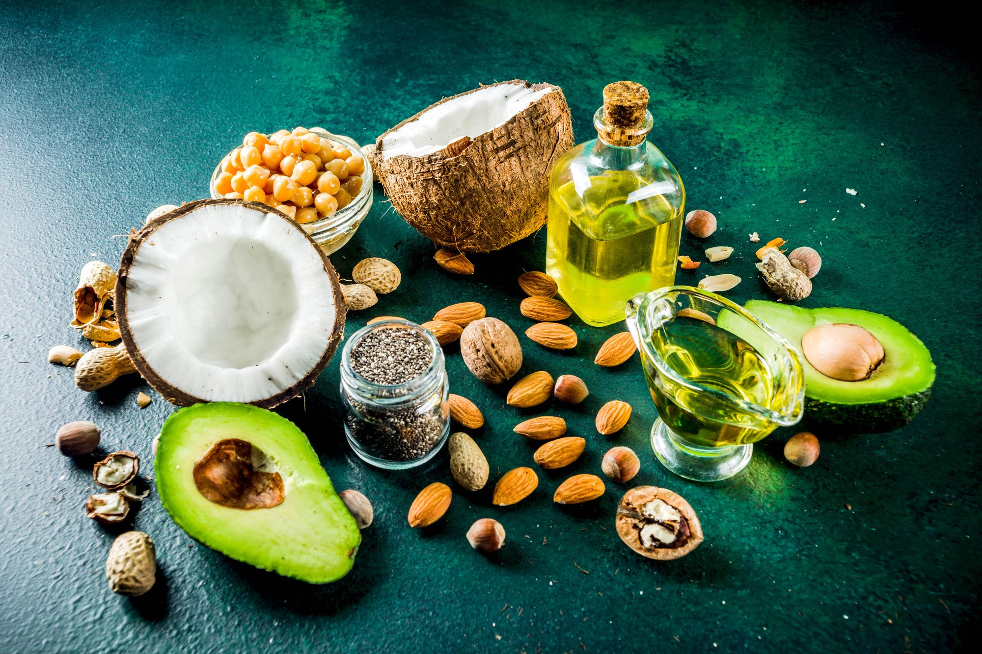



REVENUE MARKET SHARE BY SEGMENTS 2022
Source Type
Application
Plant-based :
51.0%
Meat Analog : 29.4%

Slide 5

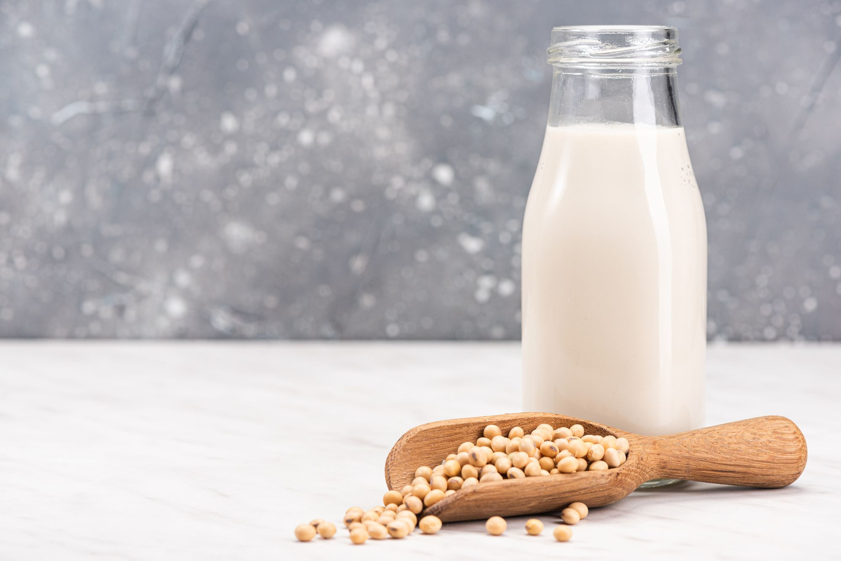
GLOBAL ALTERNATIVE PROTEIN MARKET REVENUE SHARE FOR 2022
North America:
36.2%
The North America alternative protein market dominates the overall market mostly because of the presence of major players in the U.S. Further, people in North America are more inclined towards healthy eating habits, along with consumption of sustainable products.

Slide 6

Drivers
Restraints
  Currently various alternative protein products are fewer ideal substitutes and contains high amount of salt.
  Further, edible insects used as an alternative protein contains chitin in it.
Rise in the admiration of health and nutrition-based products; Surging investment in plant-based food

Slide 7
AUTHOR'S PERSPECTIVE
  Plant-based proteins segment dominated the market of alternative proteins mainly because of the increasing adoption of consuming more sustainable and healthy food.
  Most of the consumers are moving towards dairy alternatives for wide array of reasons, including better health or to reduce their impact on the planet.
  Various protein sources, such as tofu, legumes, seitan, lentils, and soybeans are used to make plant-based meats. Moreover, it tends to be lower in saturated fat and calories, with high fibrous value.

Slide 8
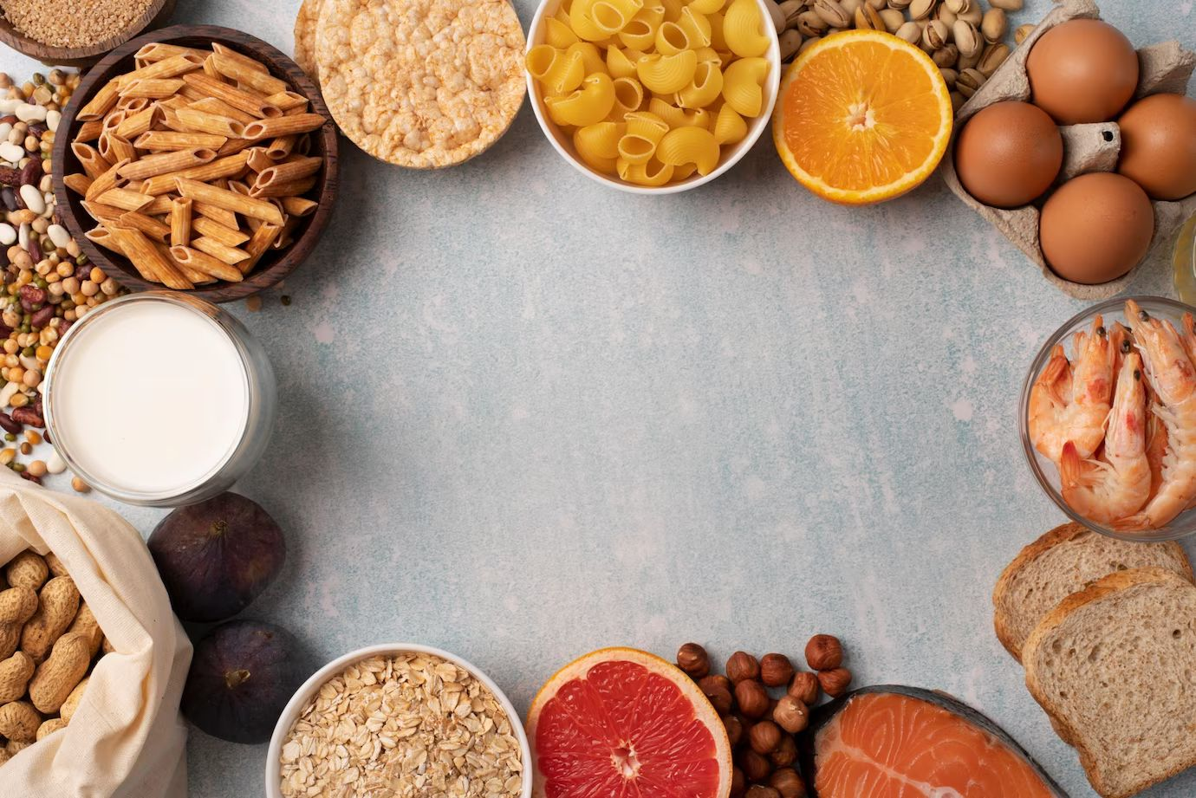








KEY PLAYERS

Slide 9


For Full Report
Contact us
COGNITIVE MARKET RESEARCH
Tel: +1 312-376-8303 | +44 020-8123-0732
India: (+91) 983-496-8611
sales@cognitivemarketresearch.com
Access the Full Report : http://tinyurl.com/5bsuhx2d
Please visit our website:
https://www.cognitivemarketresearch.com

