Slide 1

GLOBAL
ALOE VERA POWDER
MARKET REPORT
2024
Global,Regional,CountryAnalysis

Slide 2
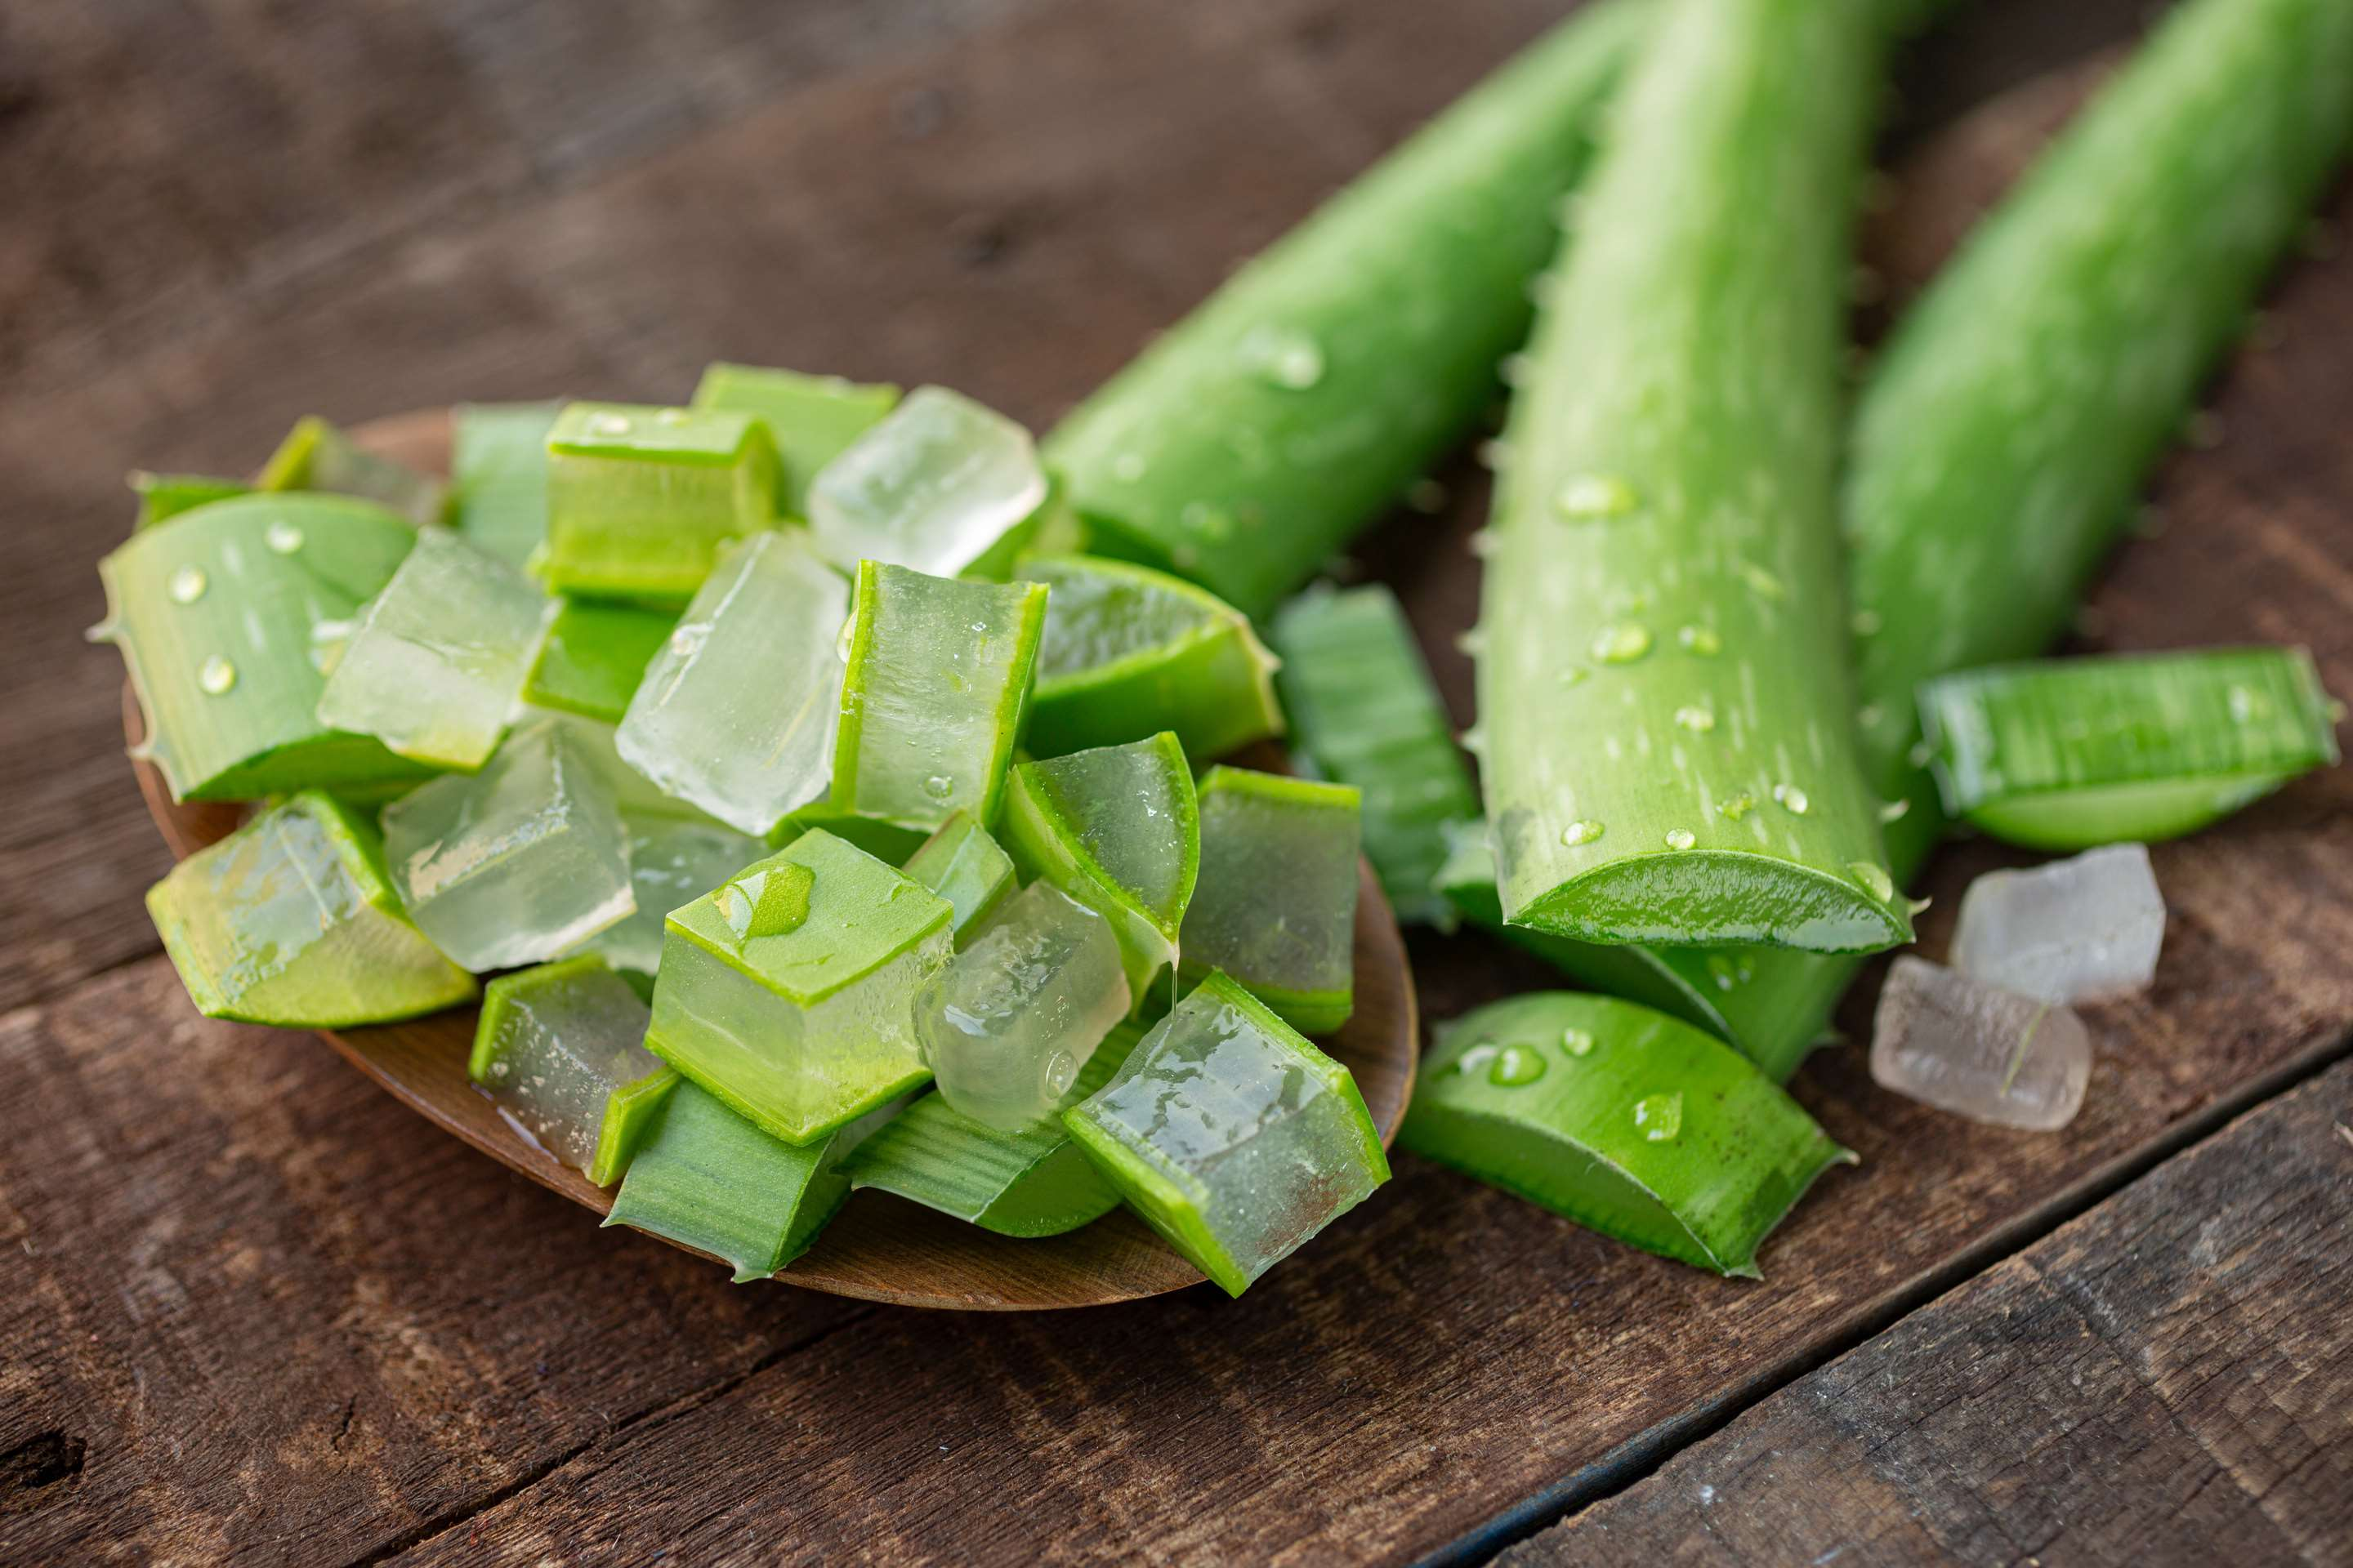
INTRODUCTION
The manufacturing, transport, and consumption of powdered form obtained from the Aloe Vera plant are all included in the Aloe Vera Powder market. The plant's therapeutic qualities are preserved during the dehydration and milling processes that produce aloe vera powder. It is used in several industries, such as food and beverage, pharmaceutical, and cosmetics. Aloe vera powder is a popular ingredient in cosmetic products, dietary supplements, and functional meals because of its healing, soothing, and moisturizing qualities. Growing consumer interest in natural and plant-based products and increased knowledge of aloe vera's health advantages are driving the market. Manufacturers are constantly coming up with novel formulations and applications to meet the varied needs of consumers and expand the market.

Slide 3


KEY INSIGHTS
MARKET SIZE
USD 2151.2 million
2024
CAGR
7.30%
2024- 2030

Slide 4
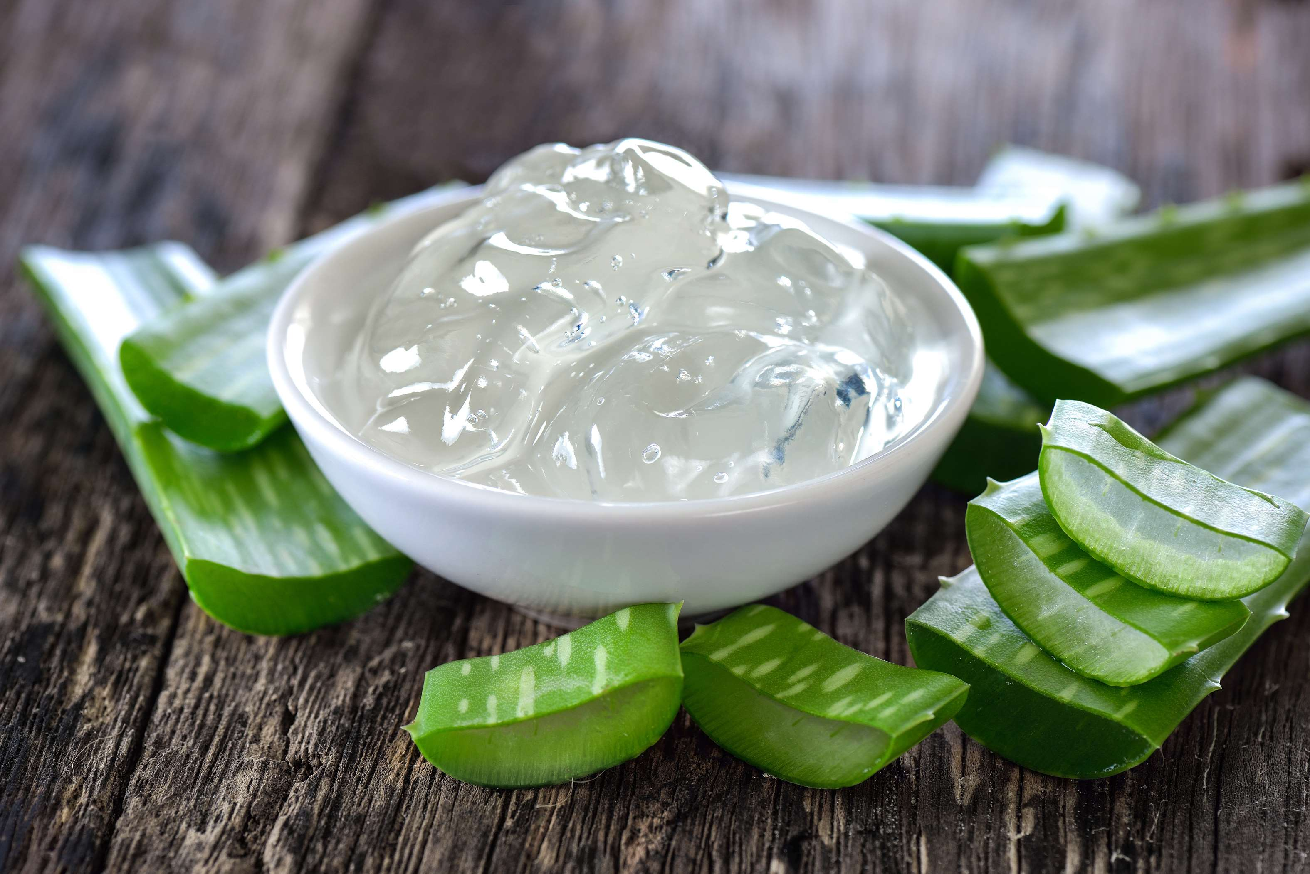
REVENUE MARKET SHARE BY SEGMENTS 2022
  Conventional
  Diet
Type Segment
  Food & Beverage
  Pharmaceutical
  Cosmetic
Application Segment

Slide 5

Global Aloe Vera Powder Market Revenue share for 2024
North America
40%

Slide 6

  Rising Demand for Natural Ingredients to Increase the Demand Globally
  Convenience and Versatility to Propel Market Growth
Drivers
  Limited Scientific Evidence for Some Health Claims to Limit the Sales
Restraints

Slide 7
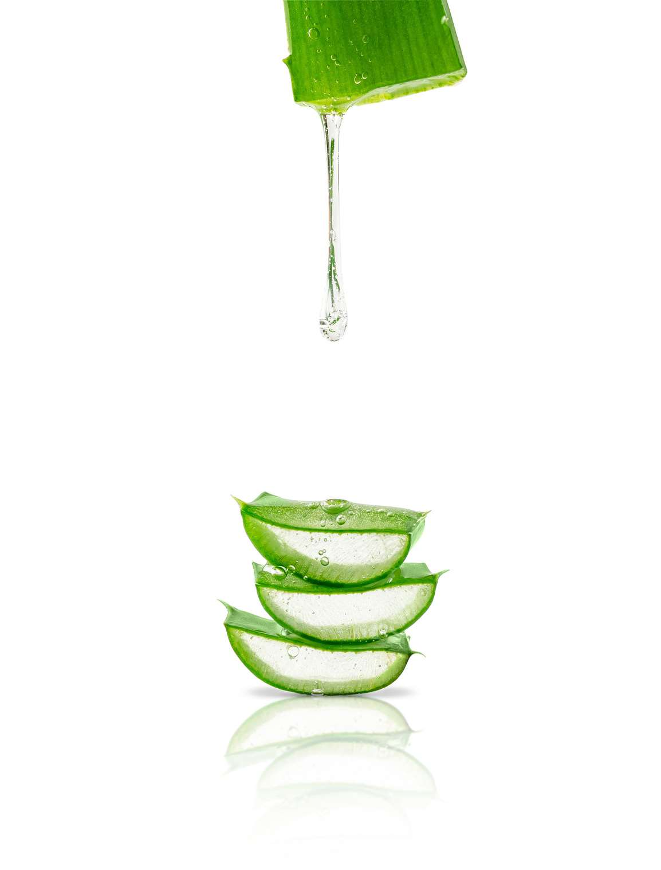
AUTHOR'S PERSPECTIVE
  The global Aloe Vera Powder market will expand significantly by 7.30 % CAGR between 2024 to 2031.
  The market for functional foods and beverages is expanding as customers look for goods with additional health benefits. These goods use aloe vera powder because of its supposed health benefits.
  Better drying techniques enable the creation of premium aloe vera powder while preserving its advantageous qualities. Manufacturers find the product more appealing as a result

Slide 8


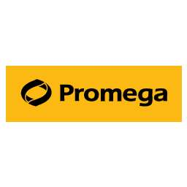





KEY PLAYERS

Slide 9


For Full Report
Contact us
COGNITIVE MARKET RESEARCH
Tel: +1 312-376-8303 | +44 020-8123-0732
India: (+91) 983-496-8611
sales@cognitivemarketresearch.com
Access the Full Report : https://shorturl.at/iHQRS
Please visit our website:
https://www.cognitivemarketresearch.com

