Slide 1

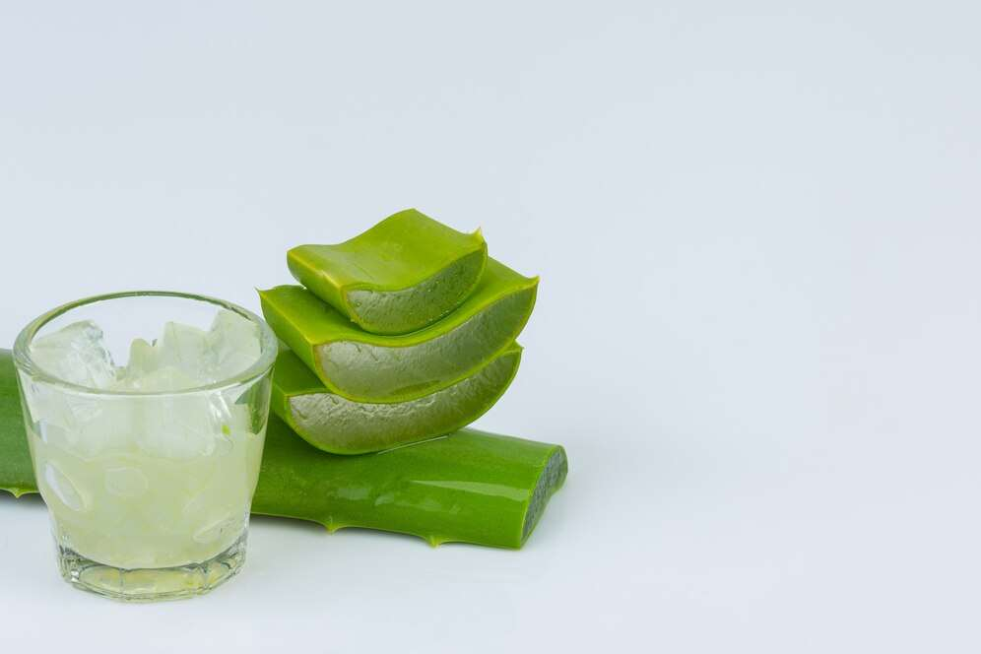
ALOE VERA JUICE
MARKET REPORT
2024
Qualitative Analysis + Quantitative Analysis

Slide 2
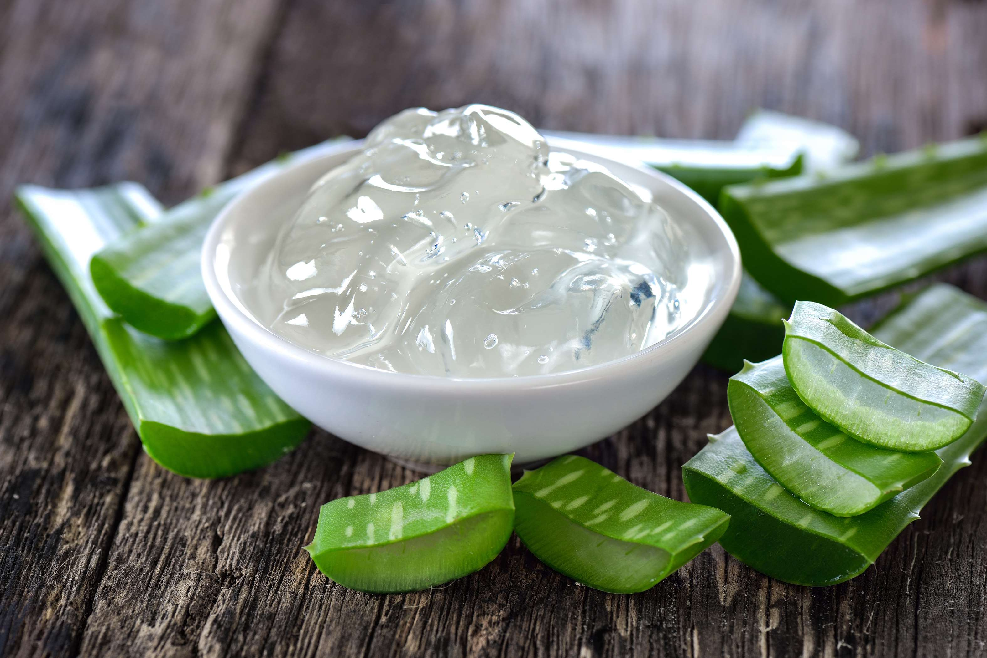
INTRODUCTION
The aloe vera juice market has witnessed significant growth in recent years, driven by increasing consumer awareness of its purported health benefits. Aloe vera, known for its medicinal properties, is widely consumed for its digestive, immune-boosting, and skincare benefits. This surge in demand has led to the introduction of various aloe vera juice products, ranging from pure extracts to flavored blends, catering to diverse consumer preferences. With the growing emphasis on natural remedies and functional beverages, the aloe vera juice market is poised for further expansion. This presents opportunities for manufacturers to innovate and capitalize on the rising consumer interest in healthier beverage options.

Slide 3


KEY INSIGHTS
MARKET SIZE
USD 14581.2 million
2024
CAGR
7.00%
2024- 2031

Slide 4
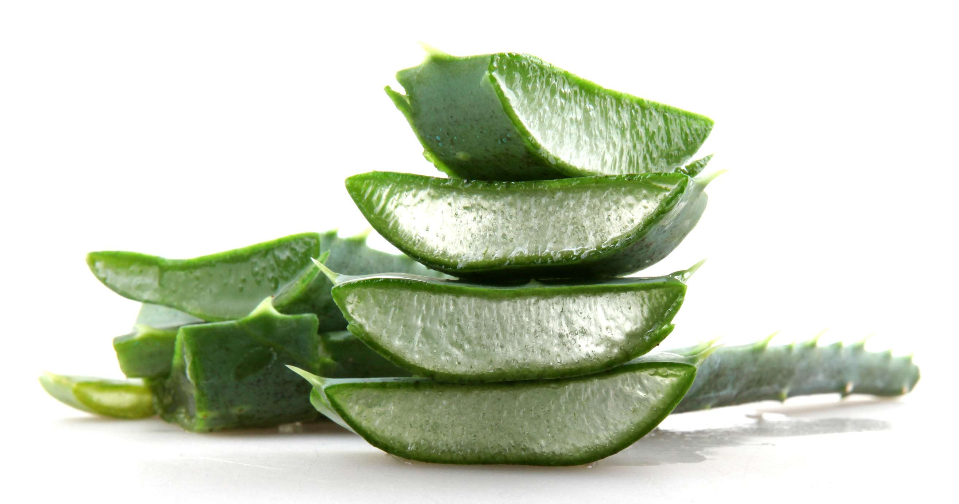
REVENUE MARKET SHARE BY SEGMENTS 2024
  Food & Beverage Products
  Cosmetics
  Medicine
Application Segment
  Hypermarkets
  Departmental Stores
  Online Retail
  Medical Stores
Distribution Channel

Slide 5


North America
40%
North America Aloe Vera Juice Market Revenue share for 2024 is 40%

Slide 6

  Rising Demand for Functional Beverages to Increase the Demand Globally
  Increased Availability and Distribution Channels to Propel Market Growth
Drivers
Bitter Taste and Texture to Limit the Sales
Restraints

Slide 7

AUTHOR'S PERSPECTIVE
  The global Aloe Vera Juice Market will expand significantly by 7.00% CAGR between 2024 to 2031.
  The flavored type stands out as the dominating category. Offering a diverse range of flavors, such as mango, pineapple, and berry, flavored aloe vera juices attract consumers seeking enhanced taste experiences while reaping the health benefits associated with aloe vera.
  The dominating category is ready-to-drink juice. Offering convenience and immediate consumption, ready-to-drink aloe vera juice products cater to modern consumers' fast-paced lifestyles.

Slide 8

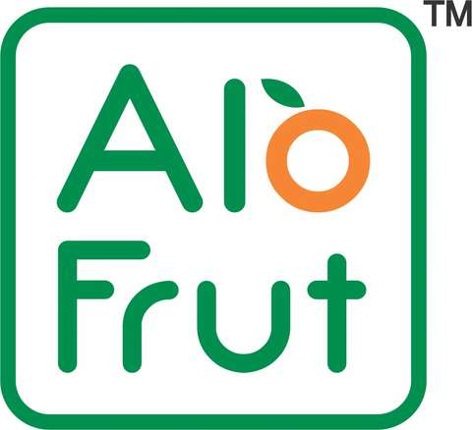








KEY PLAYERS

Slide 9


For Full Report
Contact us
COGNITIVE MARKET RESEARCH
Tel: +1 312-376-8303 | +44 020-8123-0732
India: (+91) 983-496-8611
sales@cognitivemarketresearch.com
Access the Full Report : https://tinyurl.com/3by7zrr7
Please visit our website:
https://www.cognitivemarketresearch.com

