Slide 1

GLOBAL
ALMOND PROTEIN
MARKET REPORT
2024
Global,Regional,CountryAnalysis

Slide 2

INTRODUCTION
Almond protein is a type of protein that comes from almonds which're the seeds found in the Prunus dulcis tree. It is made by grinding flour and isolating the proteins. People who want to increase their protein intake often choose almond protein as a plant based option. It’s known for its value. Contains essential amino acids that help with muscle growth and overall health. One of its benefits is that it's hypoallergenic making it suitable, for those with allergies to dairy or soy. Almond protein can be used in food products, like plant based protein powders, bars and baked goods because of its versatility.

Slide 3


KEY INSIGHTS
MARKET SIZE
USD 4514.2 million
2024
CAGR
6.80%
2024- 2031

Slide 4
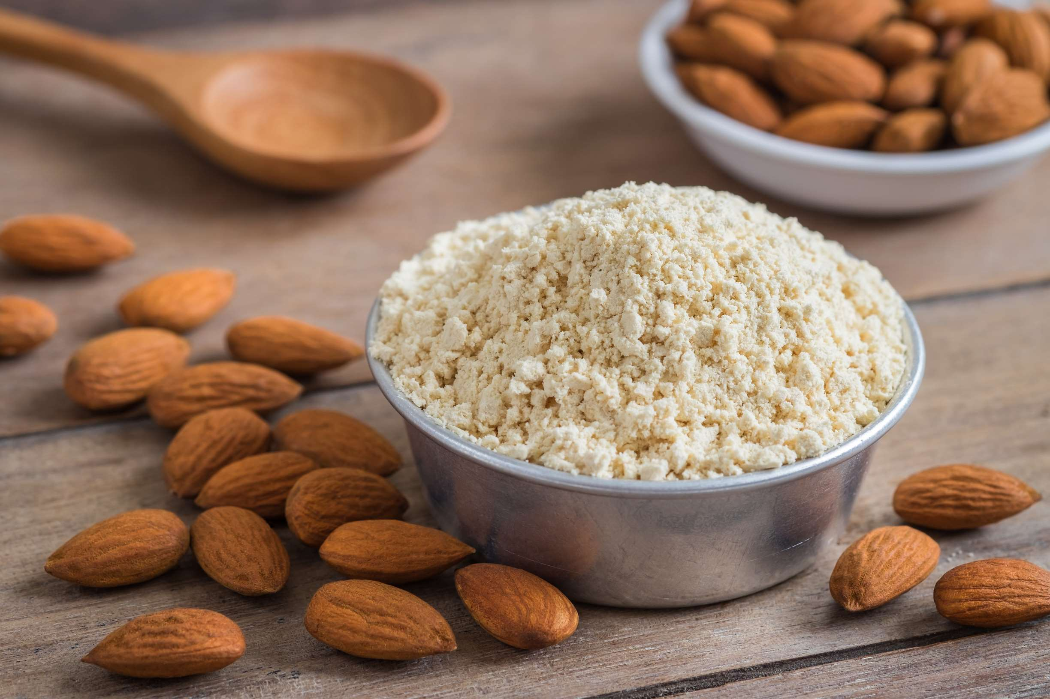
REVENUE MARKET SHARE BY SEGMENTS 2022
  Beverages
  Confectionery & Bakery
  Personal Care
  Sports Nutrition
  Dietary Supplements
  Cold Pressed
  Extraction
Type Segment
Processing Method
  Online
  Hypermarket & Supermarket
  Convenience Store
  Specialty Stores
  Food Grade
  Pharmaceutical Grade
  Cosmetic Grade
Application Segment
Grade Segment

Slide 5

Global Almond Protein Market Revenue share for 2024
North America
40%

Slide 6

Fitness and Sports Nutrition Trends to Propel Market Growth
Drivers
Competition from Alternative Plant Proteins to create Hurdles in Market Growth
Restraints

Slide 7

AUTHOR'S PERSPECTIVE
  The global almond protein market will expand significantly by 6.80% CAGR between 2023 and 2030.
  The online category witnessed an unprecedented uptick as consumers increasingly sought the simplicity of browsing, selecting, and ordering almond protein products from the comfort of their homes, driving unparalleled growth in this dynamic market segment.
  Increasing awareness of health and wellness is driving consumer preference towards plant-based proteins like almond protein, contributing to a surge in sales.
  Demand for dietary supplements remains higher in the almond protein market.

Slide 8








KEY PLAYERS

Slide 9


For Full Report
Contact us
COGNITIVE MARKET RESEARCH
Tel: +1 312-376-8303 | +44 020-8123-0732
India: (+91) 983-496-8611
sales@cognitivemarketresearch.com
Access the Full Report : http://tinyurl.com/yetua5z6
Please visit our website:
https://www.cognitivemarketresearch.com

