Slide 1
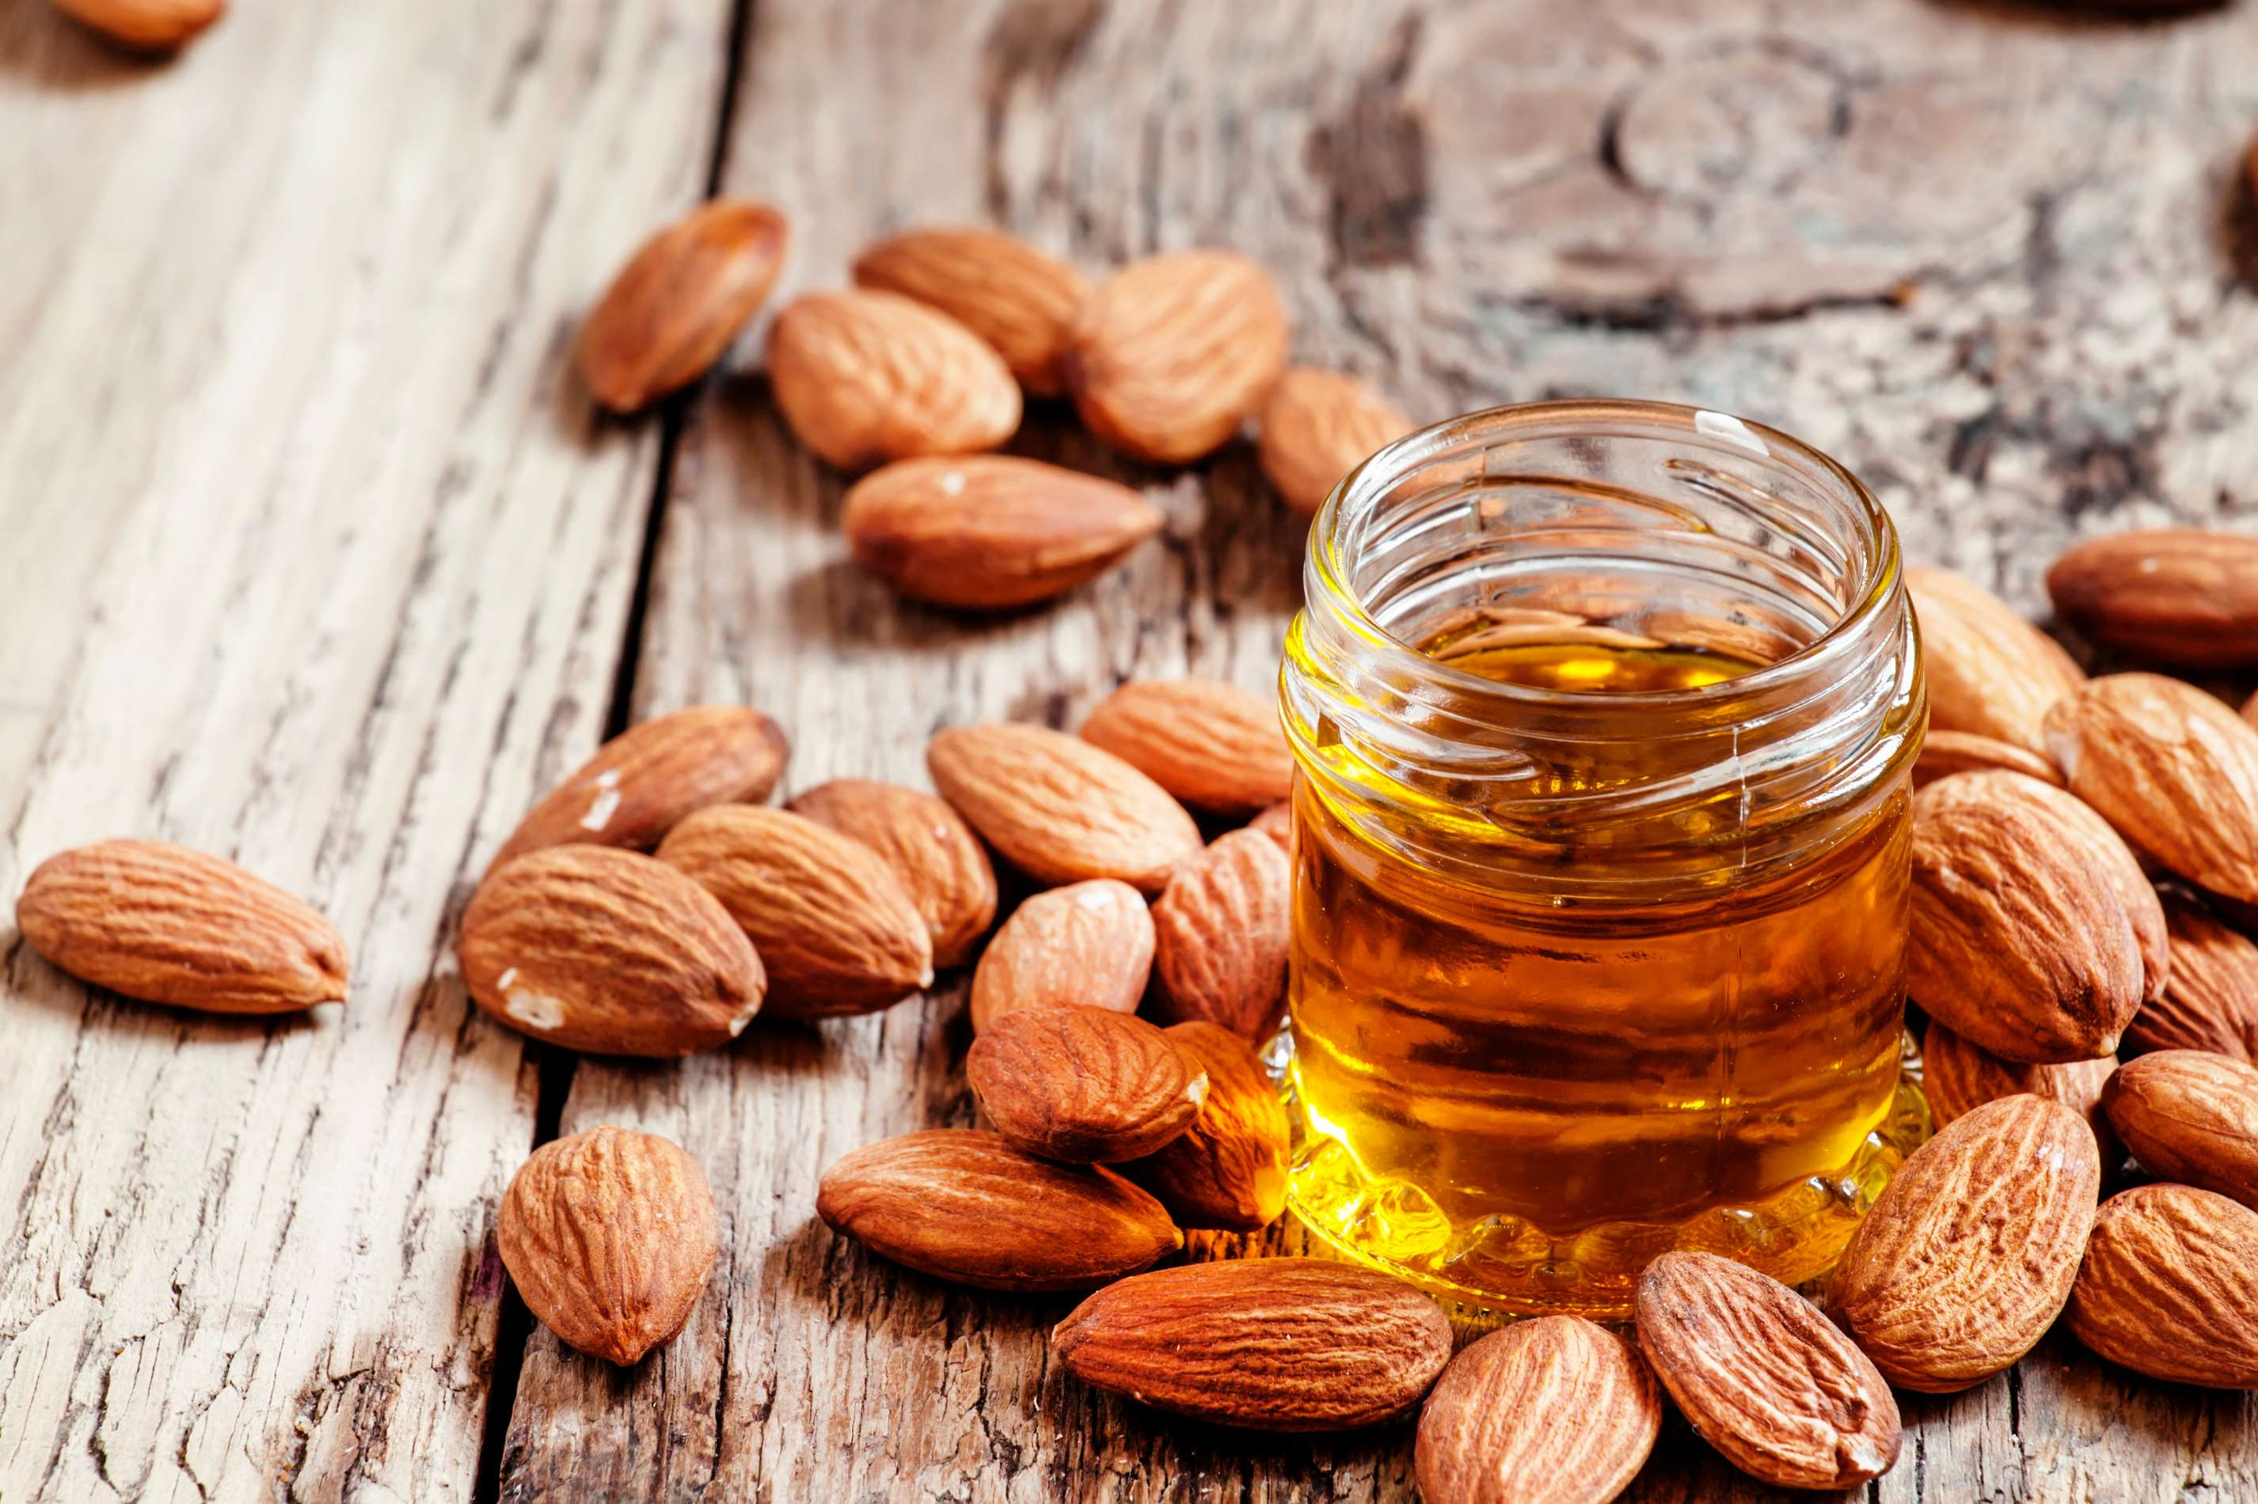
GLOBAL
ALMOND OIL
MARKET REPORT 2024
Global,Regional,CountryAnalysis

Slide 2

INTRODUCTION
Almond oil is a yellowish oil extracted from sweet or bitter almonds and is an excellent source of unsaturated fatty acids and phytosterols. Almond oil contains more vitamin E as compared to other nut oils and features excellent moisturizing properties. This helps boost immunity, maintain healthy cholesterol levels, and lower the risk of cancer and heart disease.

Slide 3
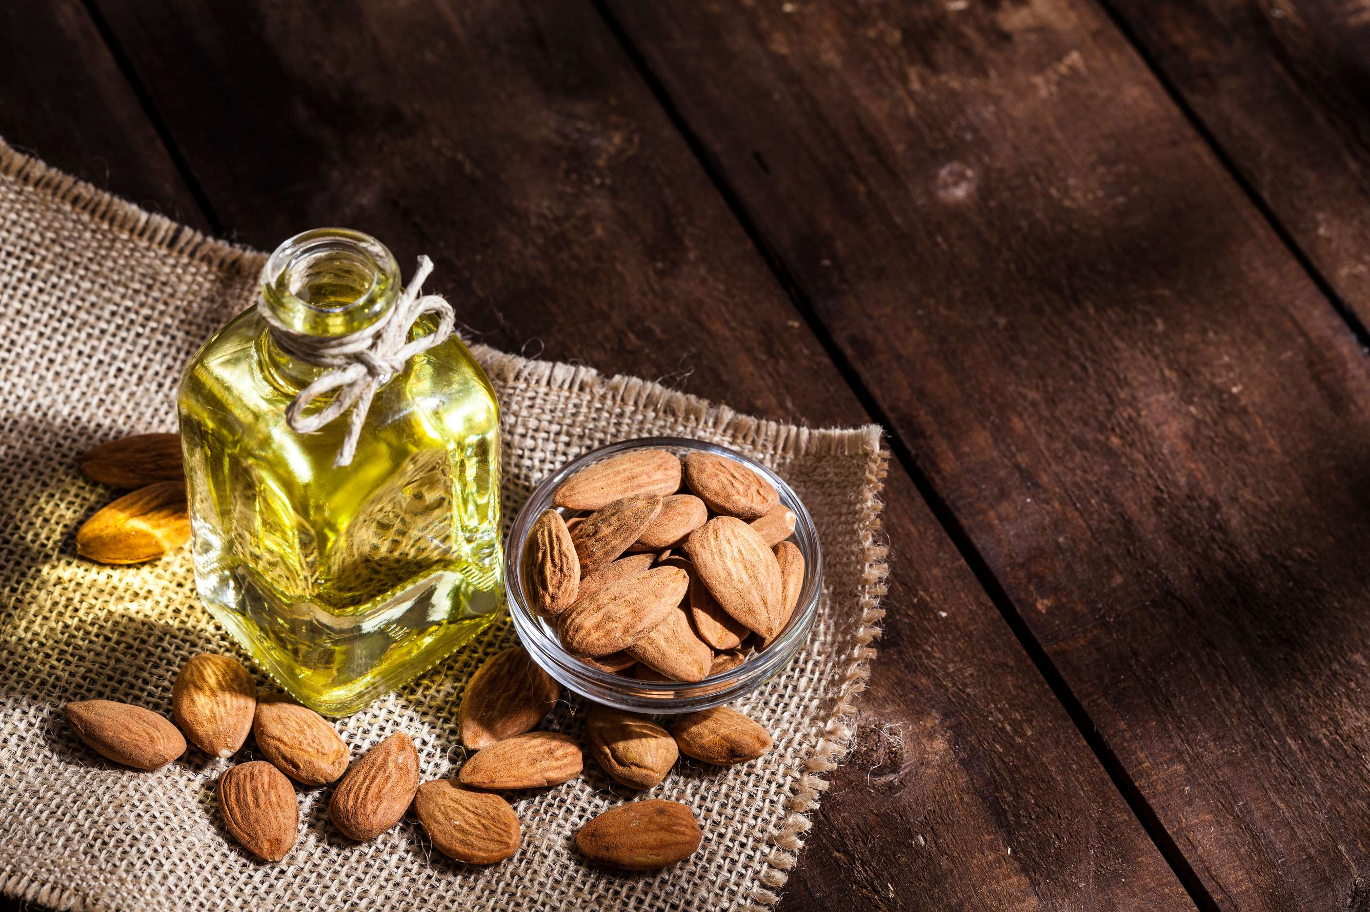

KEY INSIGHTS
MARKET SIZE
USD 1,756.34 Million
2022
FORECAST
USD 5,384.4 Million
2030
CAGR
12.01 %
2023- 2030

Slide 4
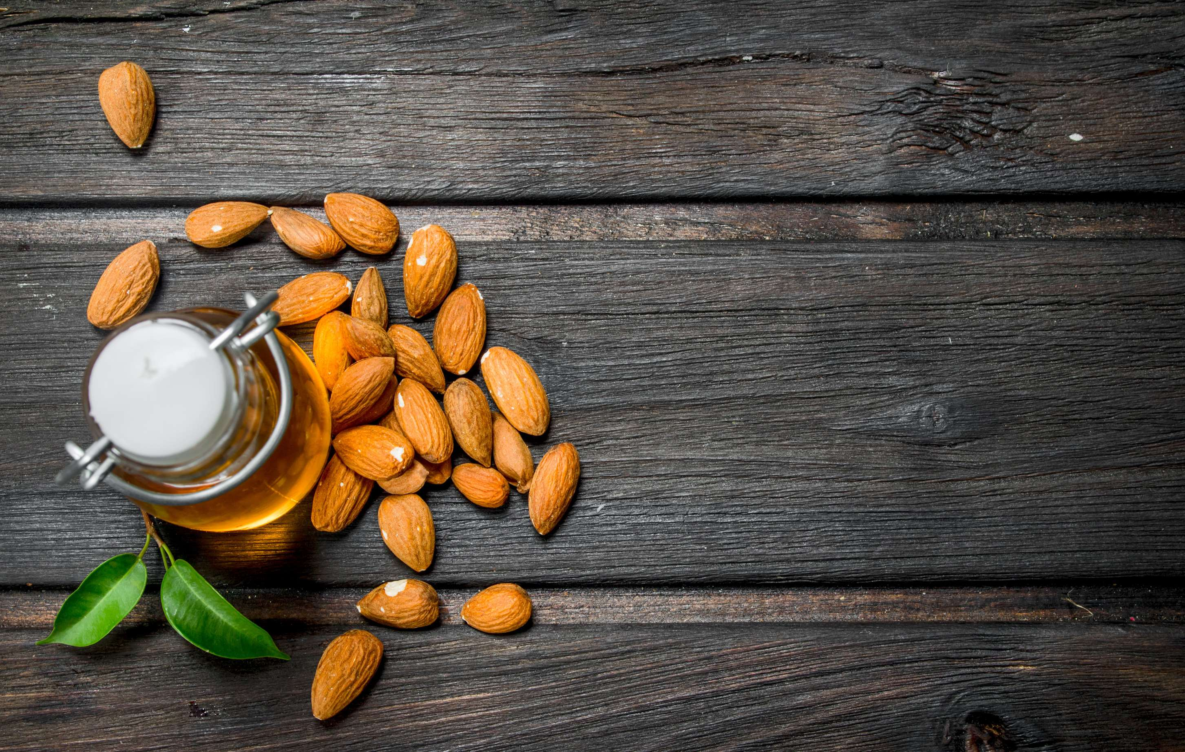
REVENUE MARKET SHARE BY SEGMENTS 2022
  Sweet Almond Oil
  Bitter Almond Oil
By Product
  Food Preparation
  Cosmetics
  Carrier oils
  Pharmaceutical
Application segment
  Hypermarkets & Supermarkets
  Pharmacy
  Cosmetic Discounters
Distribution Channel

Slide 5
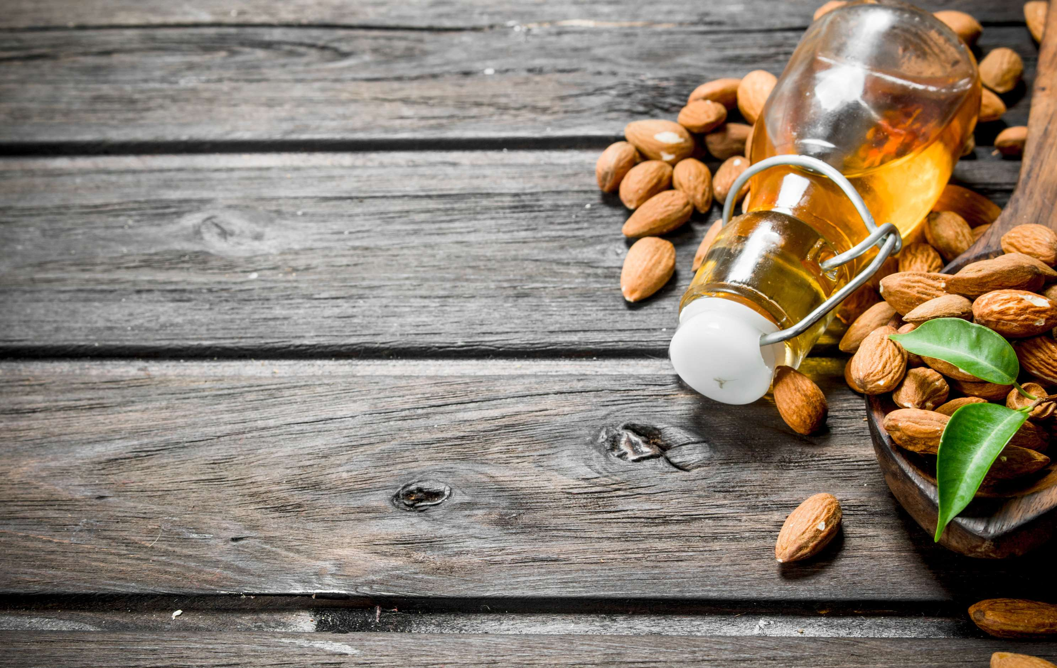

Global Almond Oil Market Revenue share for 2022
North America

Slide 6
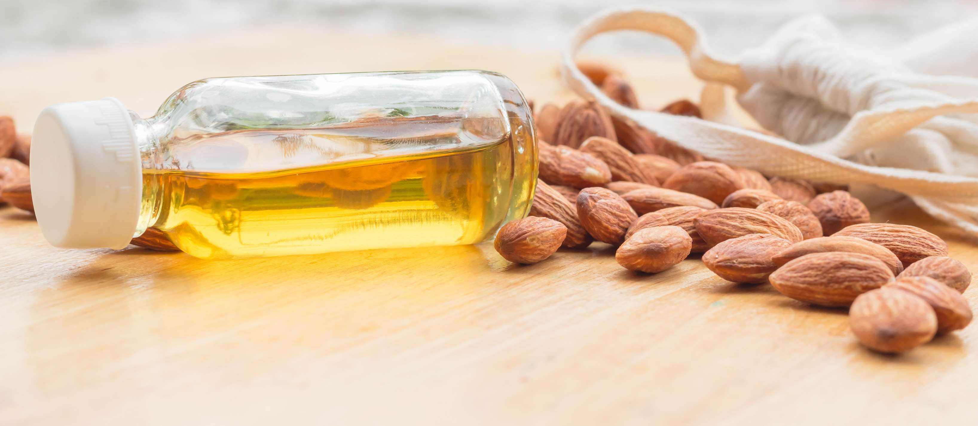
Increasing demand for almond oil in aromatherapy products and applications in the pharmaceutical industry is the major factor expected to drive the growth of the almond oil market
Drivers

Slide 7

AUTHOR'S PERSPECTIVE
  Global Almond Oil Market Report 2023 talks about crucial market insights with the help of segments and sub-segments analysis.
  This is attributed to sweet almond oil used in the cosmetics industry as an excipient, agent, lubricant, and sebum-restoring agent for products projected to drive the growth of this segment.
  This is due to the increasing availability of almond oil through hypermarkets & supermarkets, food specialty stores, and pharmacy & cosmetic discounters expected to drive the growth of the cosmetic discounter segment.

Slide 8
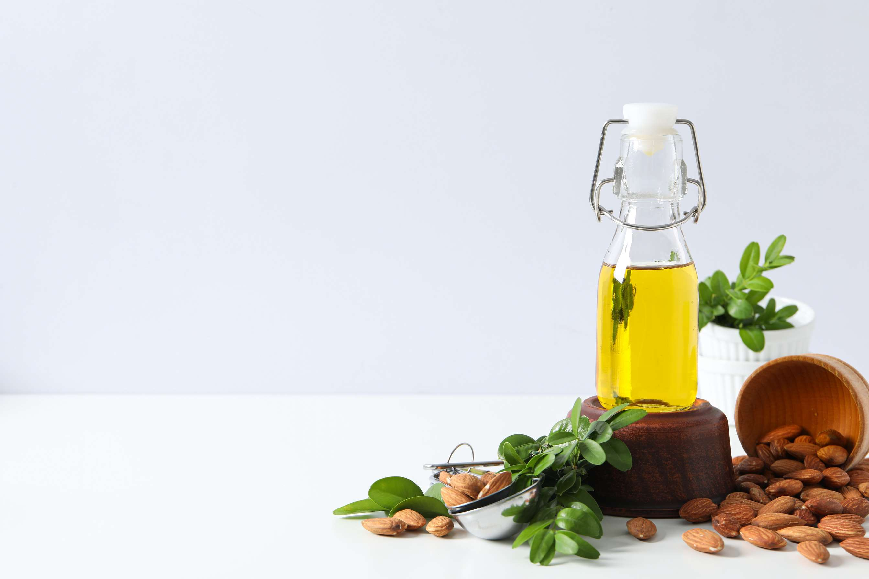









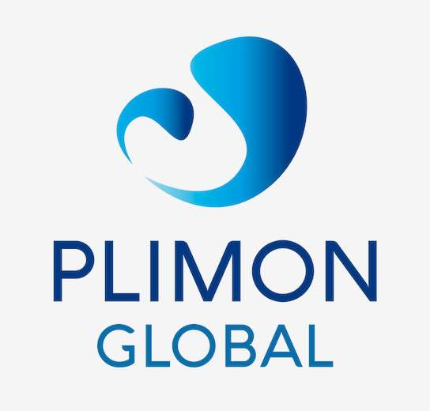


KEY PLAYERS

Slide 9


For Full Report
Contact us
COGNITIVE MARKET RESEARCH
Tel: +1 312-376-8303 | +44 020-8123-0732
India: (+91) 983-496-8611
sales@cognitivemarketresearch.com
Access the Full Report : http://tinyurl.com/mue6xrs5
Please visit our website:
https://www.cognitivemarketresearch.com

