Slide 1
GLOBAL ALMOND MILK MARKET REPORT 2024
Global,Regional,CountryAnalysis

Slide 2
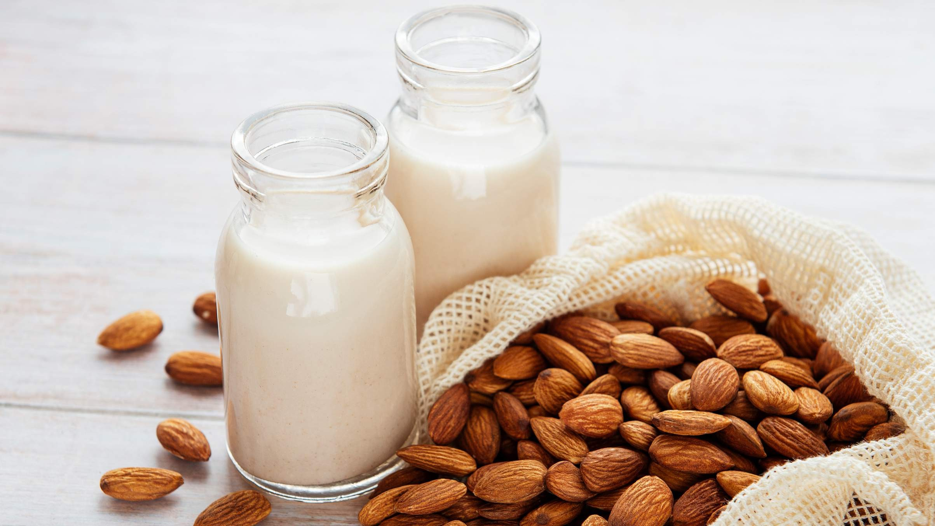
INTRODUCTION
Almond milk is an alternative to dairy that perfectly combines the goodness of nature with dietary choices. Made from almonds, this creamy beverage brings together the nutty flavours and smooth texture in a delightful way. It is highly regarded for its plant-based benefits, being lactose- and cholesterol- free, making it an excellent option for those who prioritize their health. With a hint of sweetness and incredible versatility, almond milk adds a touch of elegance to the morning coffee or any culinary masterpiece the one creates.
Its unique nurturing qualities showcase the process that turns almonds into a velvety elixir, satisfying the tastes of discerning individuals who crave a nourishing drink experience.

Slide 3
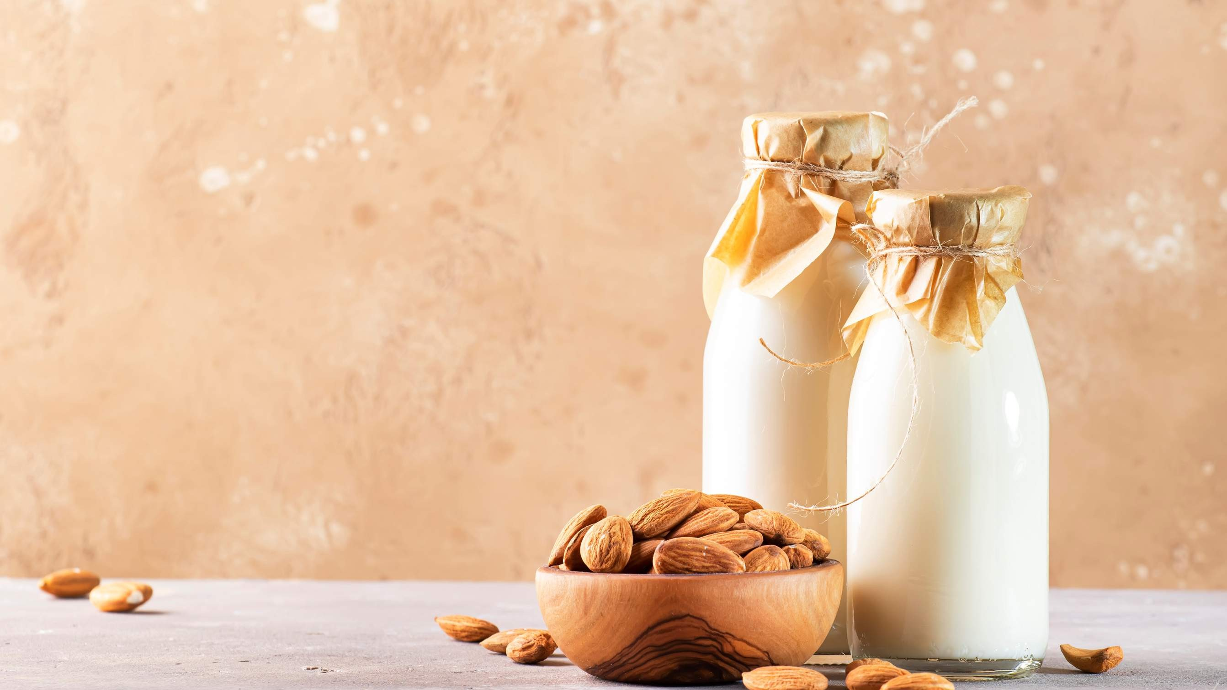

KEY INSIGHTS
MARKET SIZE
USD 5315.2 million
2023
CAGR 9.00%
2023
-
2030

Slide 4
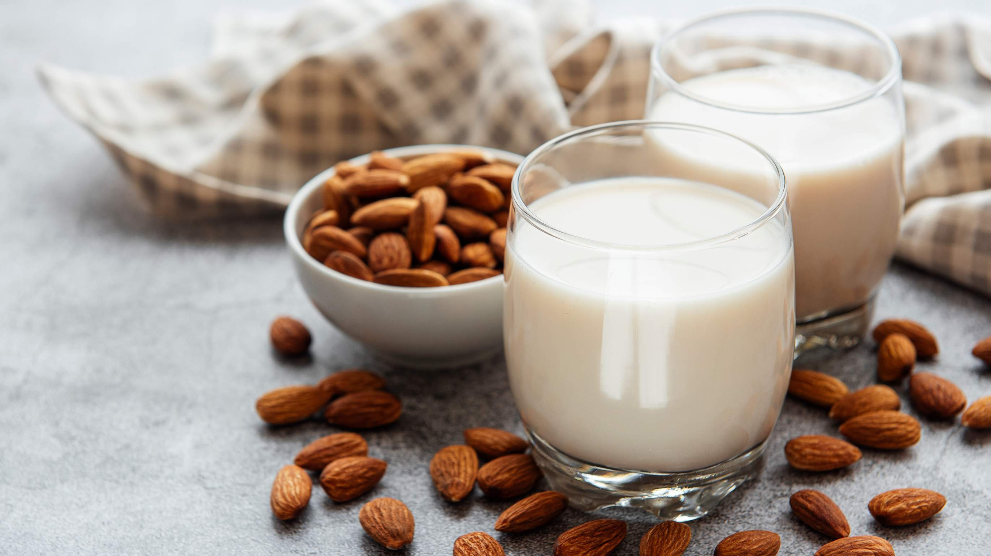
REVENUE MARKET SHARE BY SEGMENTS 2022
Bottles Cans Cartons
Category Segment
Conventional Organic
Packaging Type Segment
Beverages Frozen Desserts Personal Care Others
Original Almond Milk Vanilla Almond Milk Non-Dairy Almond Milk
Type Segment
By Application
Plain Sweetened Plain Unsweetened Flavoured Sweetened
Flavoured Unsweetened
Store-Based
Non-Store-Based
Formulation Segment
Distribution Channel

Slide 5
Global Almond Milk Market Revenue share for 2022
North America 40%

Slide 6
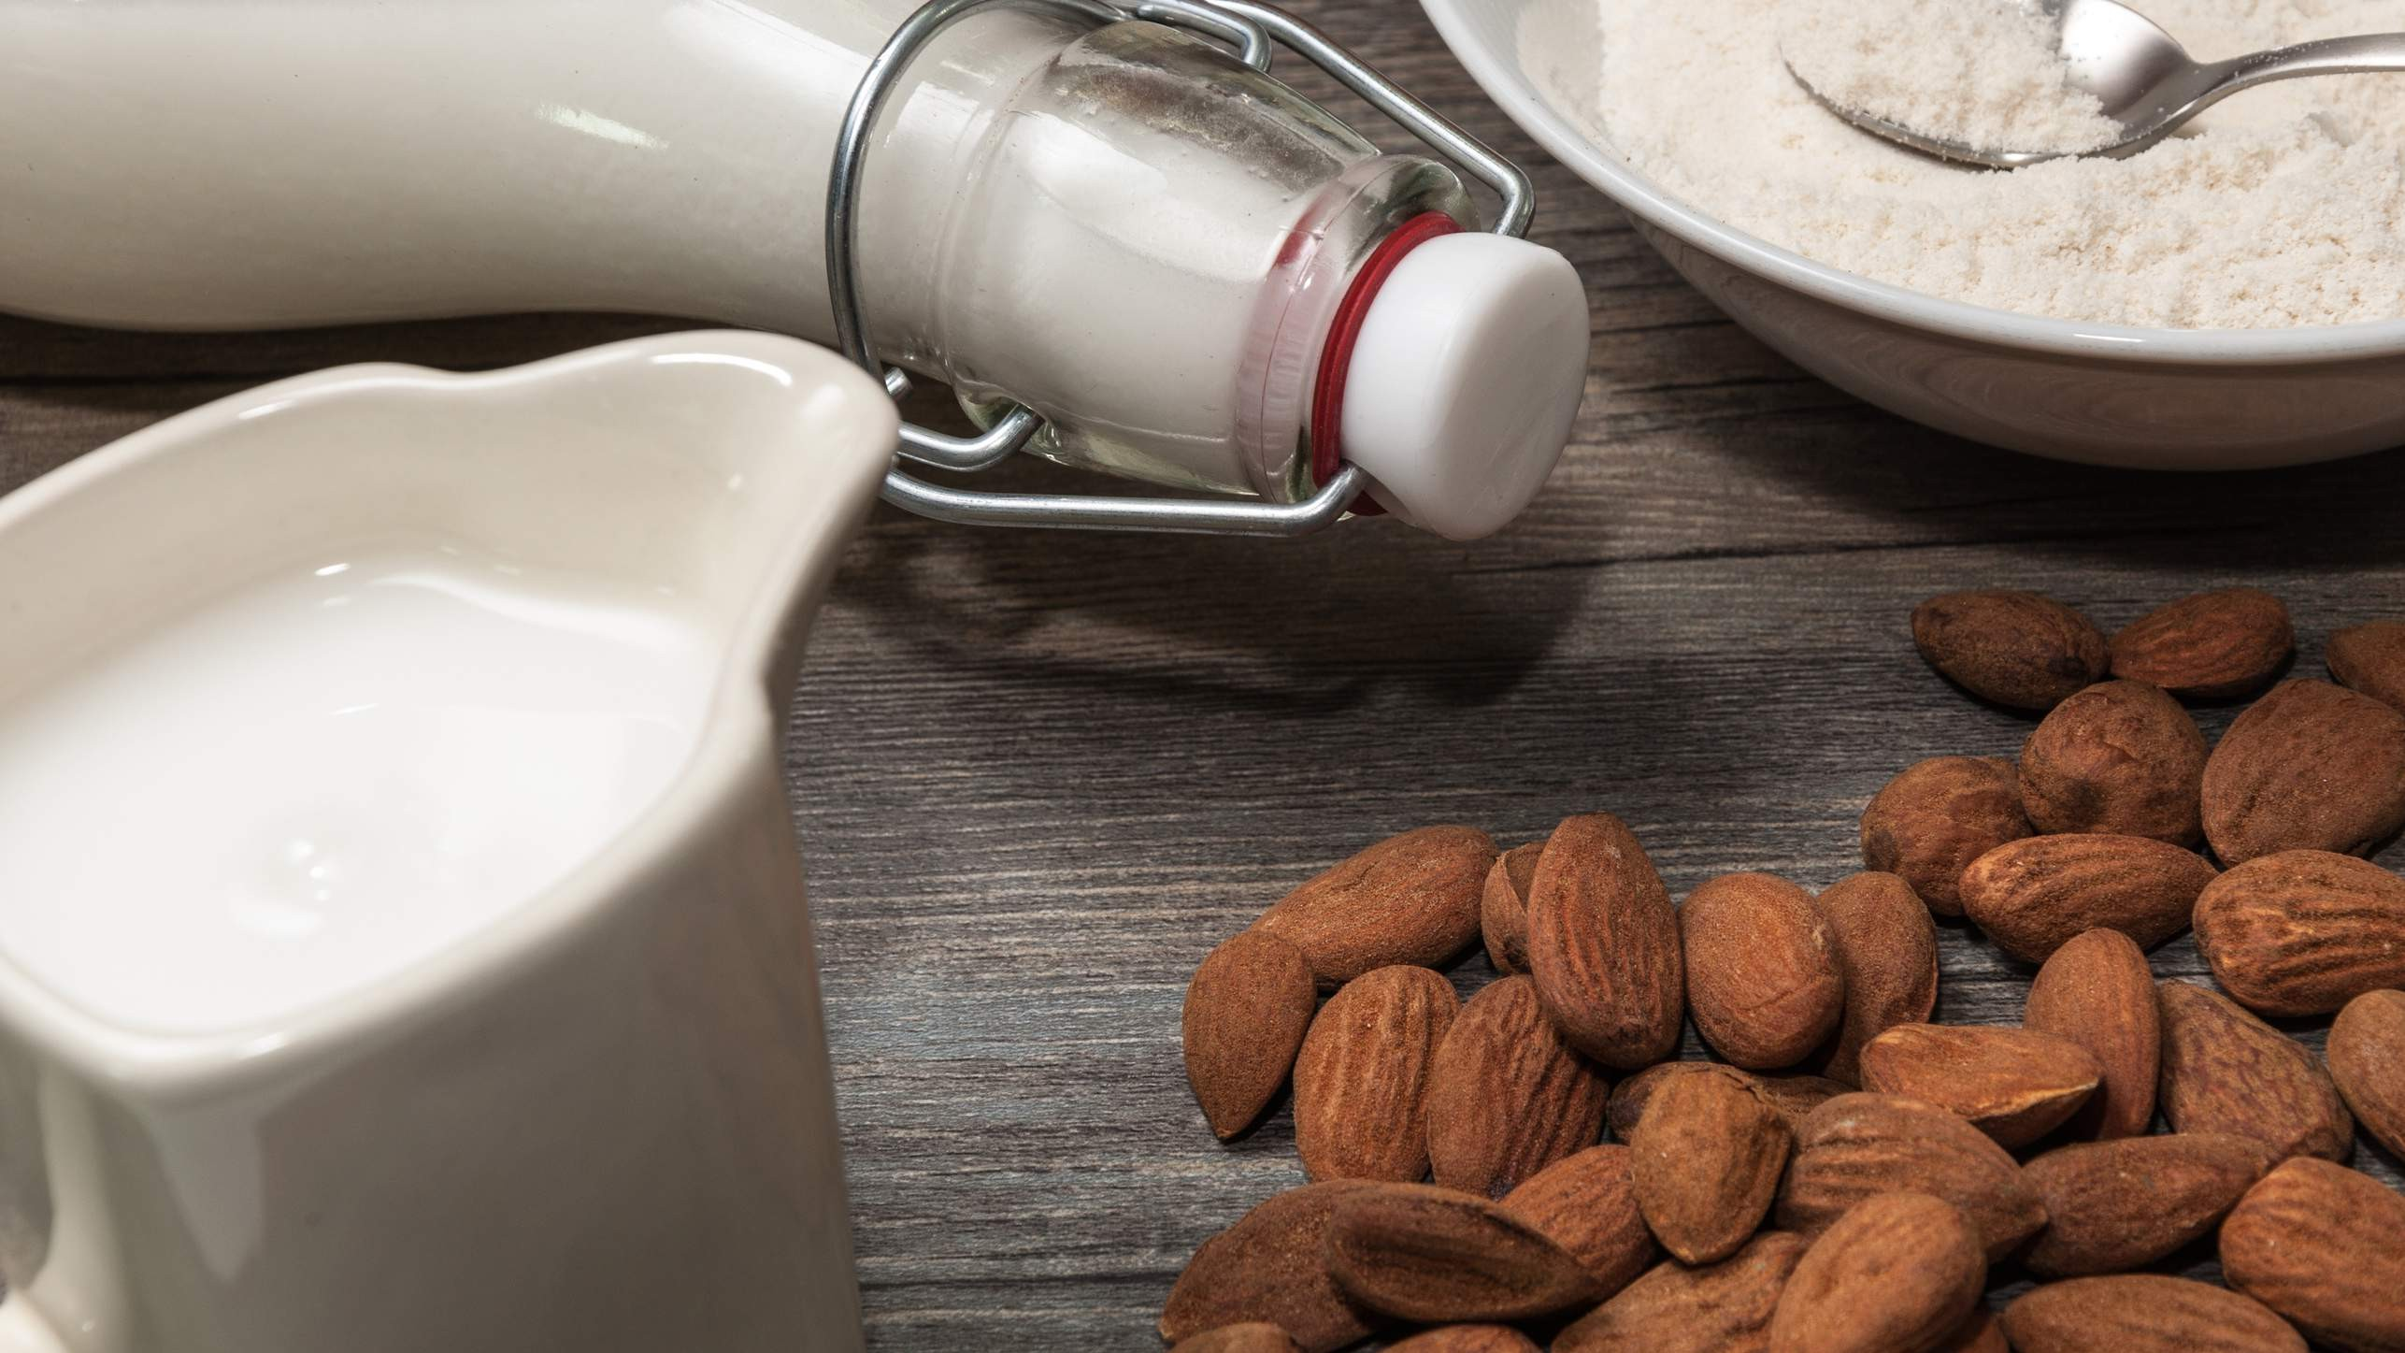
Increased Incidence of Lactose Intolerance to Propel Market Growth
Drivers
Nut Allergies and Sensitivities to Restrict Market Growth
Restraints

Slide 7
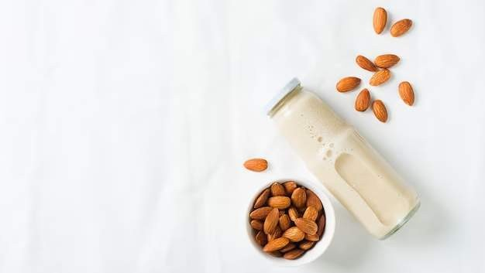
AUTHOR'S PERSPECTIVE
The global almond milk market will expand significantly by 9.00% CAGR between 2023 and 2030.
Amidst the array of plant-based choices, conventional almond milk remains a consistent favourite, striking a harmonious balance between accessibility and familiarity
As the fastest-growing category, vanilla almond milk not only reshapes the market but also translates flavour innovation into tangible sales success, capturing a burgeoning share of the almond milk market.
The harmonious fusion of sweetness without overwhelming the almond essence not only captivates palates but also ensures a stable and enduring presence on shopping lists, sustaining its prominence and contributing significantly to the overall financial success of almond milk sales.
The delightful synergy between almond milk and frozen delights not only reflects changing tastes but cements its status as a pivotal force steering the growth trajectory of almond milk sales.

Slide 8













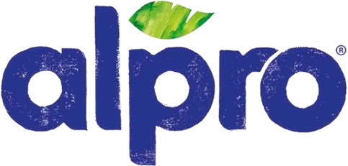
KEY PLAYERS
TM

Slide 9


Contact us
For Full Report
COGNITIVE MARKET RESEARCH
Tel: + 1 312 - 376 - 8303 | + 44 020 - 8123 - 0732
India: ( + 91 ) 983 - 496 - 8611
sales@ cognitivemarketresearch. com
Access the Full Report : http://tinyurl.com/yvjpsmwz
Please visit our website:
https://www.cognitivemarketresearch.com

