Slide 1
GLOBAL ALMOND BUTTER MARKET REPORT 2024
Global,Regional,CountryAnalysis

Slide 2
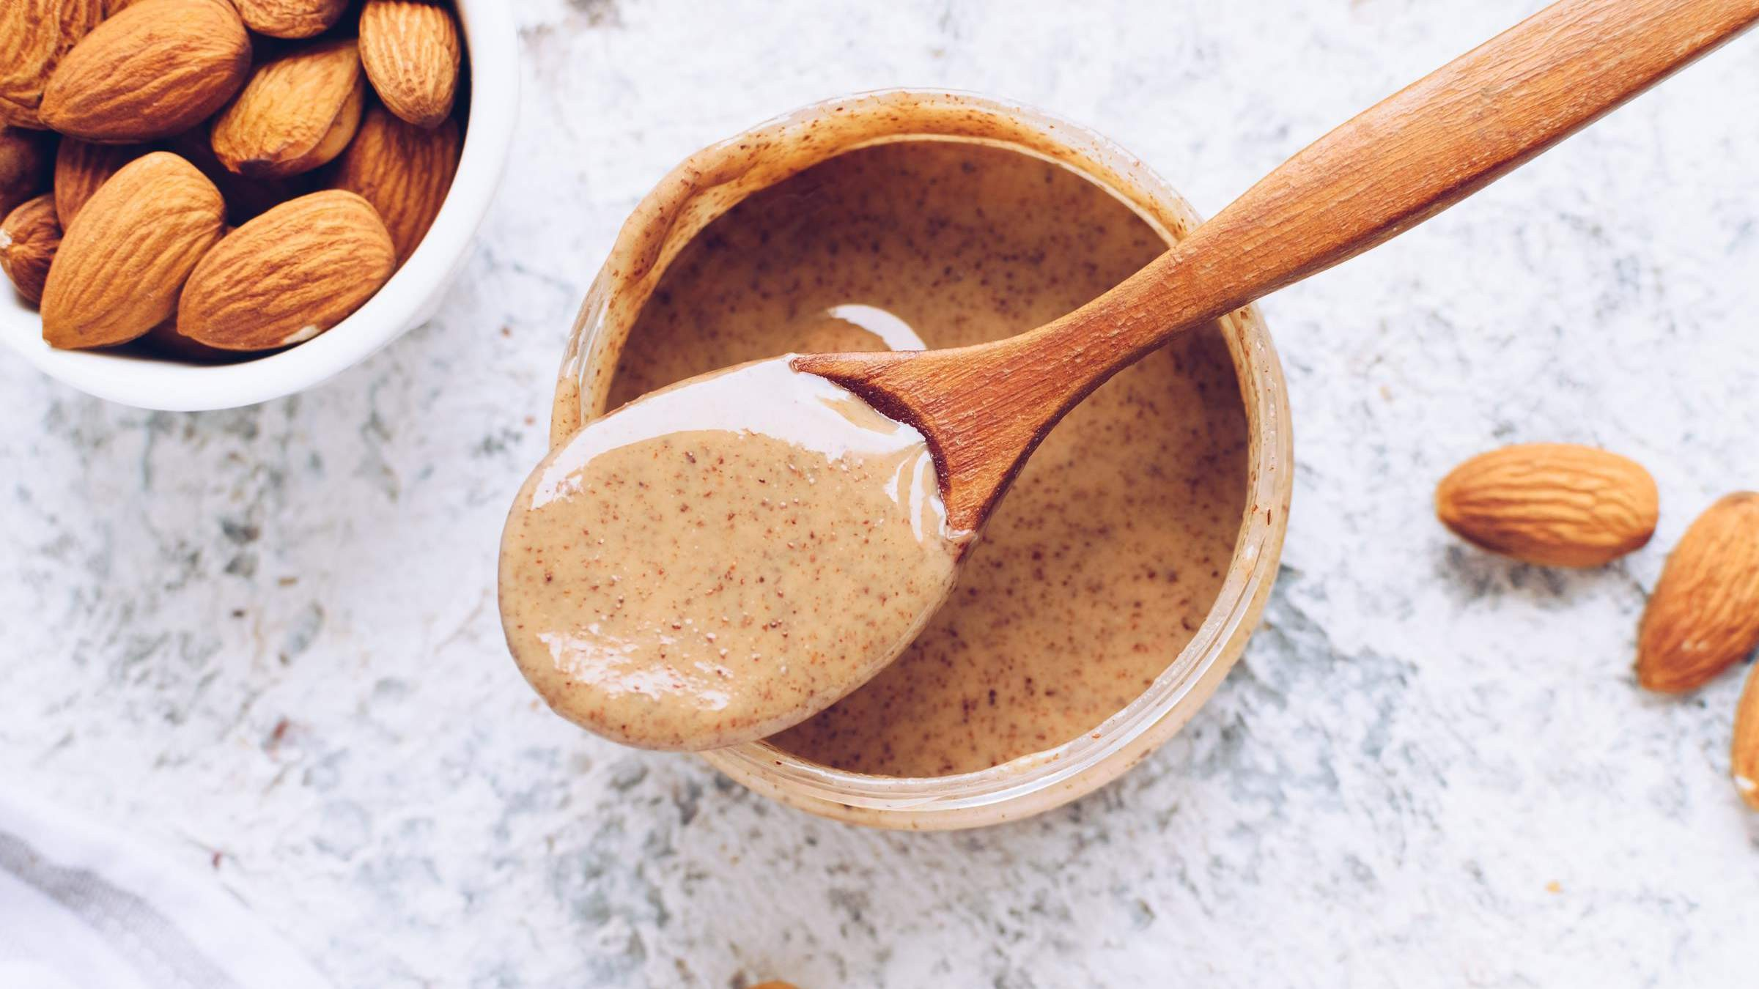
INTRODUCTION
Almond butter, a creation represents a smooth blend of finely crushed almonds carefully crafted to create a delightful spread. This luxurious mixture, derived from almonds, captures the essence of both indulgence and nutrition. Known for its consistency and nutty flavour almond butter offers a pleasure that seamlessly combines mindful eating, with gastronomic delight. Its appeal lies in the amalgamation of high-quality almonds ground to perfection, resulting in a melting experience on the palate. Like a symphony, for the taste buds, almond butter stands as a delicacy that embodies both taste and well-being.

Slide 3
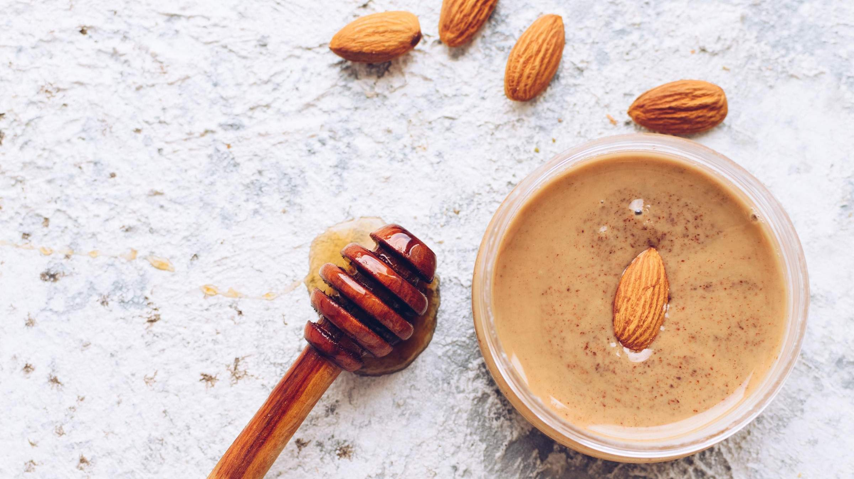

KEY INSIGHTS
MARKET SIZE
USD 700.2 million
2024
CAGR 8.20%
2024
-
2031

Slide 4
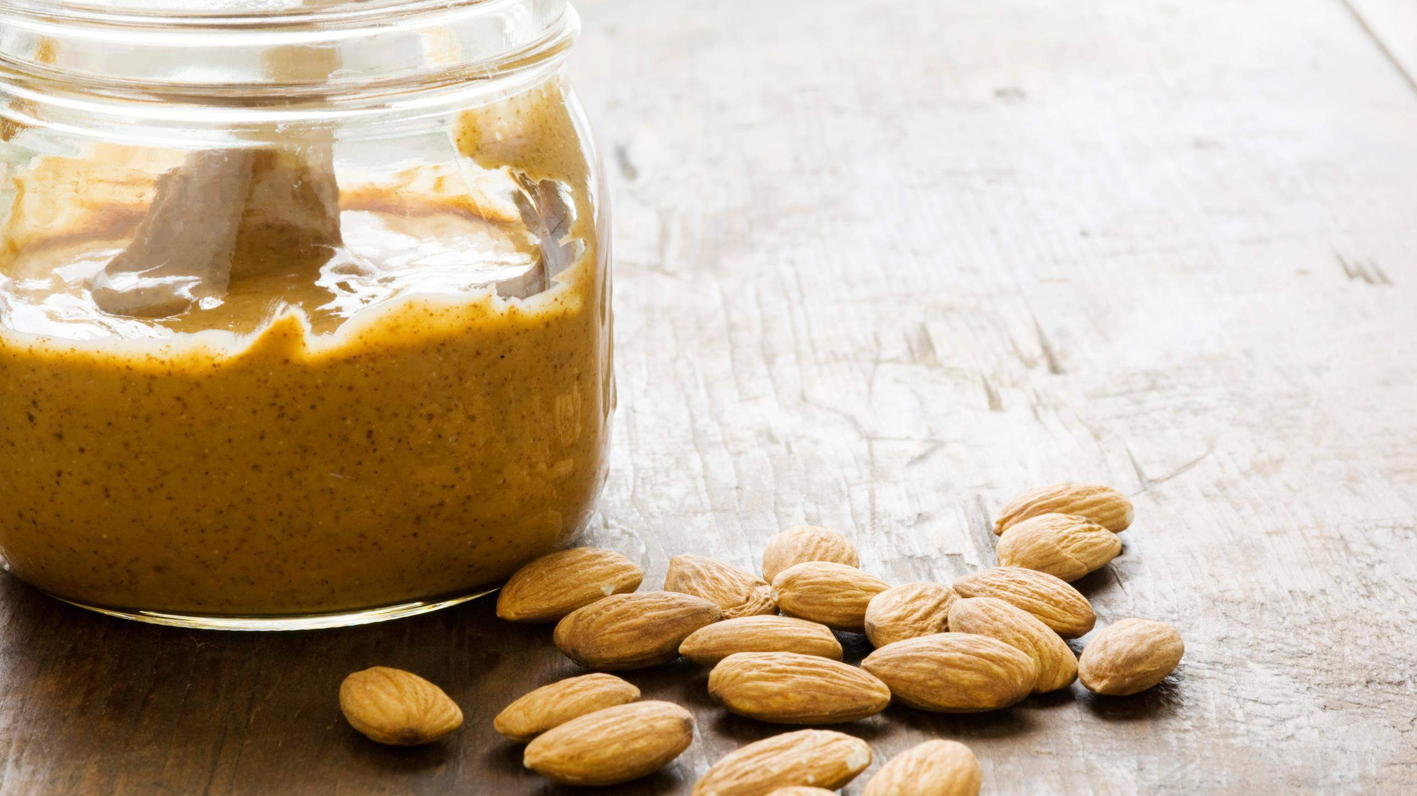
REVENUE MARKET SHARE BY SEGMENTS 2022
Food & Beverage Industry
HoReCa
Household Retail
Organic
Conventional
Nature Segment
End Use Segment
Spreads
Liquid
Blocks
B2B
B2C
Form Segment
Sales Channel

Slide 5
Global Almond Butter Market Revenue share for 2024
North America 40%

Slide 6
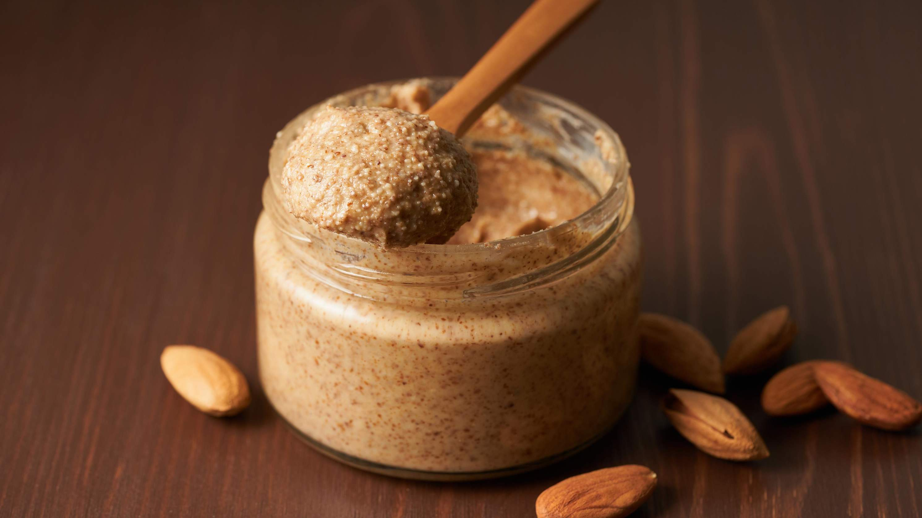


Increasing Culinary Applications to propel the market growth
Challenges in Cricket Balls Market Amidst Quality Concerns to Restrict Market Growth

Slide 7

AUTHOR'S PERSPECTIVE

Slide 8



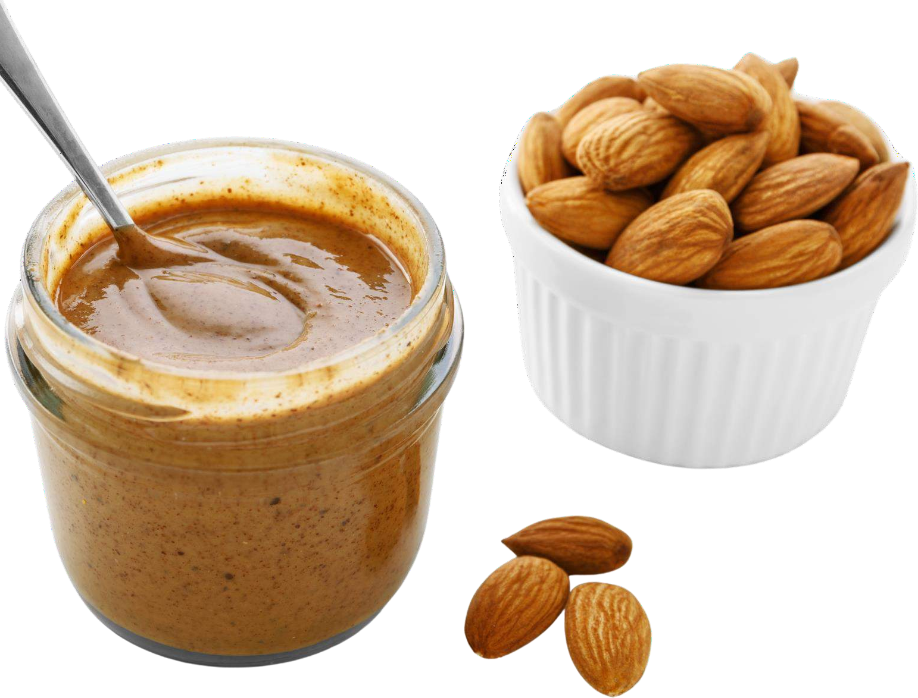








KEY PLAYERS

Slide 9


Contact us
For Full Report
COGNITIVE MARKET RESEARCH
Tel: + 1 312 - 376 - 8303 | + 44 020 - 8123 - 0732
India: ( + 91 ) 983 - 496 - 8611
sales@ cognitivemarketresearch. com
Access the Full Report : http://tinyurl.com/mpxtp4xx
Please visit our website:
https://www.cognitivemarketresearch.com

