Slide 1

GLOBAL
ALCOHOLIC ICE CREAM MARKET REPORT
2024
Global,Regional,CountryAnalysis

Slide 2
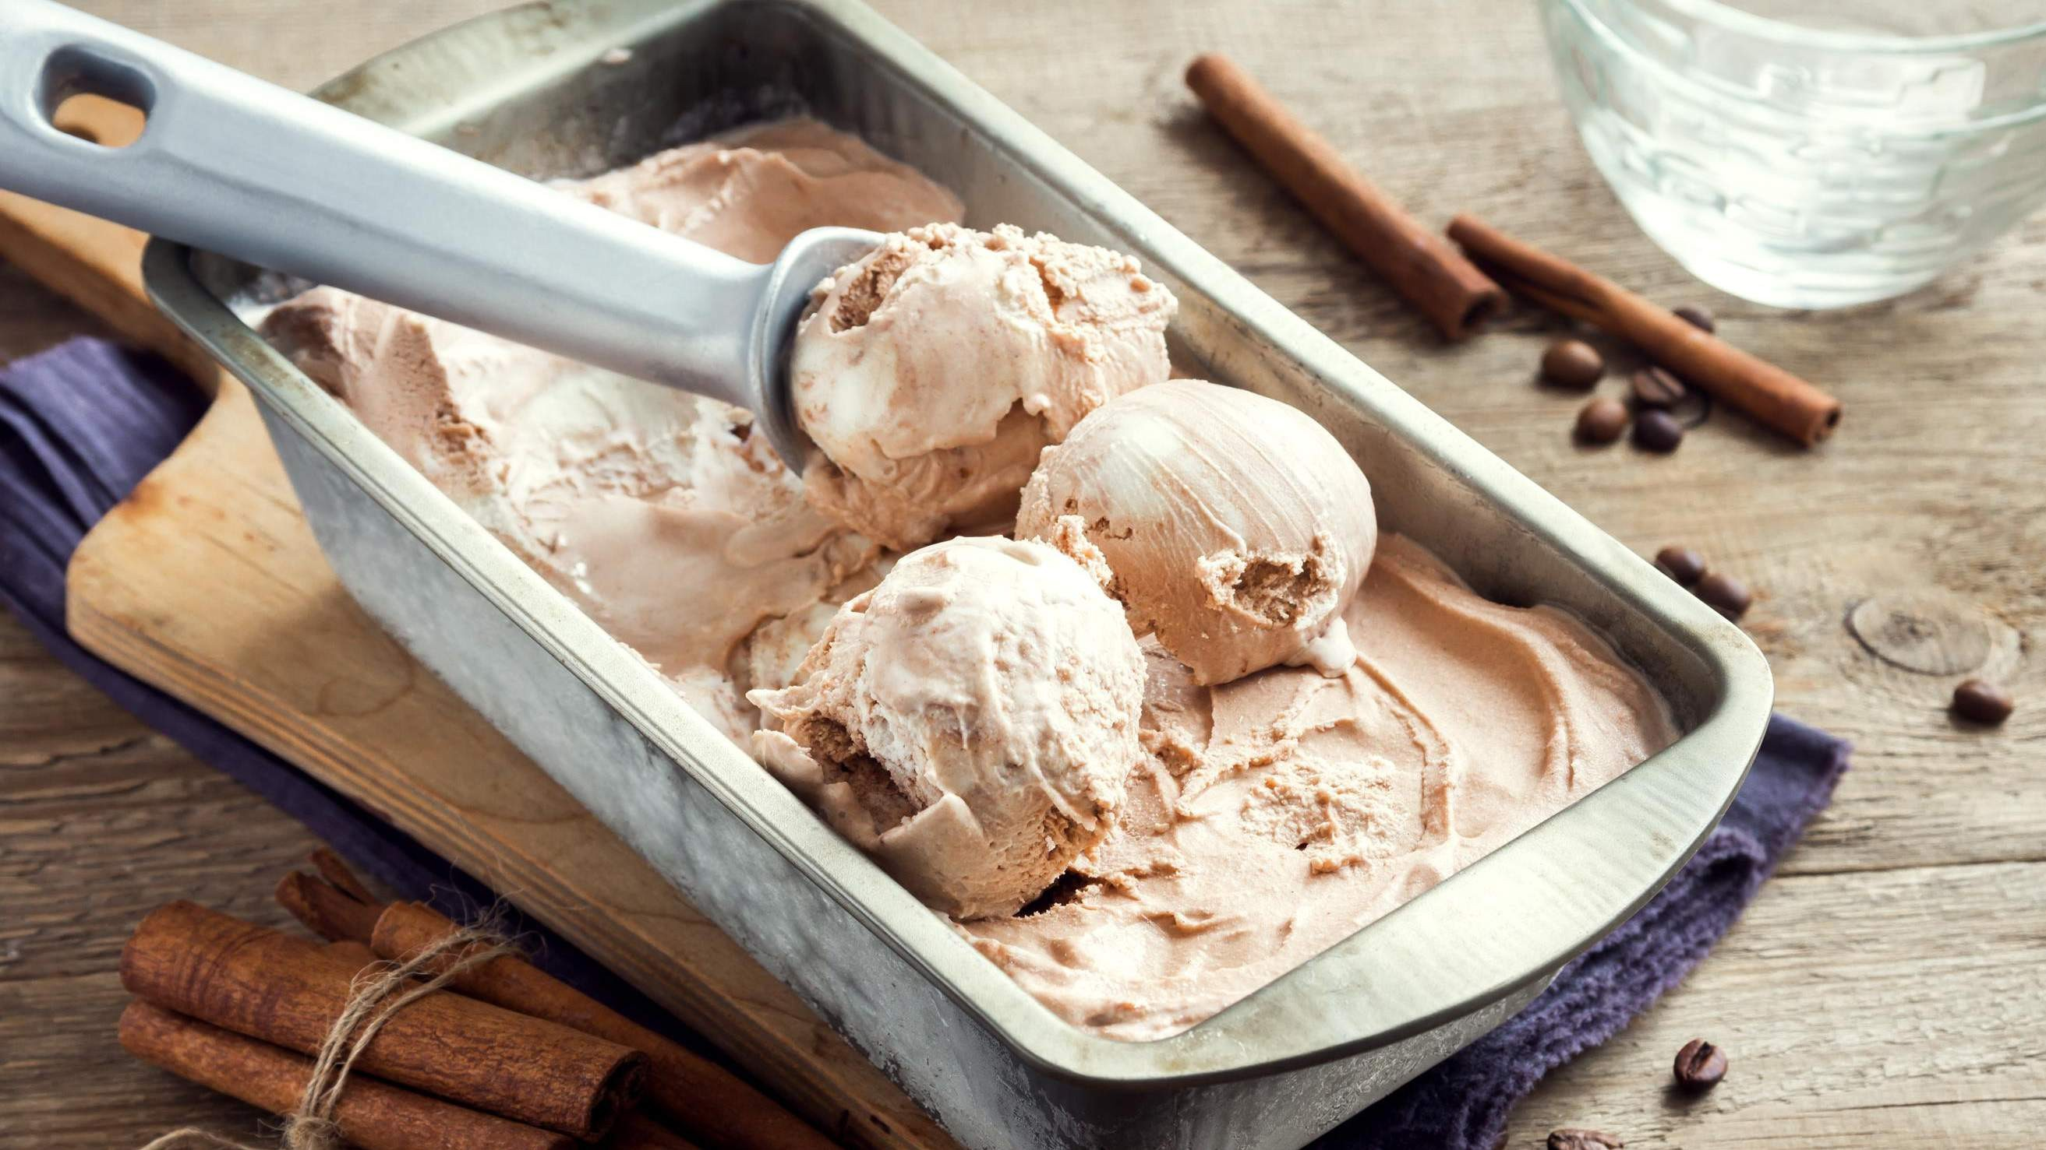
INTRODUCTION
Ice cream infused with alcohol is simply ice cream with alcohol in it. The ice cream contains other kinds of alcohol than denatured alcohol. The consumer chooses alcoholic ice cream over other nice and delightful food products since it comes in a range of flavor and tastes. Producers incorporate different flavors and tastes to make alcohol-infused ice cream more appealing.
Therefore, over the forecast period, the market for alcohol-infused ice cream
is expected to rise due to the rising flavor of this product and the growing popularity of alcohol-infused food items.

Slide 3
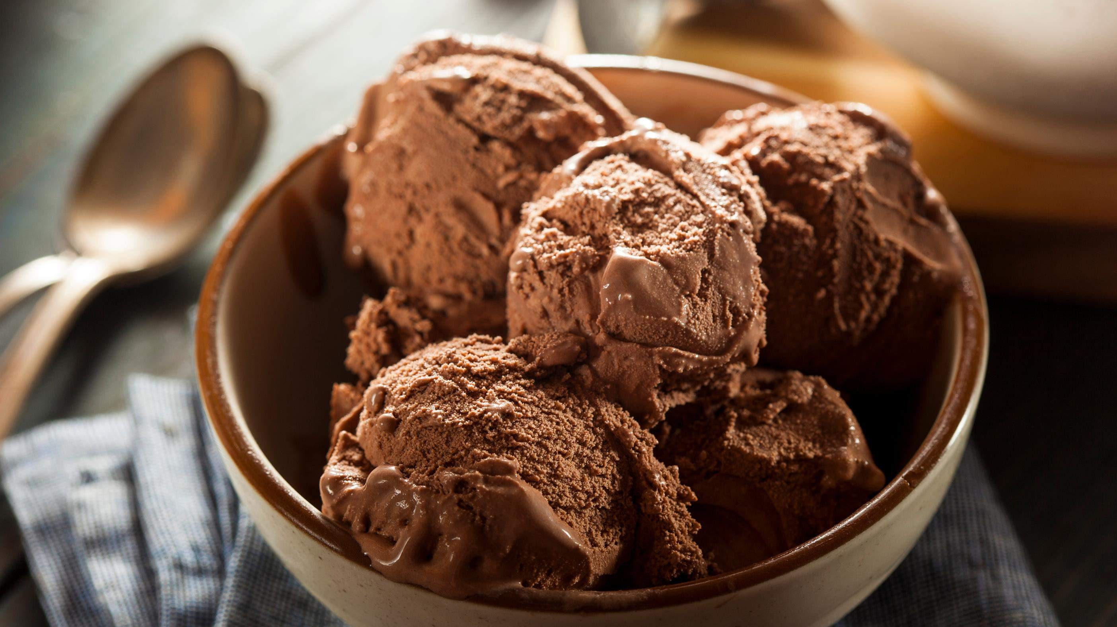

KEY INSIGHTS
MARKET SIZE
USD 842.2 million
2023
CAGR 6.80%
2023
-
2030

Slide 4
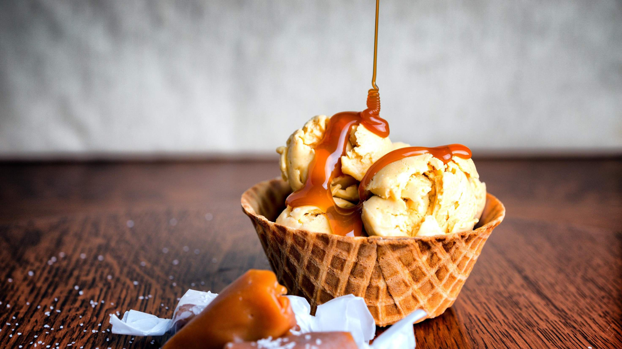
REVENUE MARKET SHARE BY SEGMENTS 2022
Low Alcohol
High Alcohol
ABV Segment
Beer
Rum
Vodka
Flavor Segment
Offline
Online Stores
Distribution Channel

Slide 5

Global Alcoholic Ice Cream Market Revenue share for 2022
North America 40%

Slide 6



Changing Lifestyles And Increasing Disposable Incomes To Propel Market Growth
Regulatory Challenges and Storage Requirements to Restrict Market Growth

Slide 7

AUTHOR'S PERSPECTIVE
The Worldwide Alcoholic Ice Cream market will expand significantly by 6.80% CAGR between 2023 and 2030.
High Alcoholic Ice Cream is the fastest-growing category over the forecast period due to Customers experiencing vertigo effects like those of alcohol when using it
Beer is the fastest-growing category over the forecast period; because of continuous innovation in taste, flavor, packaging, and other areas, the public is shifting towards sophisticated, moderate, and premium beverage-based goods, such as ice cream with alcohol added.
The demand for Alcoholic Ice Cream is rising due to the rising flavor of this product and the growing popularity of alcohol-infused food items.
Demand for Vodkas remains higher in the Alcoholic Ice Cream market.

Slide 8
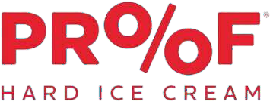
KEY PLAYERS

Slide 9


Contact us
For Full Report
COGNITIVE MARKET RESEARCH
Tel: + 1 312 - 376 - 8303 | + 44 020 - 8123 - 0732
India: ( + 91 ) 983 - 496 - 8611
sales@ cognitivemarketresearch. com
Access the Full Report : http://tinyurl.com/ycy4daek
Please visit our website:
https://www.cognitivemarketresearch.com

