Slide 1
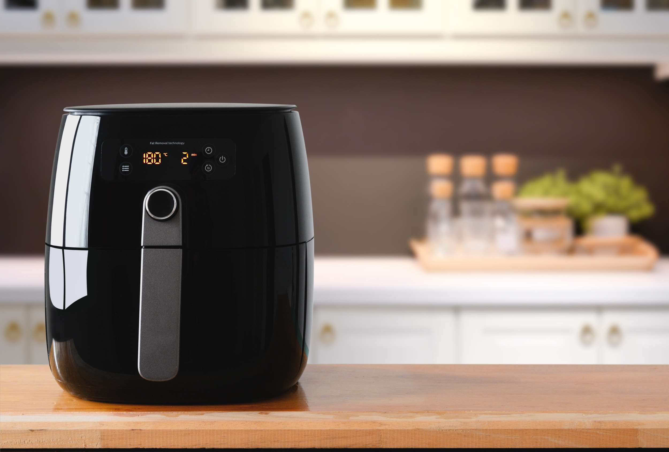
GLOBAL
AIR FRYER
MARKET REPORT
2024
Global,Regional,CountryAnalysis

Slide 2

INTRODUCTION
Like a fan oven, air fryers cook food by circulating hot air, and they also use a chemical mechanism called the reaction of Maillard to brown up the food's outside and provide delicious results. Increased demand is anticipated for lodging, dining, and medical facilities. Furthermore, the strong demand for energy-efficient goods will support market expansion. The degree of competition was further increased by the entry of new rivals and brands with private labels into the market. A few of the key elements anticipated to fuel market expansion are rising consumer health consciousness and a need for quick and easy cooking solutions. The rise in e-commerce and online shopping platforms and the incorporation of intelligent technology into air fryers will present development prospects for the market.

Slide 3


KEY INSIGHTS
MARKET SIZE
USD 989.2 million
2023
CAGR
7.20%
2023- 2030

Slide 4

REVENUE MARKET SHARE BY SEGMENTS 2022
  Low (USD 30-100)
  Mid (USD 100-200)
  Premium (Above USD 200)
  Drawer Type Air Fryer
  Lid Type Air Fryer
Type Segment
Price Range Segment
  Specialty Stores
  Supermarkets
/Hypermarkets
  E-Commerce
  Manual
  Digital
Function Segment
Distribution Channel
  Smaller Model Size (2-4.9 Litres)
  Larger Model Size (5-5.9 Litres)
  Extra-Large Model Size (6-12 Litres)
  Residential
  Restaurants and Cafes
  Hotels
Litres Segment
End User Segment

Slide 5

Global Air Fryer Market Revenue share for 2024
North America
40%

Slide 6

Increased Awareness of Health Among Customers to Provide Viable Market Output
Drivers
Customers Ignorance of the Advantages of Air Fryer Appliances to Restrict Market Growth
Restraints

Slide 7
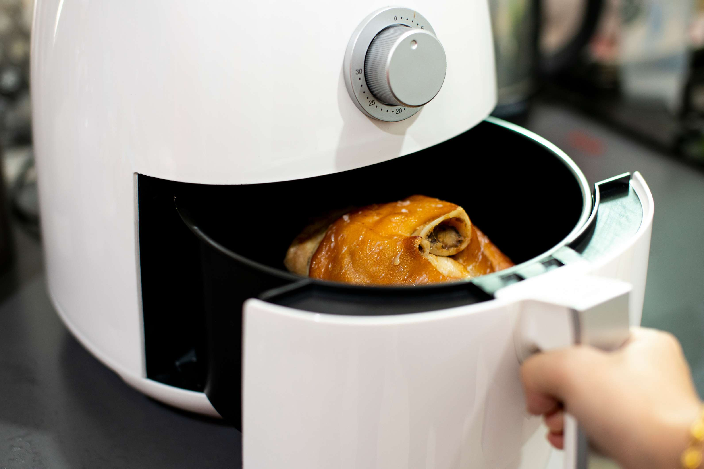
AUTHOR'S PERSPECTIVE
  The Worldwide Air Fryer market will expand significantly by 7.20% CAGR between 2023 and 2030.
  The demand for Air Fryers is rising consumer health consciousness and a need for quick and easy cooking solutions. The rise in e-commerce and online shopping platforms and the incorporation of intelligent technology into air fryers will present development prospects for the market.
  Demand for Smaller Model Sizes remains higher in the Air Fryer market.
  North American Air Fryer will continue to lead, whereas the APAC Air Fryer market will experience the most substantial growth until 2030.

Slide 8
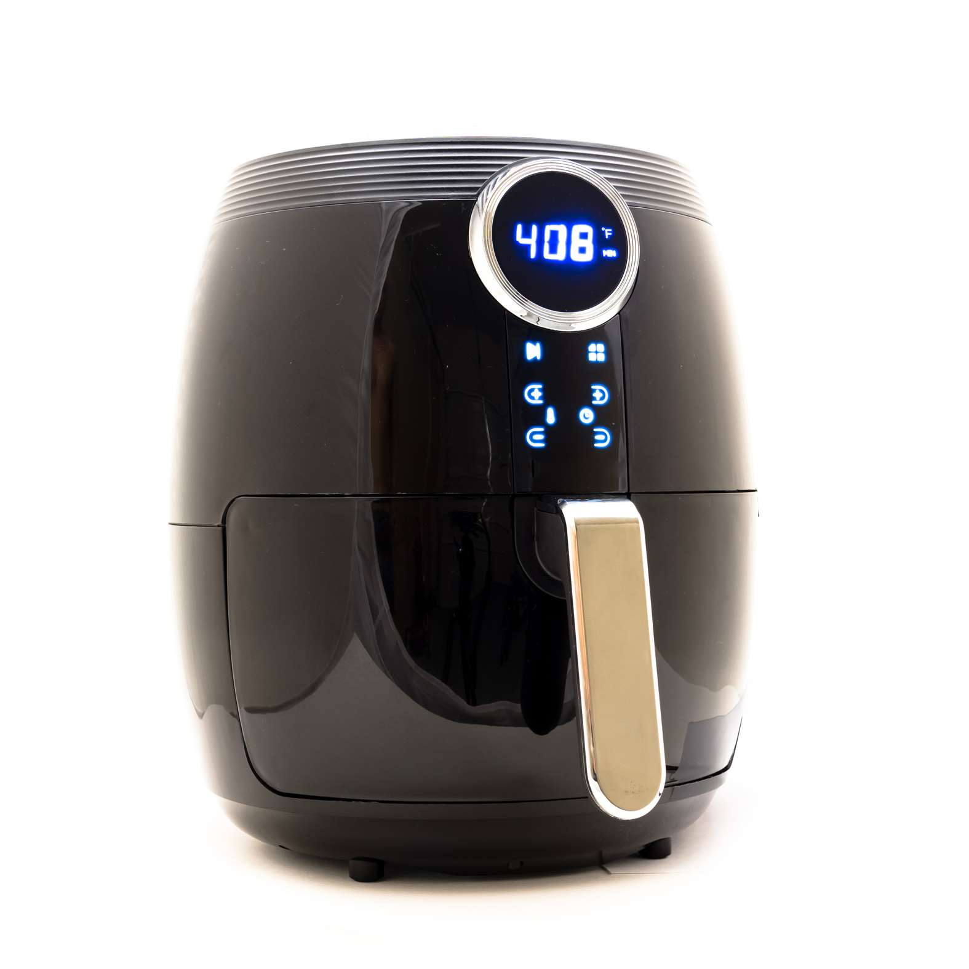












KEY PLAYERS

Slide 9


For Full Report
Contact us
COGNITIVE MARKET RESEARCH
Tel: +1 312-376-8303 | +44 020-8123-0732
India: (+91) 983-496-8611
sales@cognitivemarketresearch.com
Access the Full Report : http://tinyurl.com/2sh2e2sw
Please visit our website:
https://www.cognitivemarketresearch.com

