Slide 1
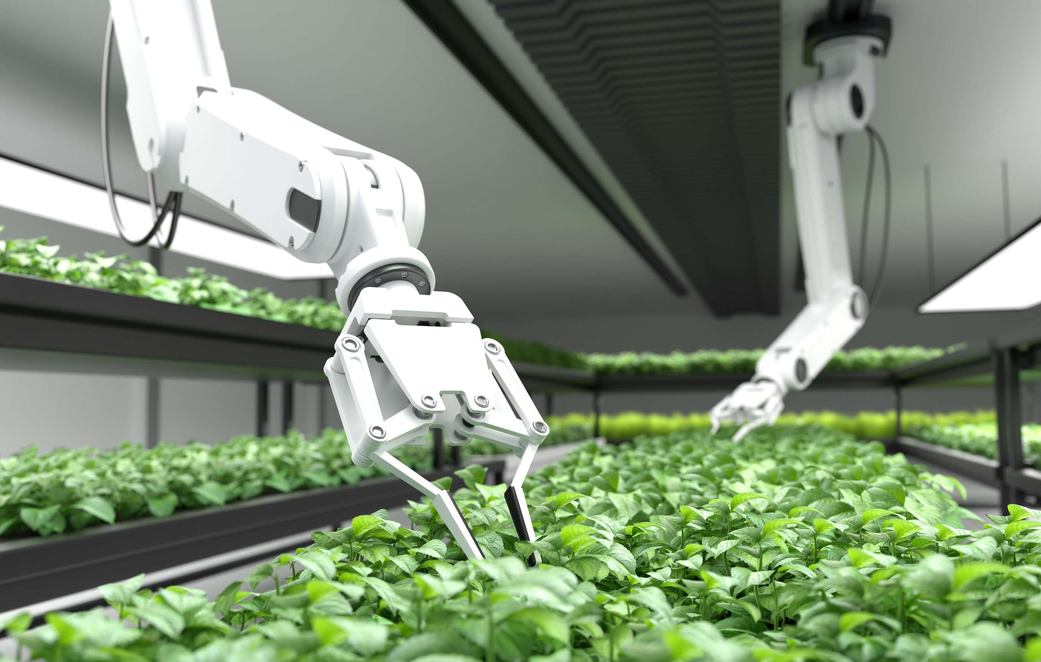
GLOBAL
AGRICULTURE ROBOTS
MARKET REPORT
2024
Global,Regional,CountryAnalysis

Slide 2
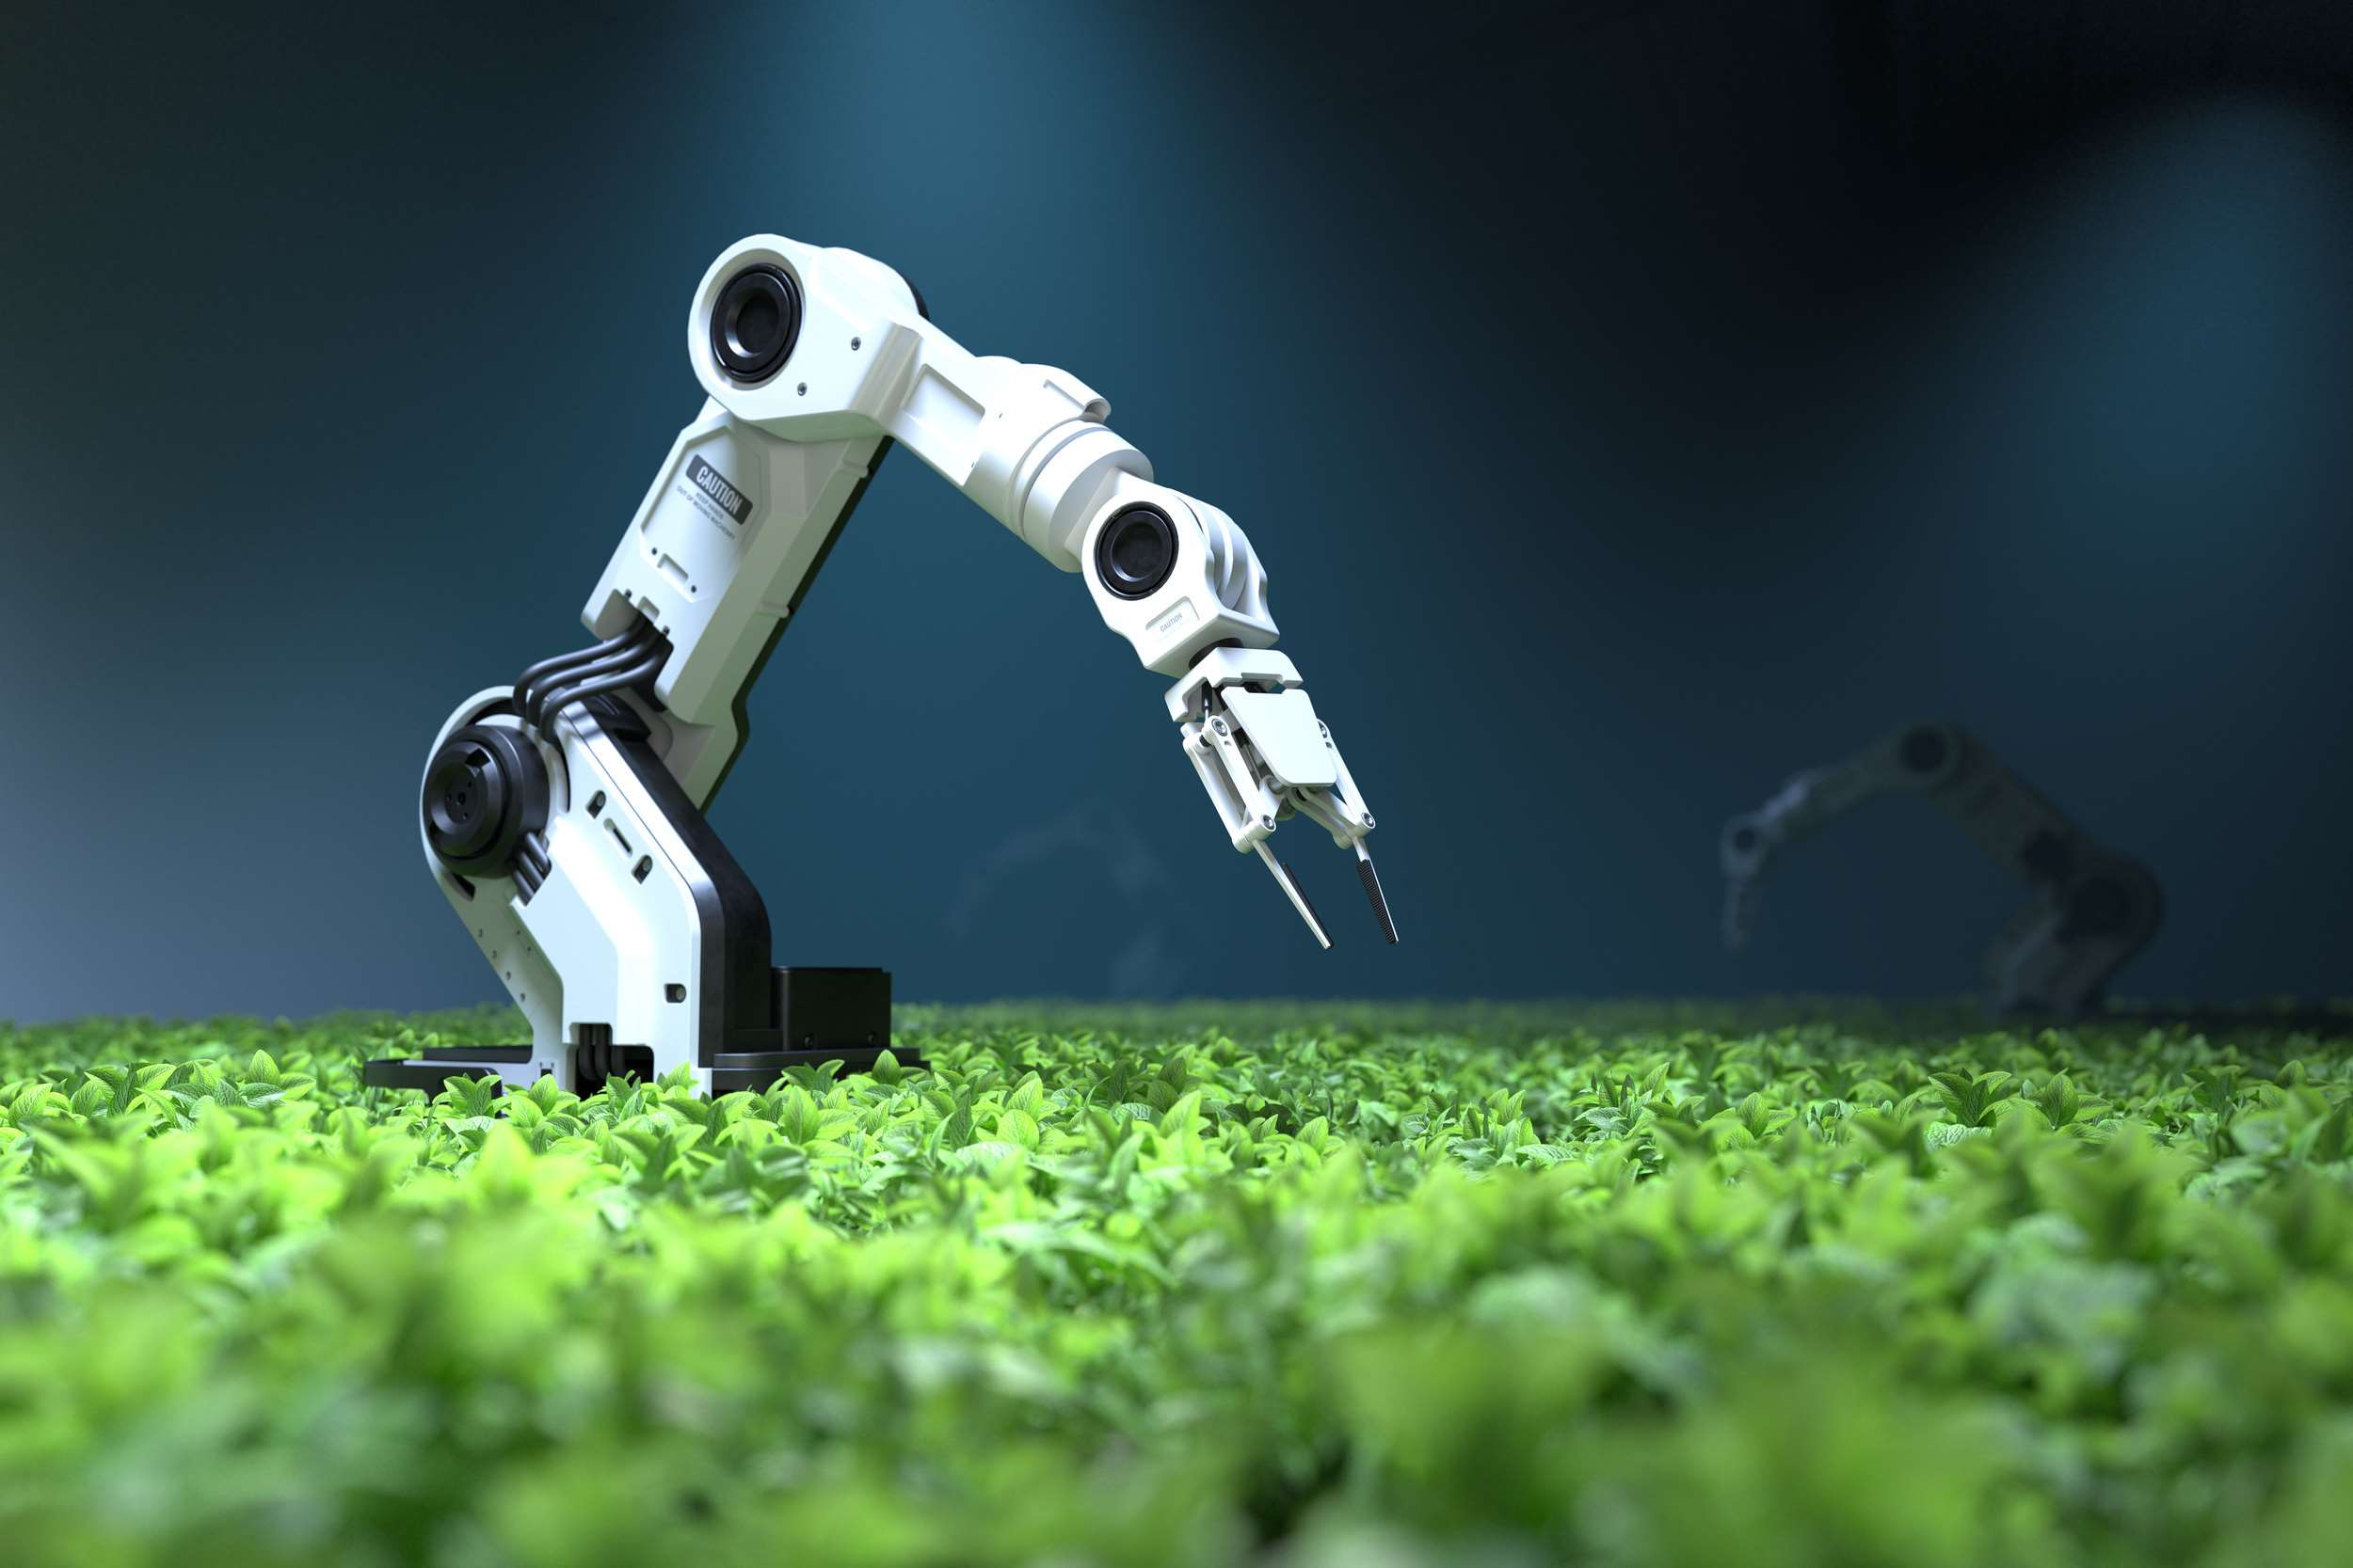
INTRODUCTION
Often referred to as agribots, agricultural robots are specialized vehicles made to carry out a range of activities in the agriculture sector. Some agricultural tasks can be completed by these robots autonomously or with little assistance from humans due to their sophisticated features and technologies. Many tasks, such as planting, seeding, weeding, harvesting, and crop monitoring, are carried out with their assistance. A few of the key drivers driving the market are the scarcity of manpower, the substantial developments in technology, the growing concern about the environment, government backing, cost-cutting and resource optimization, and the growing demand for higher productivity and efficiency in farming operations.

Slide 3
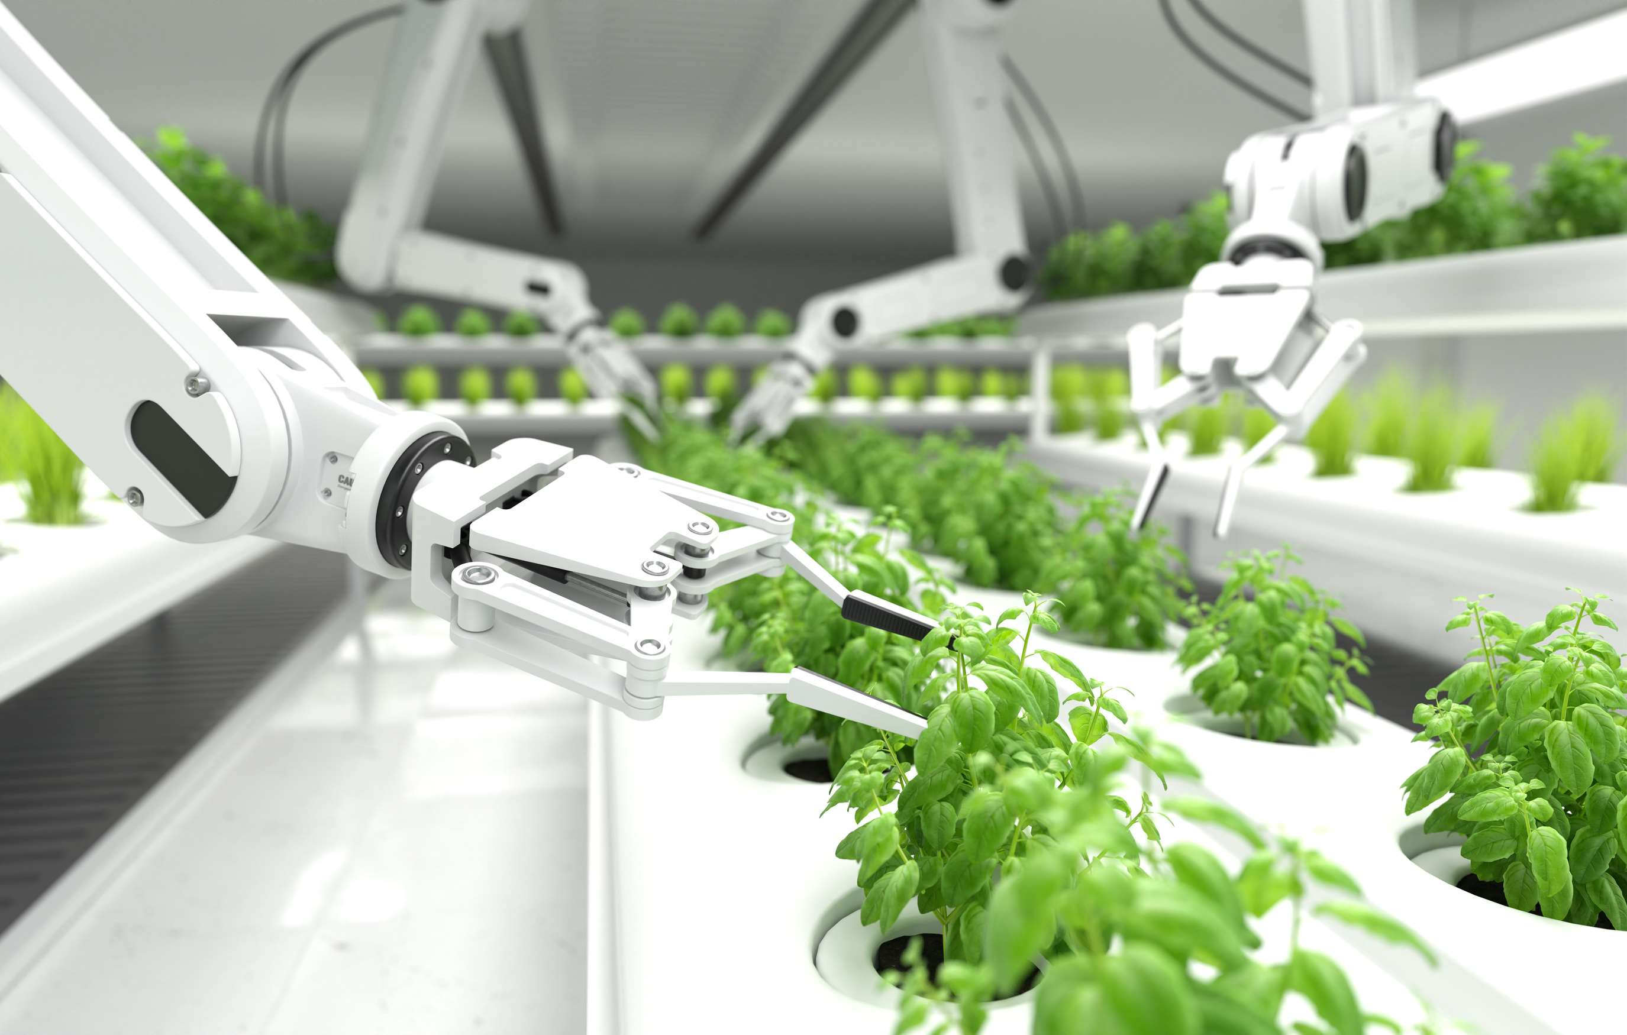

KEY INSIGHTS
MARKET SIZE
USD 13251.2 million
2023
CAGR
5.80%
2023- 2030

Slide 4
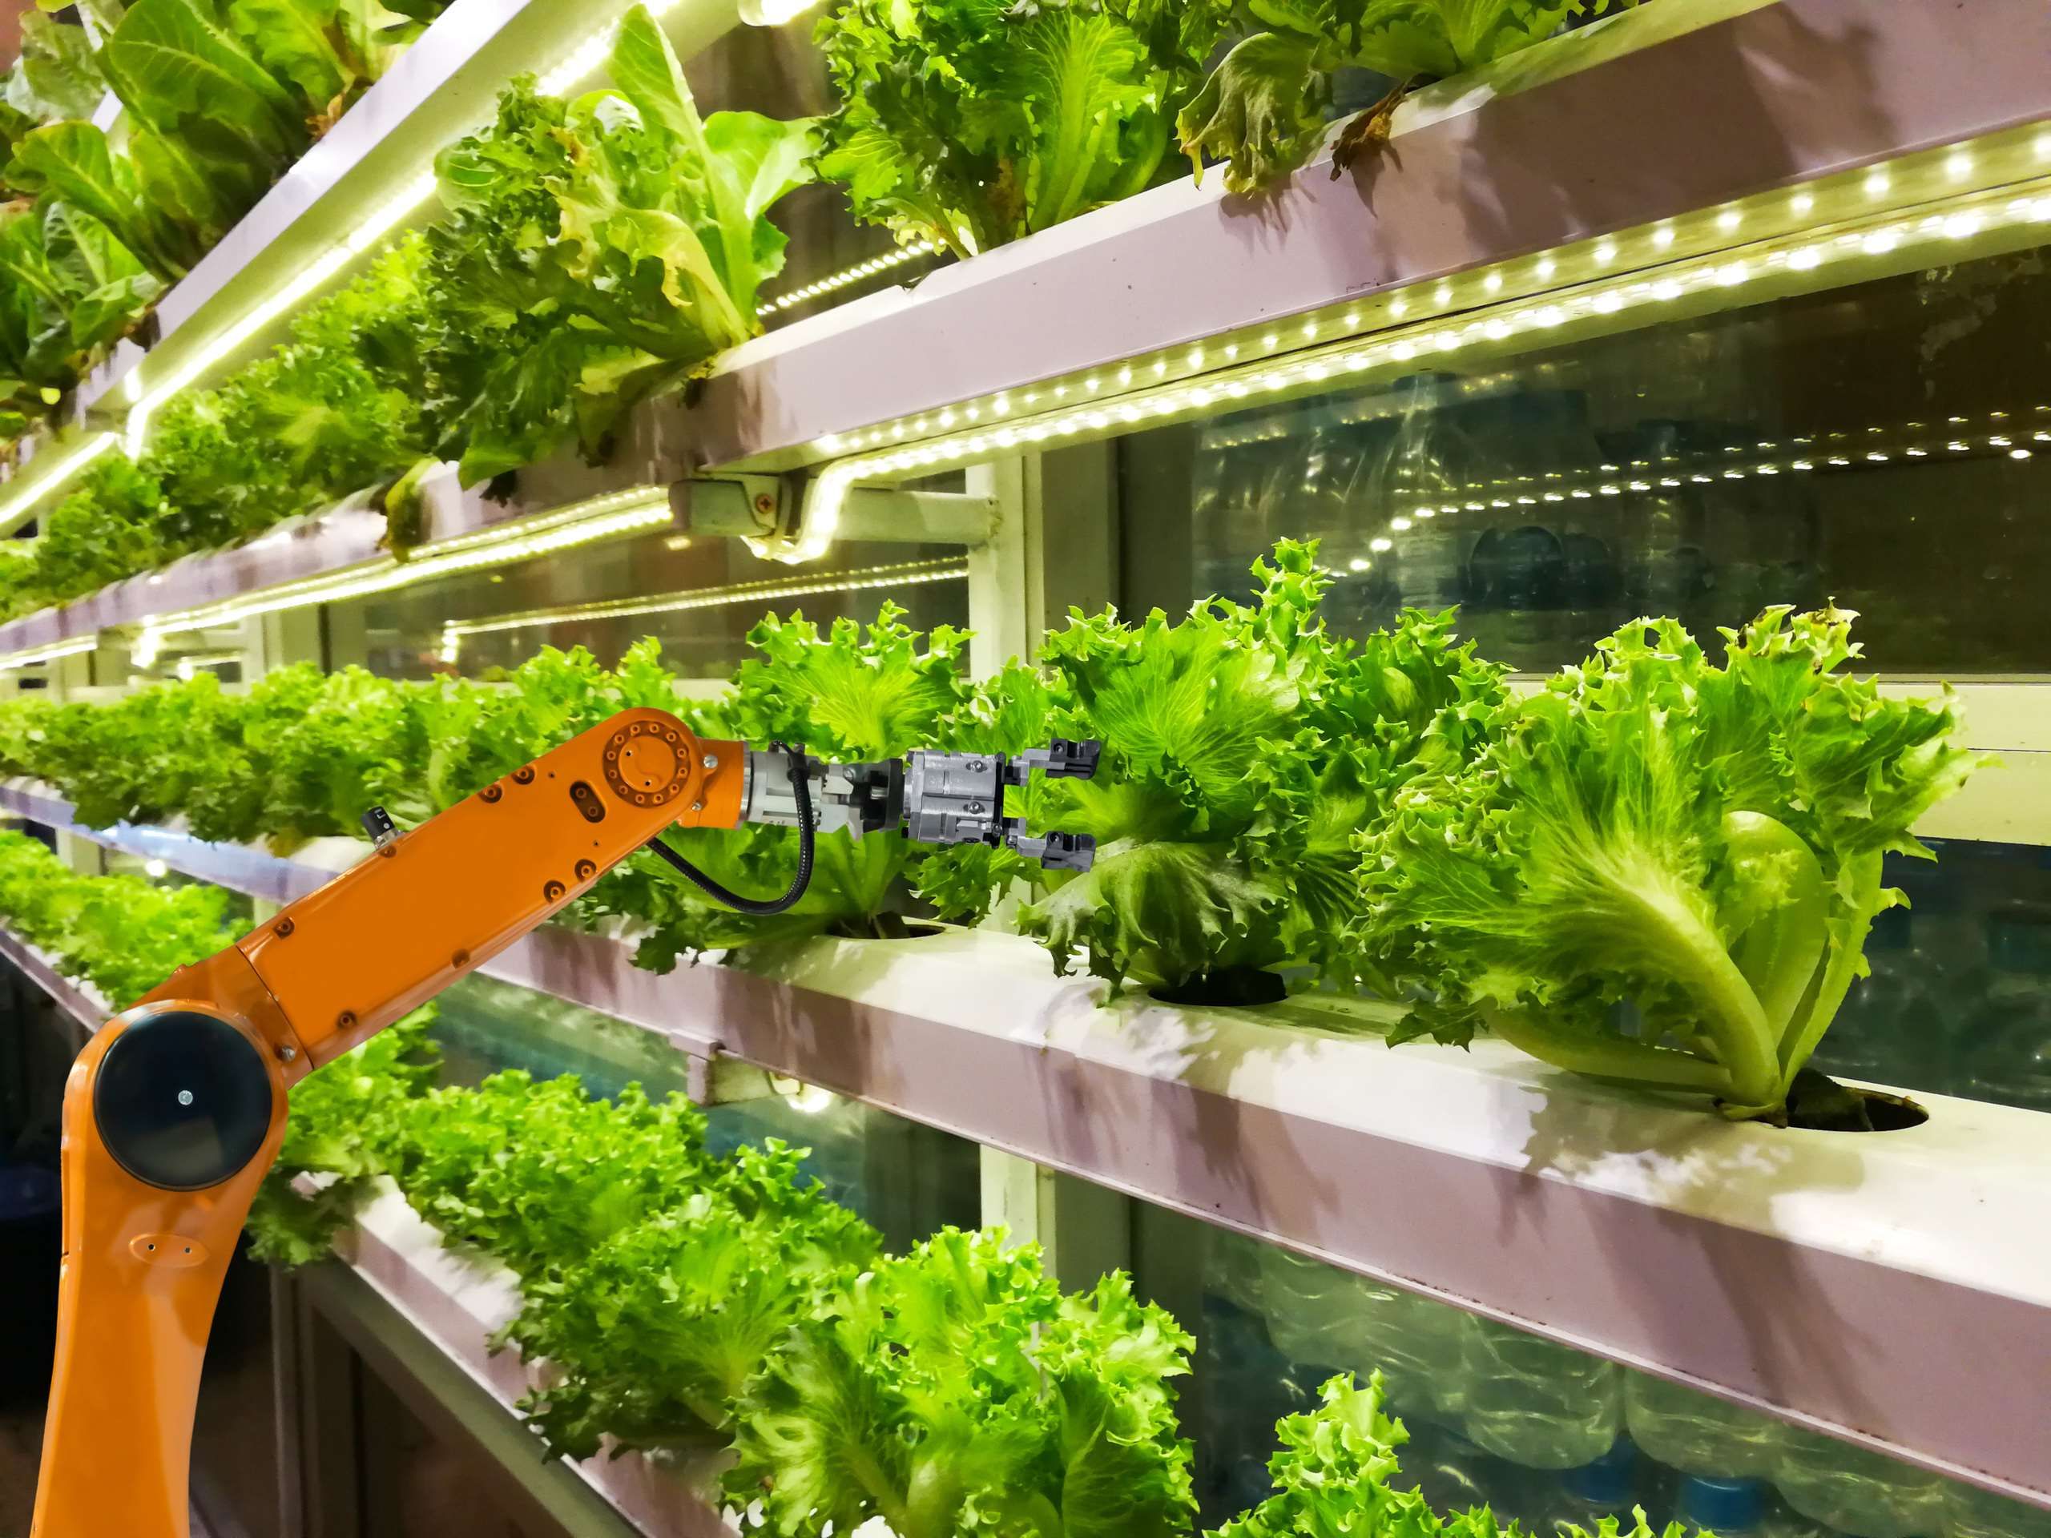
REVENUE MARKET SHARE BY SEGMENTS 2022
  Unmanned Aerial Vehicles (UAVs)
  Milking Robots
  Driverless Tractors
  Automated Harvesting Systems
  Indoor
  Outdoor
Farming Environment
Type Segment
  Harvest Management
  Field Farming
  Dairy and Livestock Management
  Irrigation Management
  Pruning Management
  Weather Tracking and Monitoring
  Inventory Management
  Hardware
  Software
  Services
Mining Method Segment
Offering Segment

Slide 5

Global Agriculture Robots Market Revenue share for 2024
North America
40%

Slide 6
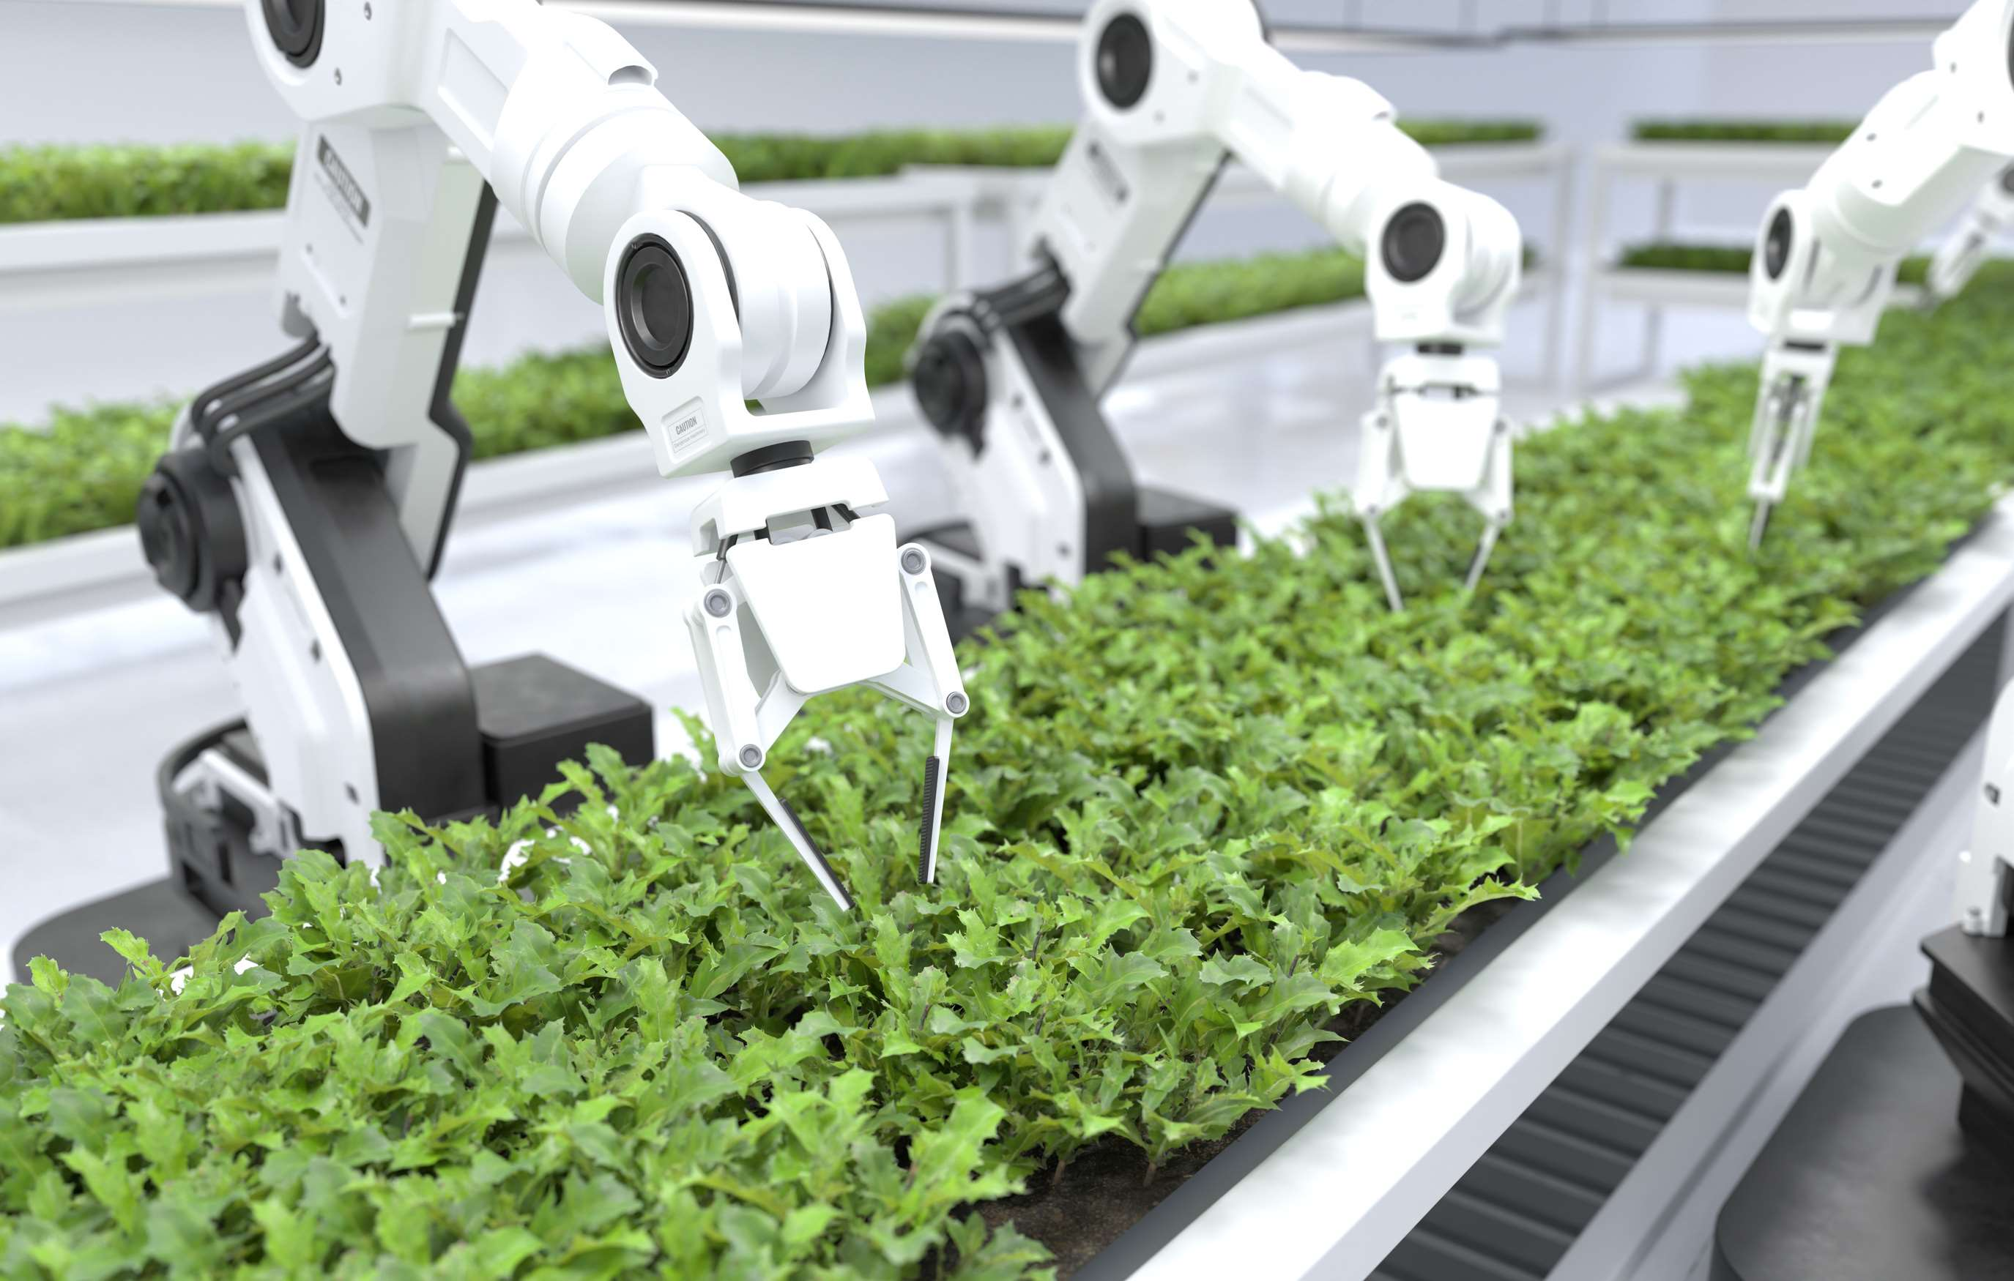
Increased Adoption of Automation Technologies to Provide Viable Market Output
Drivers
High Cost of Setup and Purchase for Agricultural Robots to Restrict Market Growth
Restraints

Slide 7
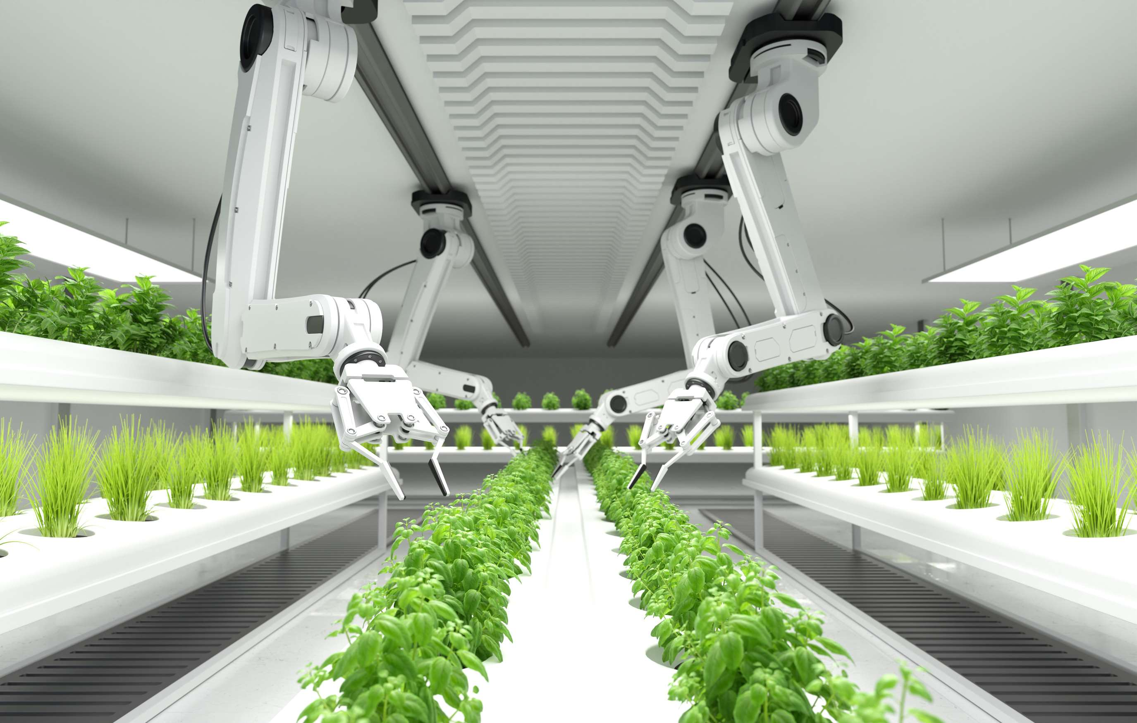
AUTHOR'S PERSPECTIVE
  The Global Agriculture Robots Market is witnessing significant growth in the near future.
  Drones, also referred to as unmanned aerial vehicles, have become very popular in the agriculture sector.
  Robots for milking provide better animal comfort, lower labor costs, and enhanced efficiency.
  The software is the fastest-growing category over the forecast period. Technological developments in artificial intelligence (AI) and machine learning (ML) are two of the main factors propelling the software segment's explosive expansion.

Slide 8





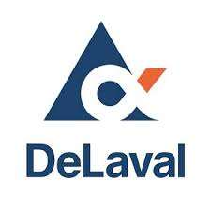
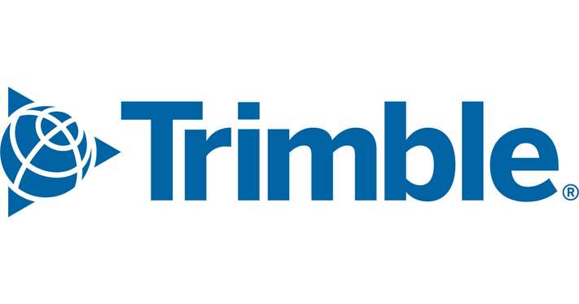

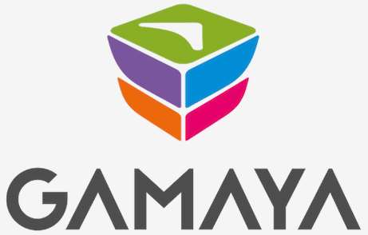

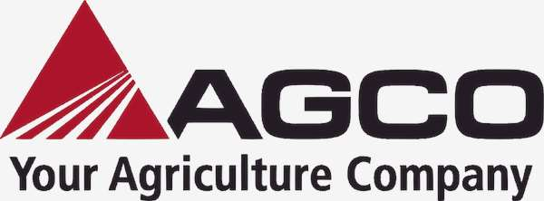
KEY PLAYERS

Slide 9


For Full Report
Contact us
COGNITIVE MARKET RESEARCH
Tel: +1 312-376-8303 | +44 020-8123-0732
India: (+91) 983-496-8611
sales@cognitivemarketresearch.com
Access the Full Report : https://tinyurl.com/3j729jpw
Please visit our website:
https://www.cognitivemarketresearch.com

