Slide 1

GLOBAL
AGRICULTURAL BIOLOGICAL
MARKET REPORT
2024
Global,Regional,CountryAnalysis

Slide 2
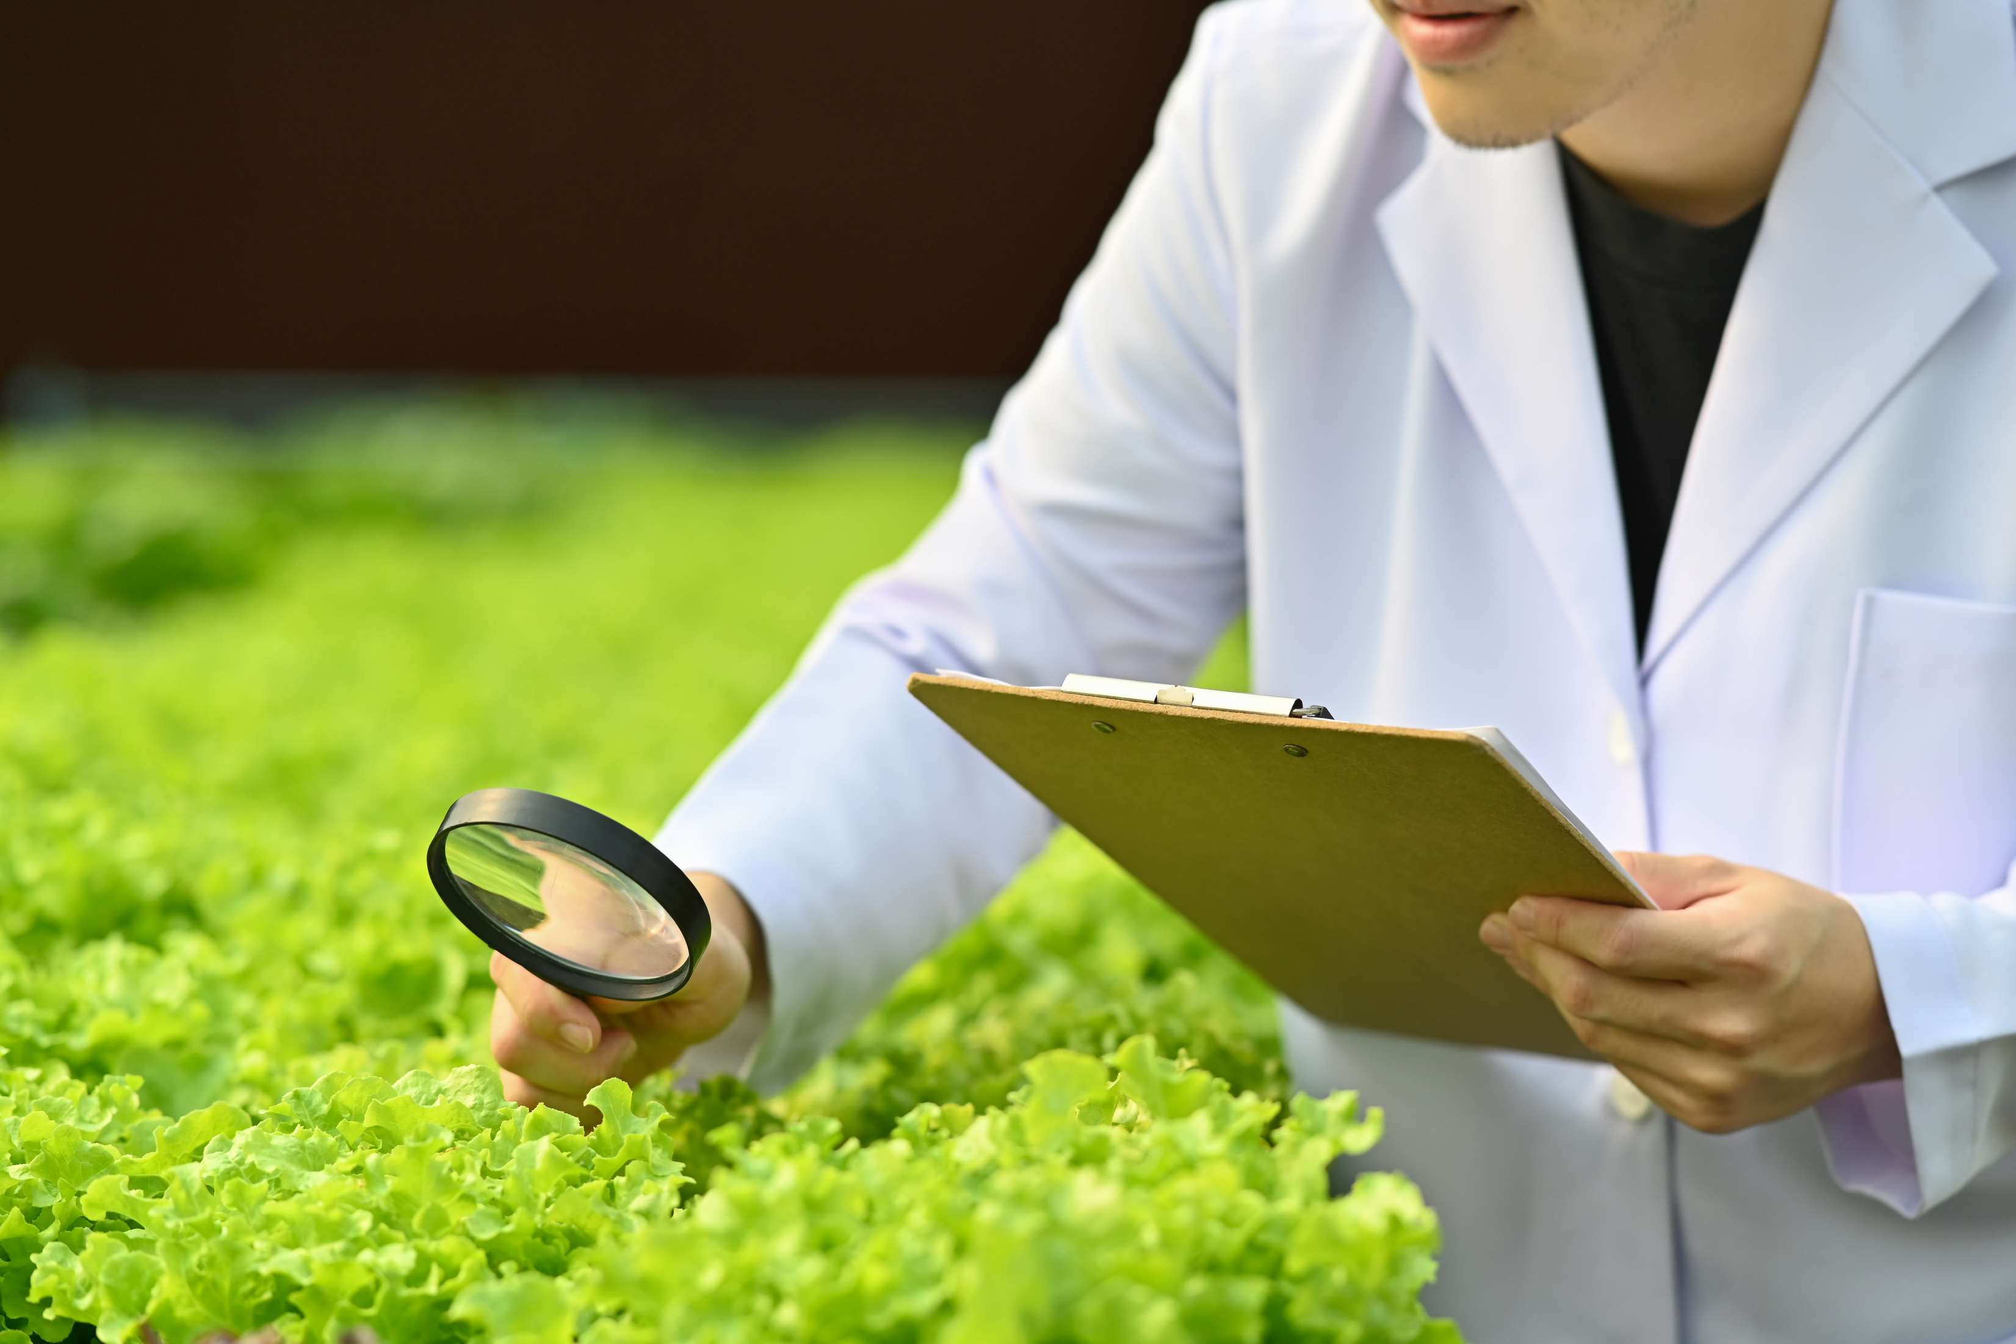
INTRODUCTION
Agricultural biological systems are organic and ecological farming approaches that use environmentally friendly fertilizers, stimulants, and pesticides together with other ecological practices. By reducing the use of synthetic and chemical fertilizers, the agricultural biological system minimizes negative environmental effects and is sustainable from an ecological and economic standpoint. The primary drivers of the growth of the worldwide agricultural biological market are the rising environmental concerns and the strict regulations imposed by the government regarding the usage of synthetic products. Furthermore, government subsidies on agricultural biological goods, regulatory support, and rising demand for bio-based agricultural products are anticipated to propel market expansion.

Slide 3


KEY INSIGHTS
MARKET SIZE
USD 15215.2 million
2023
CAGR
14.50%
2023- 2030

Slide 4
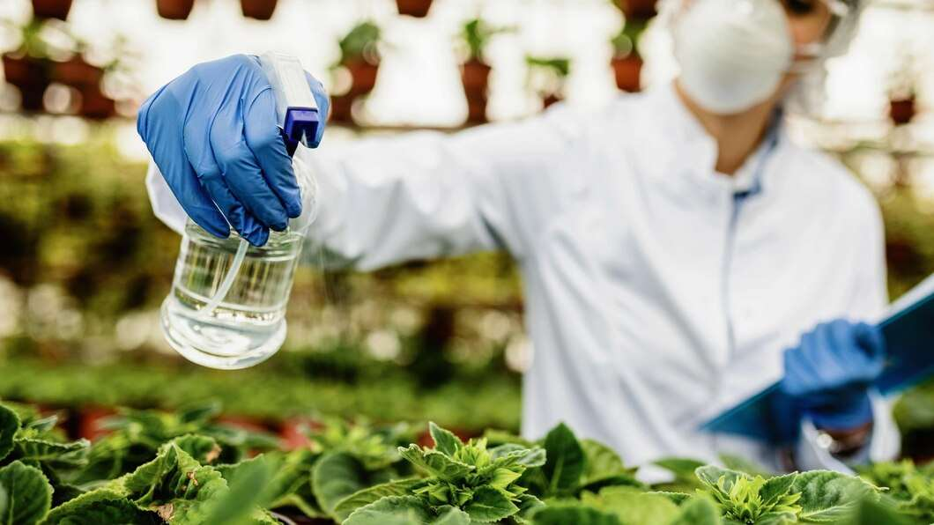
REVENUE MARKET SHARE BY SEGMENTS 2022
  Bio-Pesticides
  Bio-Stimulants
  Bio-Fertilizers
  Microbial
  Biochemical
Type Segment
Source Segment
  Fruits & Vegetables
  Cereals & Grains
  Oilseeds & Pulses
  Foliar Spray
  Soil Treatment
  Seed Treatment
Application Segment
Crop Type Segment

Slide 5

Global Agricultural Biological Market Revenue share for 2024
North America
40%

Slide 6
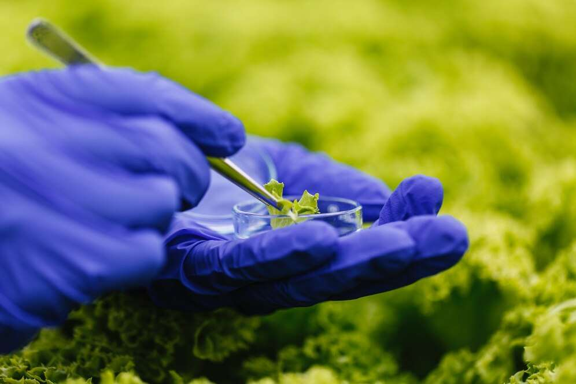
Growing Consciousness on Environmental and Health Issues to Propel Market Growth
Drivers
Low Product Shelf Life and Expensive Price to Restrict Market Growth
Restraints

Slide 7
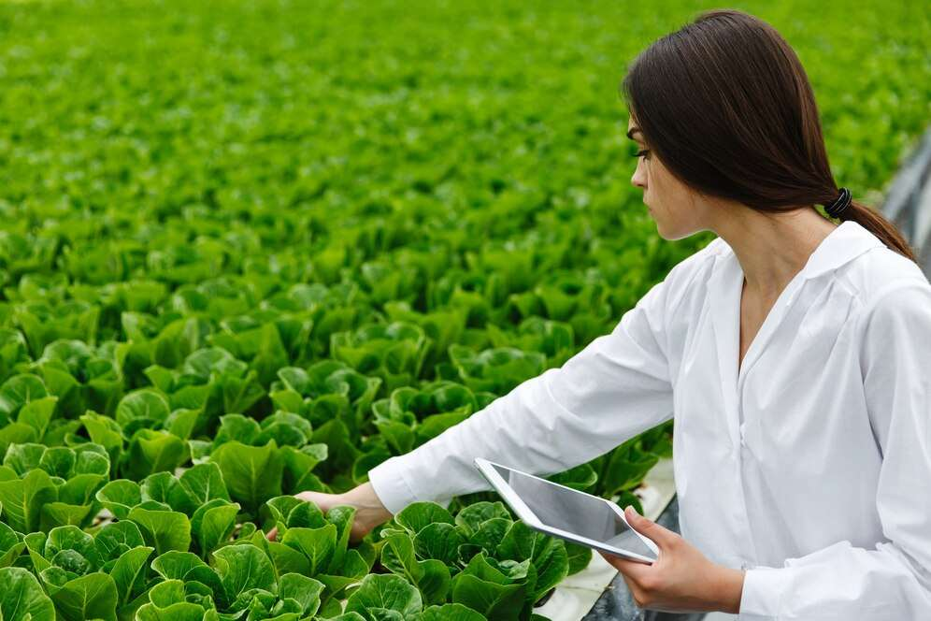
AUTHOR'S PERSPECTIVE
  The global agricultural biological market will expand significantly by 14.50% CAGR between 2023 and 2030.
  Rising environmental concerns and government laws pertaining to the use of synthetic materials are the main factors propelling the growth of the global agricultural biological market.
  Demand for microbial remains higher in the agricultural biological market.
  North American agricultural biological will continue to lead, whereas the Asia Pacific agricultural biological market will experience the most substantial growth until 2030.

Slide 8












KEY PLAYERS

Slide 9


For Full Report
Contact us
COGNITIVE MARKET RESEARCH
Tel: +1 312-376-8303 | +44 020-8123-0732
India: (+91) 983-496-8611
sales@cognitivemarketresearch.com
Access the Full Report : https://tinyurl.com/2s43uwpp
Please visit our website:
https://www.cognitivemarketresearch.com

