Slide 1

GLOBAL
AEROSPACE TITANIUM BLISK
MARKET REPORT 2024
Global,Regional,CountryAnalysis

Slide 2

INTRODUCTION
A blisk is a turbomachine component that includes the rotor disc as well as the blades. It is an important part of the engine compressor because it allows a sufficient amount of compressed air to reach the engine for combustion. Blisks offer greater aerodynamics and are lighter than standard single-bladed rotors.

Slide 3
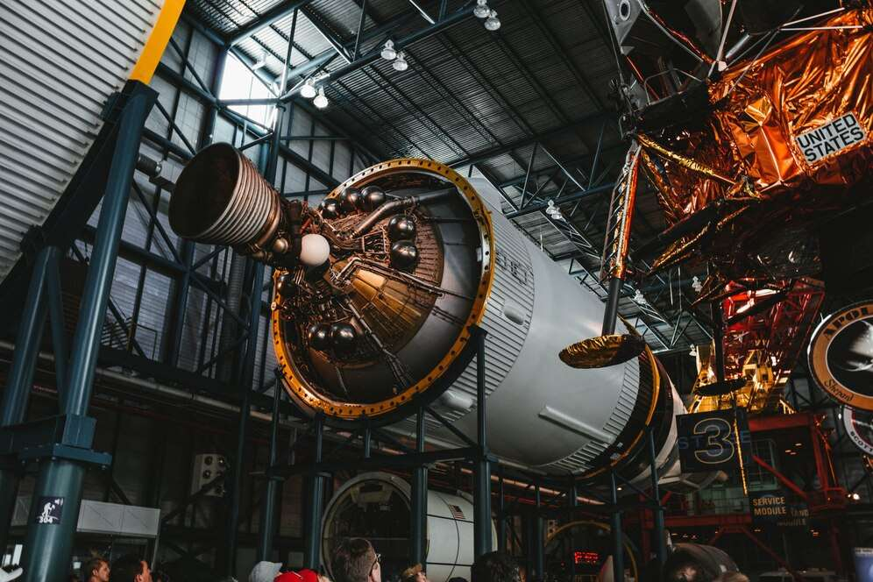

KEY INSIGHTS
MARKET SIZE
$17,716.37 Million
2029

Slide 4
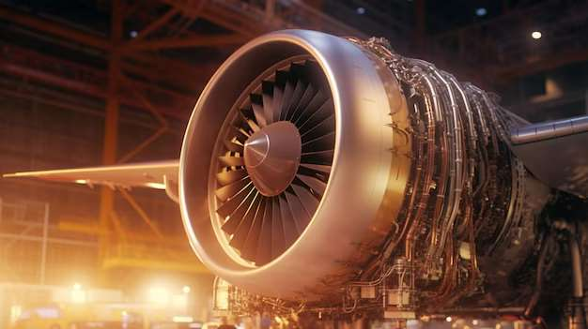
REVENUE MARKET SHARE BY SEGMENTS 2022
By Type
Less than 70 cm
USD 2,842.27 Million
By Application
Military & Homeland Security
USD 1,993.85 Million

Slide 5

Global Aerospace Titanium Blisk Market Revenue share for 2022
Asia Pacific
USD 2,111.27 Million

Slide 6
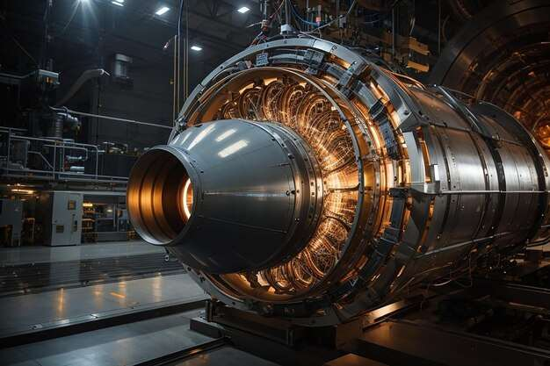
  Rise in demand for commercial aircraft
  Benefits associated with the usage of titanium
Drivers
Availability of substitute products
Restraints

Slide 7

AUTHOR'S PERSPECTIVE
  The Global Aerospace Titanium Blisk Market revenue in 2017: USD 4,082.04 Million
  Less than 70 cm held for largest share of total revenue generated in 2020
  Commercial held maximum share of Aerospace Titanium Blisk market in 2020
  Rise in demand for commercial aircraft and benefits associated with the usage of titanium stimulated the growth of the aerospace titanium blisk market
  Availability of substitute products can hinder the growth of the aerospace titanium blisk market
  Rising usage of military aircraft expected to provide enormous growth opportunities for the growth of the aerospace titanium blisk market

Slide 8

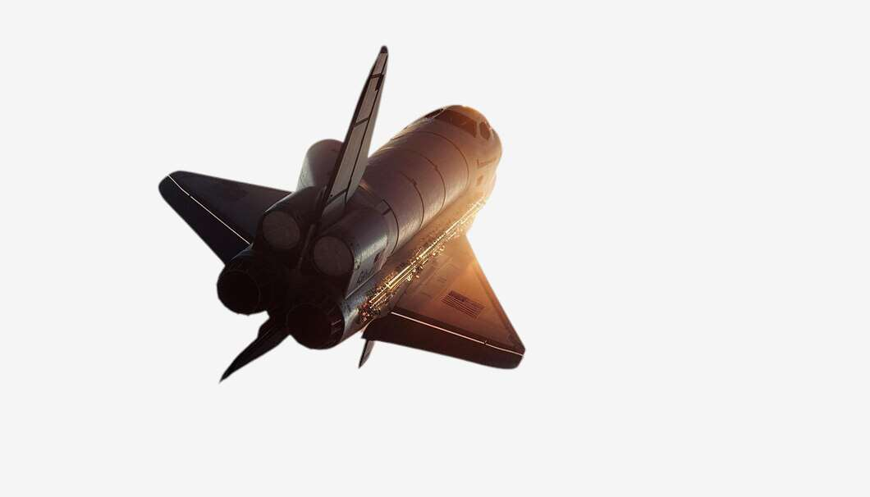






KEY PLAYERS

Slide 9


For Full Report
Contact us
COGNITIVE MARKET RESEARCH
Tel: +1 312-376-8303 | +44 020-8123-0732
India: (+91) 983-496-8611
sales@cognitivemarketresearch.com
Access the Full Report : https://tinyurl.com/wmkz4utu
Please visit our website:
https://www.cognitivemarketresearch.com

