Slide 1
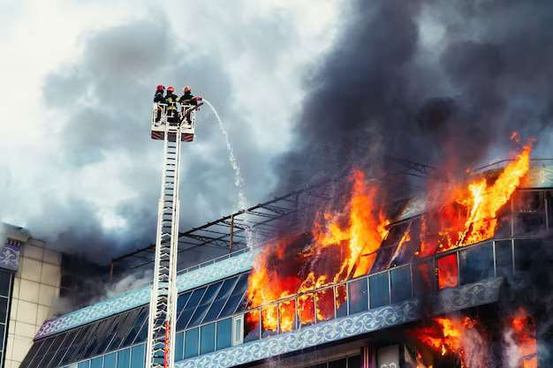
GLOBAL
AERIAL FIREFIGHTING
MARKET REPORT 2024
Global,Regional,CountryAnalysis

Slide 2
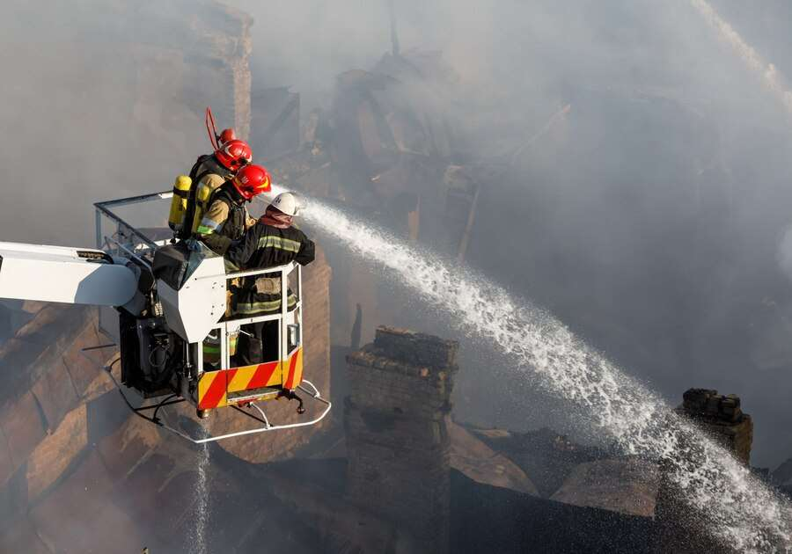
INTRODUCTION
Aerial firefighting is the employment of airplanes and other aerial resources to tackle fires. Aerial firefighting assists in the control of wildfires by continually delivering enormous amounts of water and fire-fighting solutions to the fire's hot spot. To keep a fire from spreading, it employs water, water enhancers like foams and gels, and specially manufactured fire retardants like Phos-Chek.

Slide 3
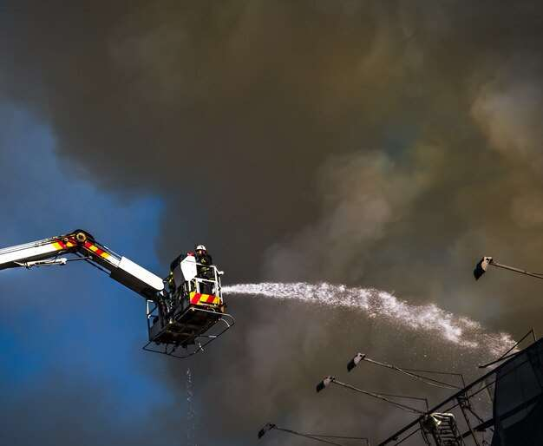

KEY INSIGHTS
MARKET SIZE
USD8,372.03 Million
2017
FORECAAST
$12,076.44 Million
2029
CAGR
5.56%
2023- 2030

Slide 4
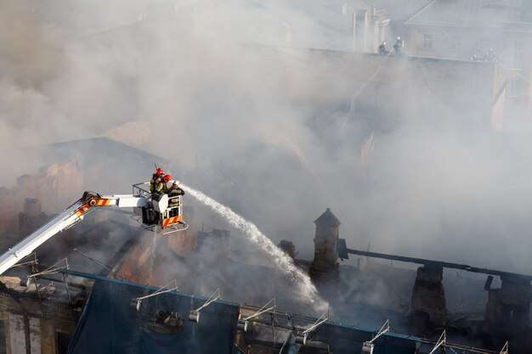
REVENUE MARKET SHARE BY SEGMENTS 2022
Type segment
Firefighting Organizations
USD 9,583.81 Million
Application analysis
Multi-Rotor
USD 4,609.12 Million

Slide 5

Global Aerial Firefighting Market Revenue share for 2022
North America
USD 2,112.22 Million

Slide 6
Increase in fire-related incidents
Drivers
High cost associated with aerial firefighting
Restraints

Slide 7
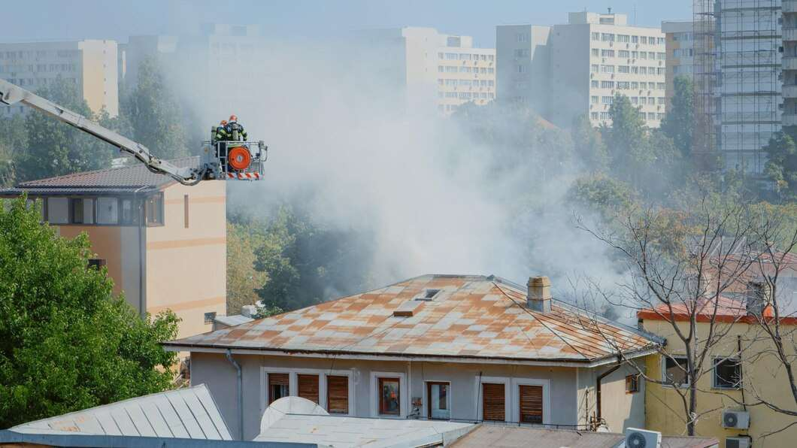
AUTHOR'S PERSPECTIVE
  The Global Aerial Firefighting Market revenue in 2017: USD 8,372.03 Million
  Firefighting Organizations held for largest share of total revenue generated in 2020
  Fixed Wing held maximum share of Aerial Firefighting market in 2020
  Increase in fire-related incidents and rising usage of aircraft in firefighting are driving the growth of the aerial firefighting market
  High-cost associated with aerial firefighting can hamper the growth of the aerial firefighting market
  Availability of technologically advanced aerial firefighting will provide enormous growth opportunities for the growth of the aerial firefighting market

Slide 8










KEY PLAYERS

Slide 9


For Full Report
Contact us
COGNITIVE MARKET RESEARCH
Tel: +1 312-376-8303 | +44 020-8123-0732
India: (+91) 983-496-8611
sales@cognitivemarketresearch.com
Access the Full Report : https://tinyurl.com/yztjethf
Please visit our website:
https://www.cognitivemarketresearch.com

