Slide 1

GLOBAL
AR AND VR SOFTWARE
MARKET REPORT 2024
Global,Regional,CountryAnalysis

Slide 2

INTRODUCTION
Augmented Reality software is an amplifying and interactive version of the real-world surrounding which is received through digital visual elements, and other sensory stimuli through holographic technology. Virtual Reality is a mesmeric experience that may need a headset to replace the users surrounding view completely with stimulated, mesmeric, and interactive virtual surroundings. AR users control their existence in the environment and VR users are dominated by the system. AR enhances both the real and virtual world while VR enhances only the fictional world.

Slide 3


KEY INSIGHTS
MARKET SIZE
USD 33.25 Billion
2022
MARKET SIZE
USD 242.02 Billion
2030
CAGR
28.2%
2023- 2030

Slide 4
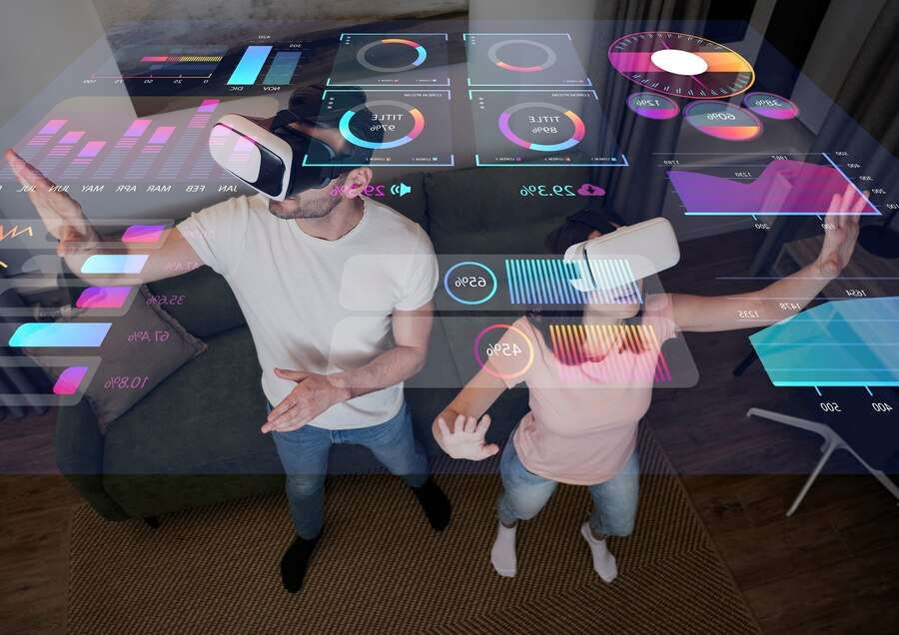
REVENUE MARKET SHARE BY SEGMENTS 2022
Technology Segment
  AR Technology
  VR Technology
  Consumer
  Commercial
  Enterprise
  Healthcare
Application segment
  Small Enterprise
  Medium Enterprise
  Large Enterprise
Software Enterprise

Slide 5
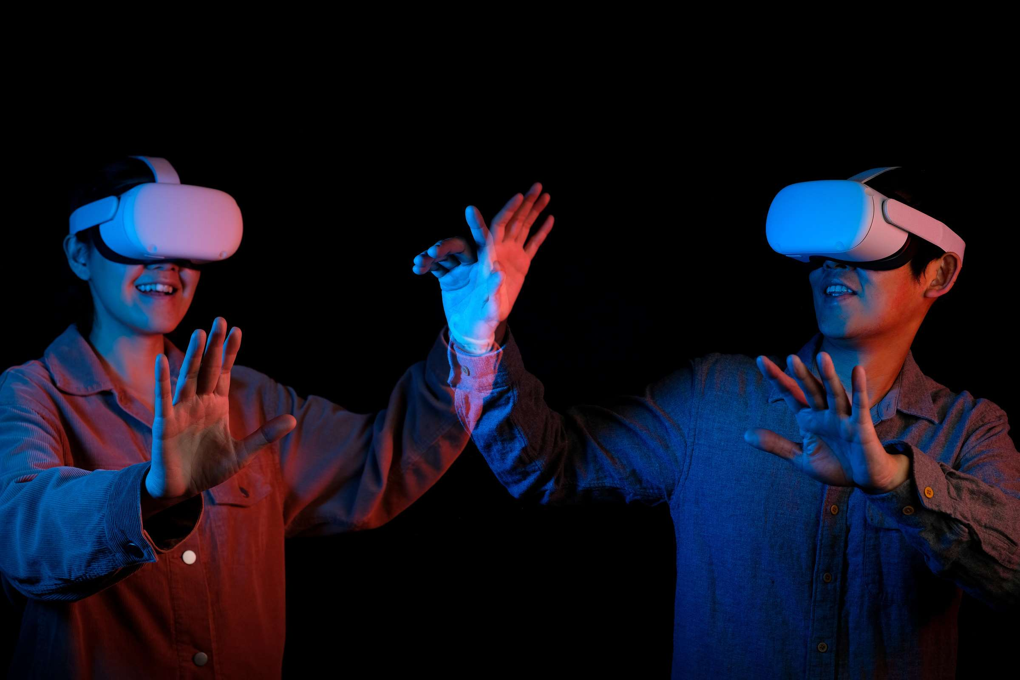

Global AR and VR Software Market Revenue share for 2022
Asia Pacific

Slide 6

  Increasing demand for Augmented Reality in E-commerce is fuelling the growth of the AR Software Market.
  Increasing demand for Virtual Reality in many industries is fuelling the growth of Virtual Reality Software Market
Drivers

Slide 7

AUTHOR'S PERSPECTIVE
  The Global AR and VR Software Market is witnessing significant growth in the near future.
  Smartphones, tablets, and other advanced electronic handheld gadgets are likely to contribute to the hardware segment's growth as developers incorporate VR-based capabilities into additional devices.
  Furthermore, because it may be utilized in training, simulation, building virtual tools, VR applications, VR game development, learning experience platforms, and segment reality, the segment is in high demand.
  In 2023, the AR Technology segment accounted for noticeable share of global AR and VR Software Market and is projected to experience significant growth in the near future.
  The Consumer segment is expected to expand at the significant CAGR retaining position throughout the forecast period.

Slide 8
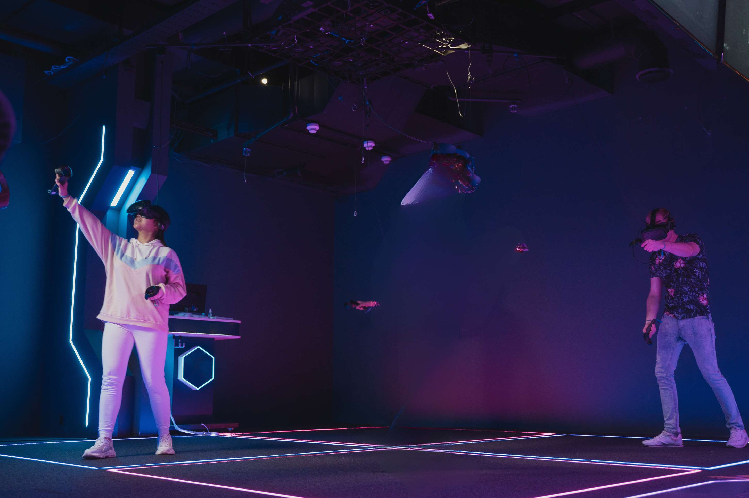














KEY PLAYERS

Slide 9


For Full Report
Contact us
COGNITIVE MARKET RESEARCH
Tel: +1 312-376-8303 | +44 020-8123-0732
India: (+91) 983-496-8611
sales@cognitivemarketresearch.com
Access the Full Report : http://tinyurl.com/uj8wdxnw
Please visit our website:
https://www.cognitivemarketresearch.com

