Slide 1

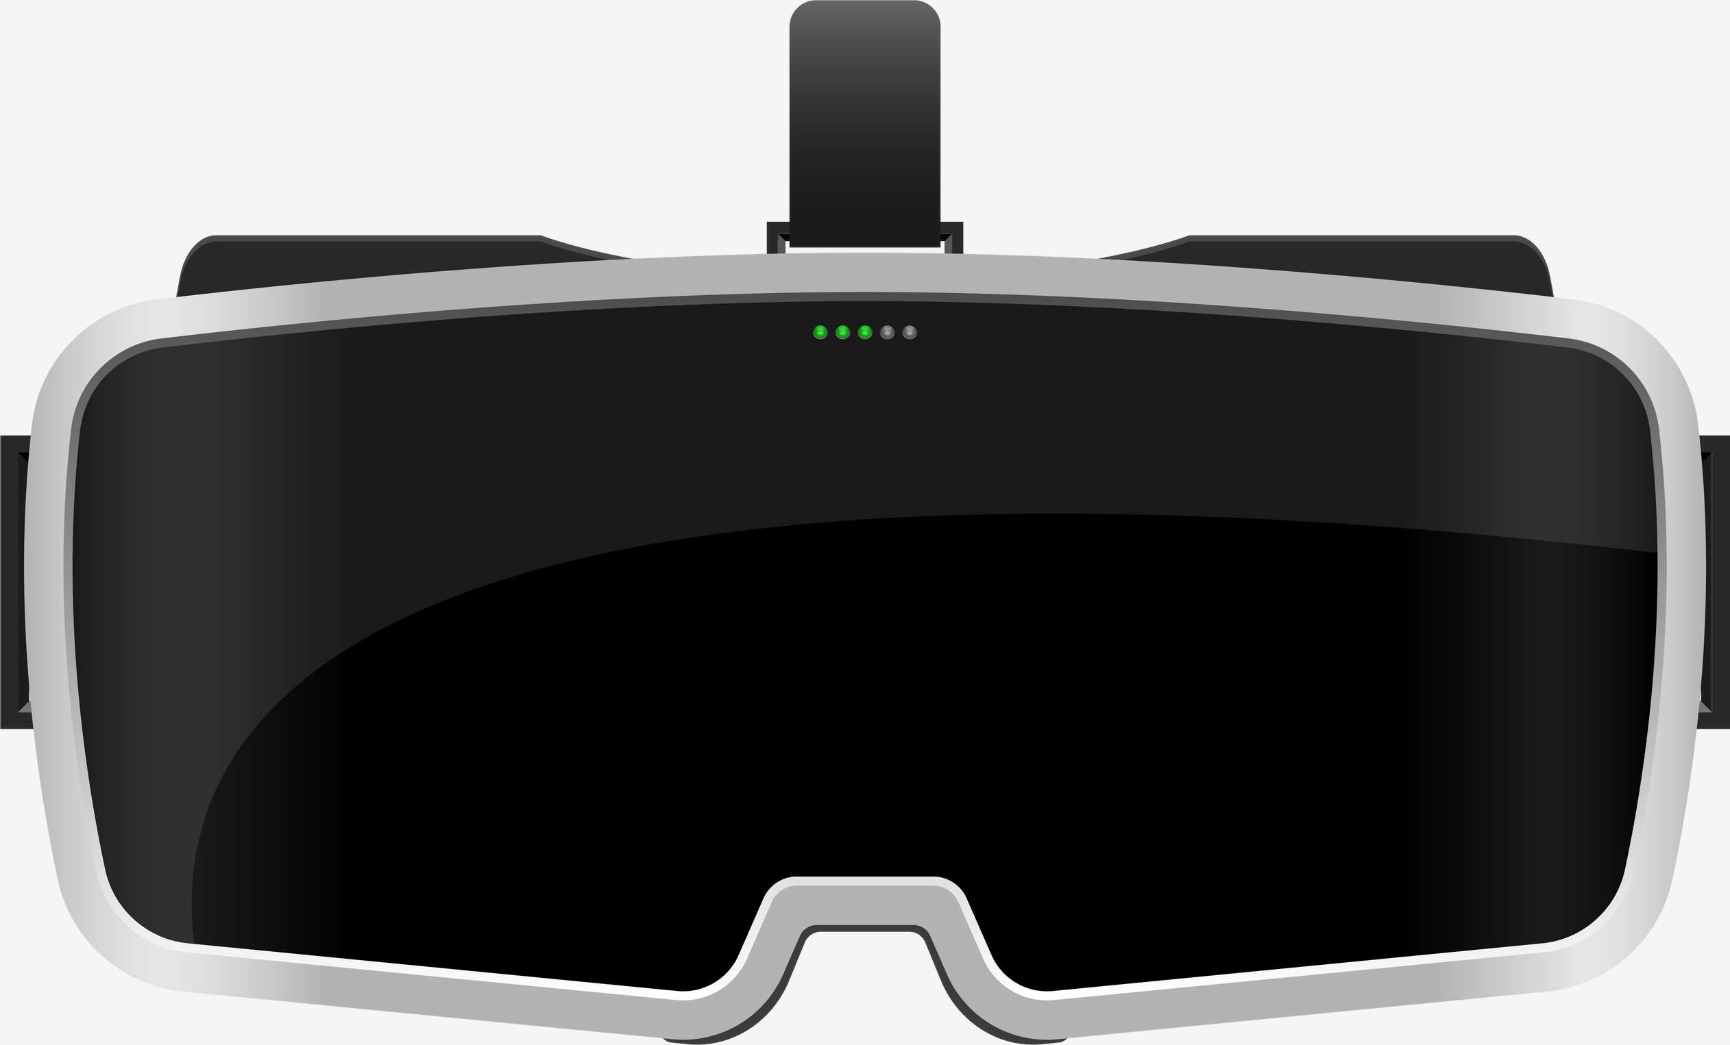

AR AND VR IN AVIATION MARKET REPORT

Slide 2


INTRODUCTION
AR and VR can aid in the visualization and interaction with aircraft parts by simulating the complex aircraft mechanisms used during the design phase.

Slide 3


KEY INSIGHTS
2022
2030
2023-2023
MARKET SIZE
$1.48 Bn
FORECAST
$30.90 Bn
CAGR
46.2%

Slide 4
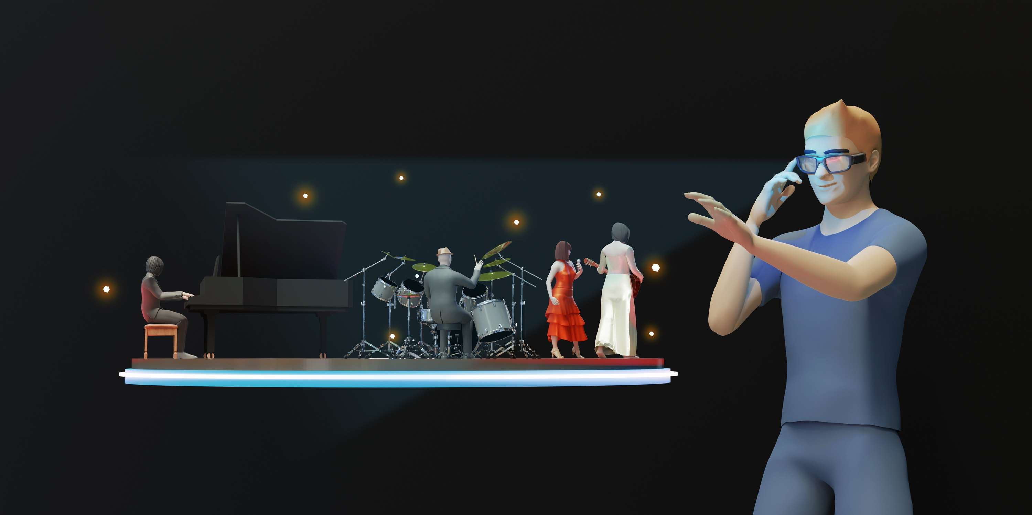
REVENUE MARKET SHARE BY SEGMENTS 2022
Technology
Marker:
63.14%
Type
Augmented Reality:
62.01%

Slide 5
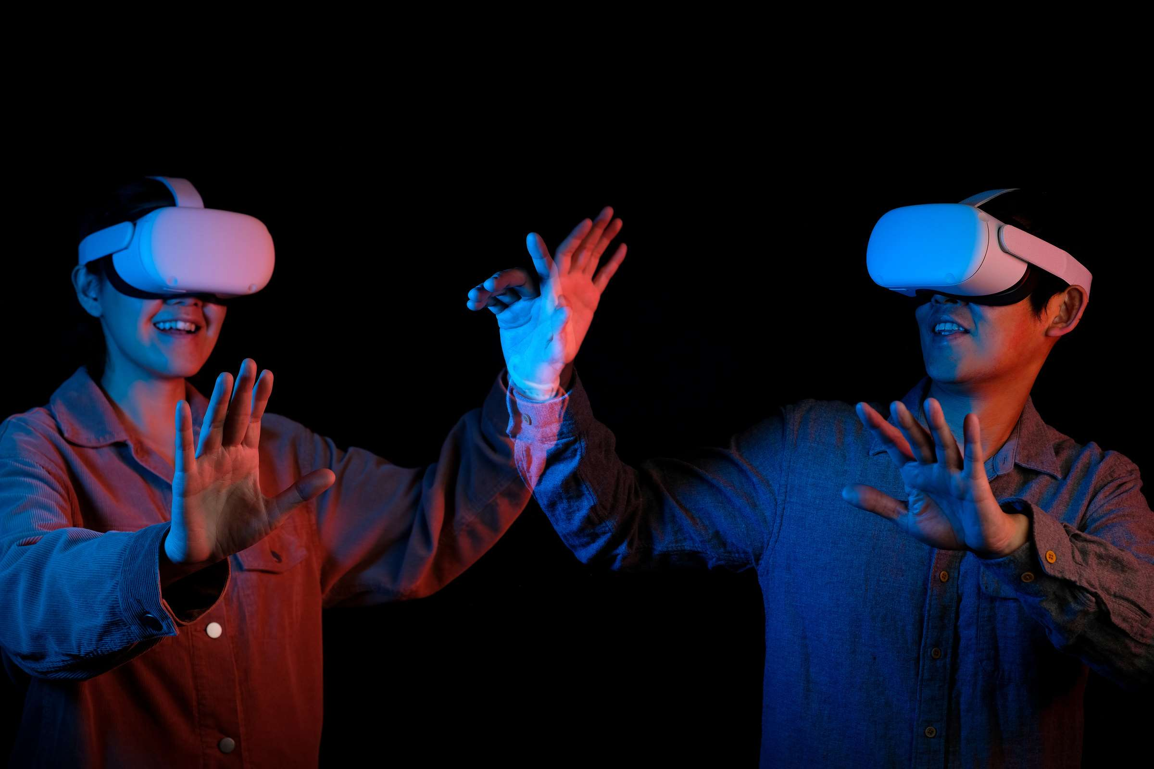

GLOBAL AR AND VR IN AVIATION MARKET REVENUE SHARE FOR 2022
ASIA PACIFIC FASTEST GROWING

Slide 6
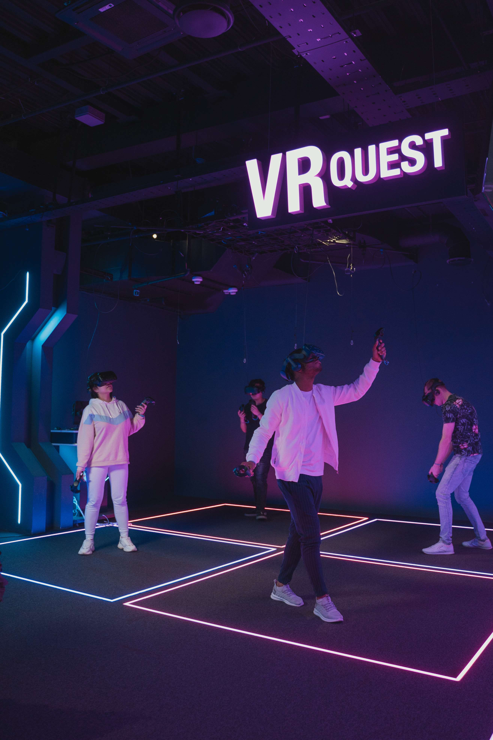
Drivers
Increasing adoption of AR and VR technologies for training purposes
RESTRAINTS
Increasing incidence of data breaches and cyber-attacks

Slide 7


AUTHOR'S PERSPECTIVE
  Technologies such as AR and VR are game changers for the aviation industry.
  They enhance customer experience, are cost-effective, save time, leave little room for error, and can provide the aviation industry with a much safer environment to learn, undertake maintenance, and support many other opportunities.

Slide 8







KEY PLAYERS

Slide 9


For Full Report
Contact us
COGNITIVE MARKET RESEARCH
Tel: +1 312-376-8303 | +44 020-8123-0732
India: (+91) 983-496-8611
sales@cognitivemarketresearch.com
Access the Full Report : https://shorturl.at/beqvW
Please visit our website:
https://www.cognitivemarketresearch.com

