Slide 1

GLOBAL
AI IN SPORTS
MARKET REPORT 2024
Global,Regional,CountryAnalysis

Slide 2
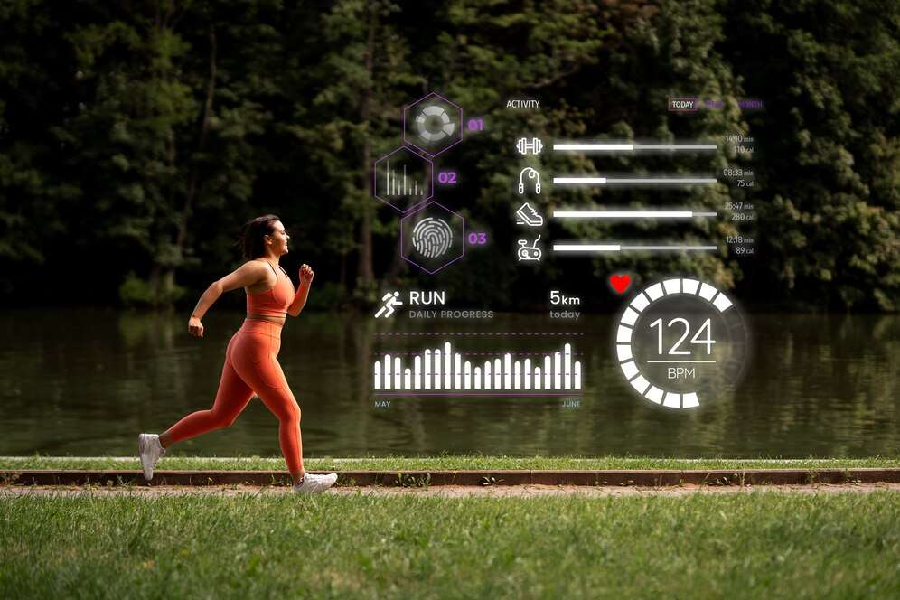
INTRODUCTION
Vertical farming is the way of growing crop in vertically stacked layers. It controlled-environment agriculture, to optimize plant growth, and soilless farming techniques such as aquaponics, hydroponics, and aeroponics. Some common choices of structures to house vertical farming systems include shipping containers, buildings, tunnels, and Others. The major advantage of utilizing vertical farming technologies is the increased crop yield that comes with a smaller unit area of land requirement.

Slide 3


KEY INSIGHTS
MARKET SIZE
$ 2.1 Billion
2023
CAGR
30.1%
2023- 2030

Slide 4

REVENUE MARKET SHARE BY SEGMENTS 2022
By Component
  Software
  Service
  Game Planning
  Game Strategies
  Performance Improvement
By Application
  Football
  Cricket
  Tennis
  Basketball
Type Segment

Slide 5


Global AI in Sports Market Revenue share for 2022
North America

Slide 6

Increase in Demand for Monitoring and Tracking Data of Players to Provide Viable Market Output
Drivers
High Cost of Implementation to Hinder Market Growth
Restraints

Slide 7

AUTHOR'S PERSPECTIVE
  The Global AI in Sports Market is witnessing significant growth in the near future.
  In 2023, the Software segment accounted for noticeable share of global AI in Sports Market and is projected to experience significant growth in the near future.
  The Game Planning segment is expected to expand at the significant CAGR retaining position throughout the forecast period.

Slide 8









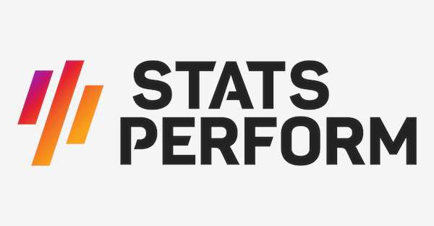


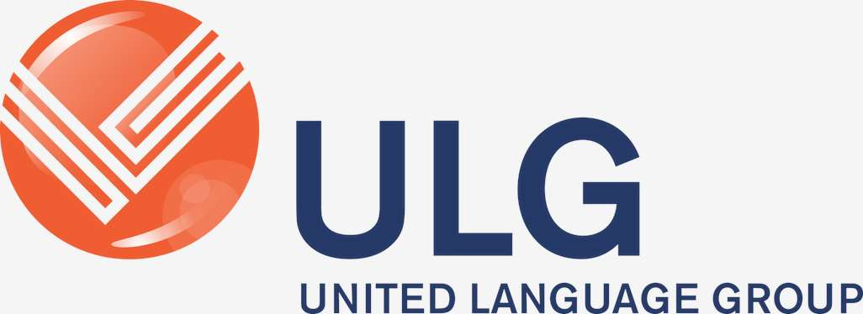
KEY PLAYERS

Slide 9


For Full Report
Contact us
COGNITIVE MARKET RESEARCH
Tel: +1 312-376-8303 | +44 020-8123-0732
India: (+91) 983-496-8611
sales@cognitivemarketresearch.com
Access the Full Report : https://tinyurl.com/4zkru3ap
Please visit our website:
https://www.cognitivemarketresearch.com

