Slide 1

GLOBAL
AI IN MENTAL HEALTH
MARKET REPORT
2024
Global,Regional,CountryAnalysis

Slide 2
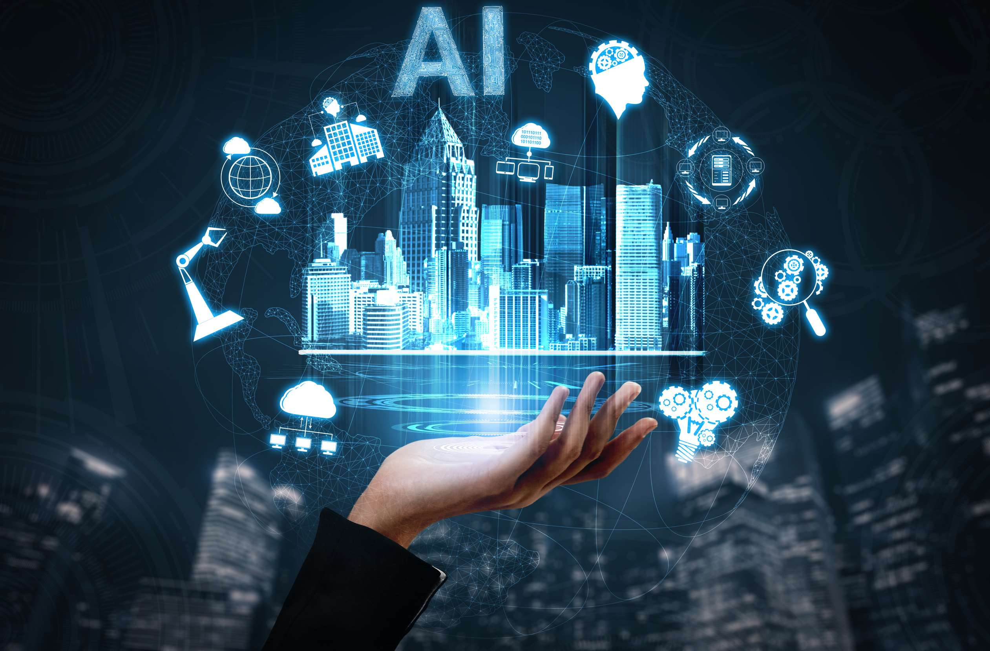
INTRODUCTION
A mental disorder is a medical condition that disturbs a person’s thinking, fexeling, interest, mood, and ability for performing daily activities. Several factors such as trauma or a history of abuse, injury, genetic disorder (biological factors), physical illness, use of alcohol or drugs, generic disorder, and chemical imbalances in the brain are some of the major factors contributing to the development of mental illness.

Slide 3


KEY INSIGHTS
MARKET SIZE
$ 910.6 Mn
2022
FORECAST
$11,371.0 Mn
2030
2023-
2030
CAGR
37.20%

Slide 4

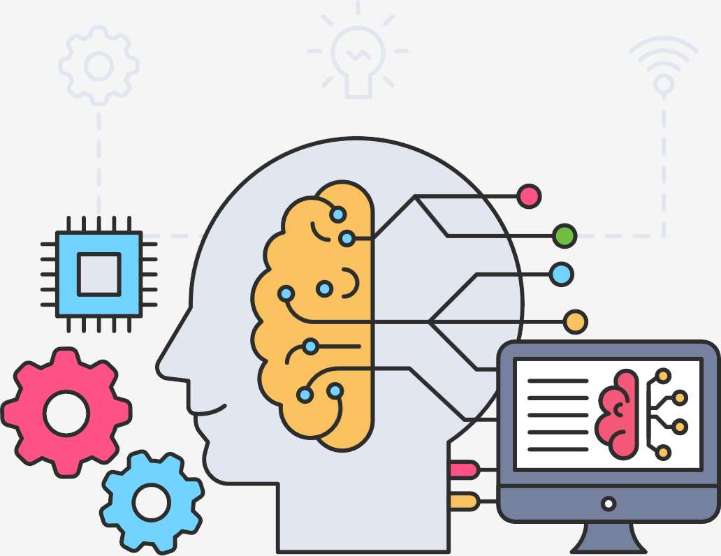
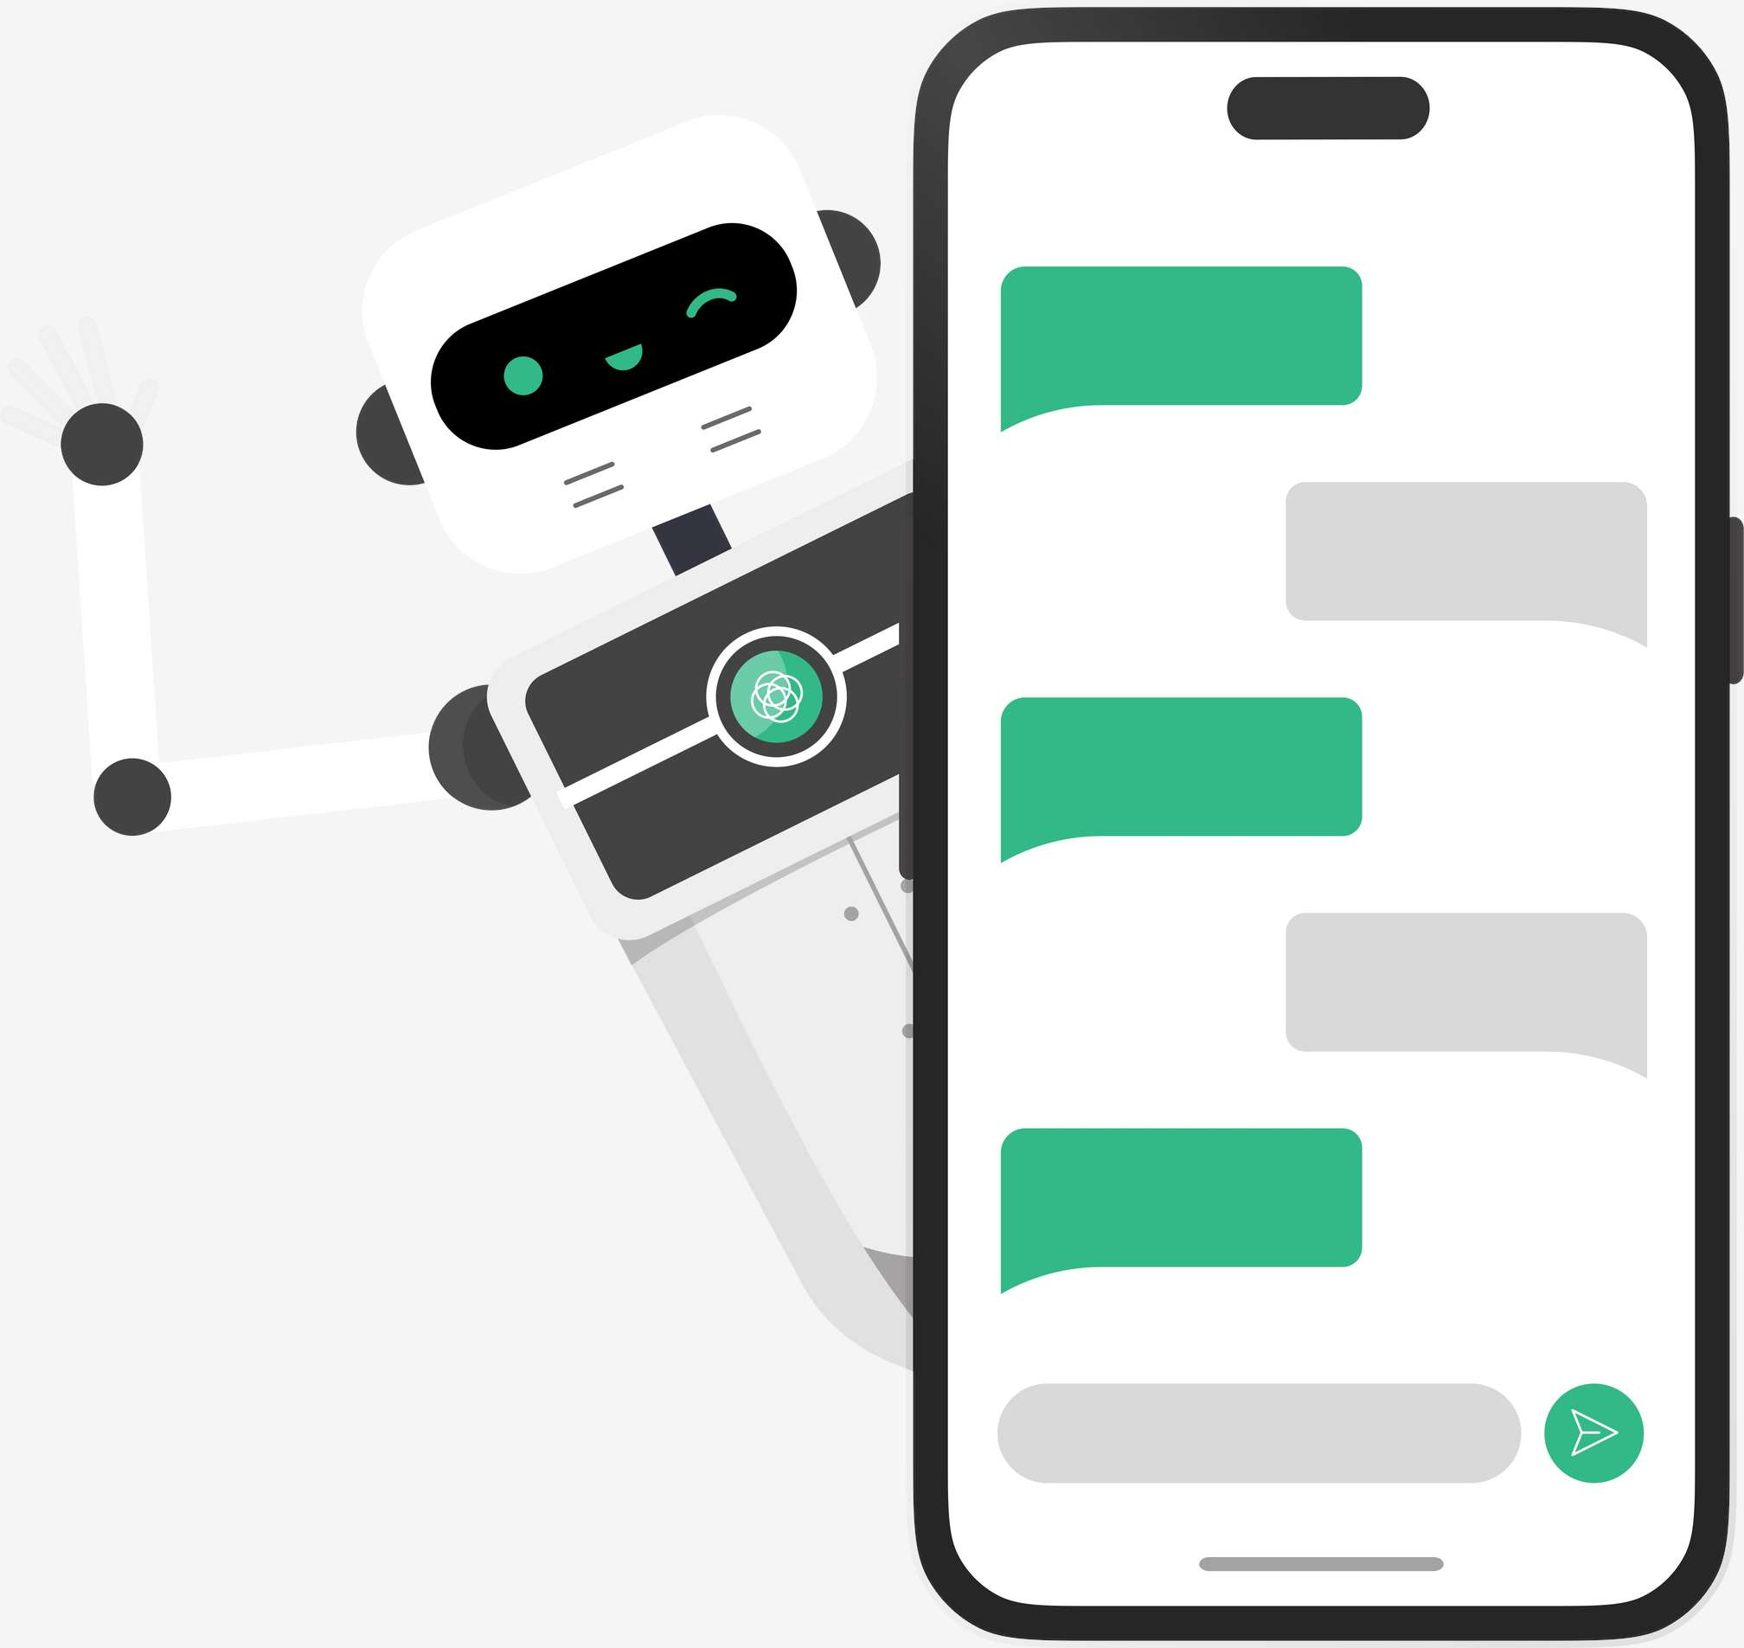
REVENUE MARKET SHARE BY SEGMENTS 2022
TECHNOLOGY
Machine Learning and Deep Learning- 64.3%
APPLICATION
Conversational Interfaces -71.8%

Slide 5
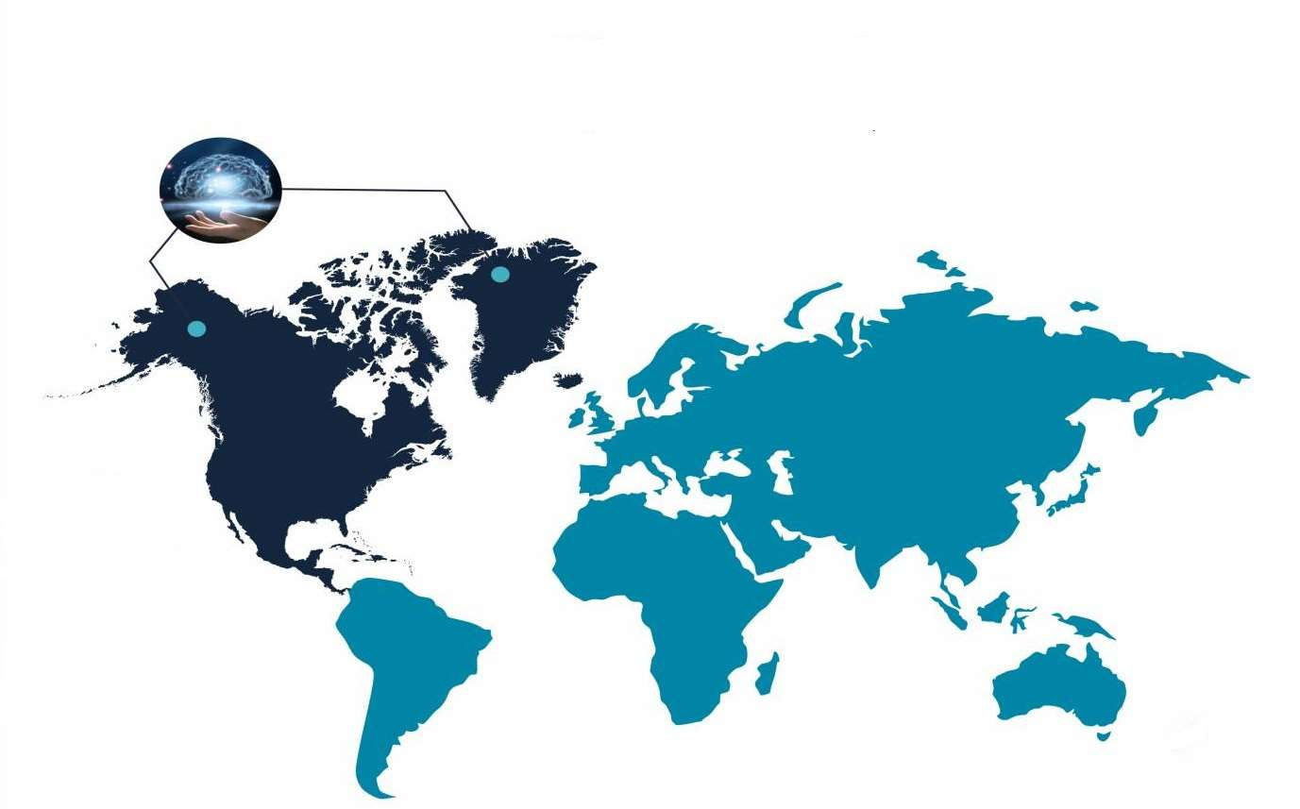
GLOBAL AI IN MENTAL HEALTH MARKET REVENUE SHARE FOR 2022
North America-
58.3%

Slide 6

DRIVERS
RESTRAINTS
Growing adoption of AI to detect mental illness and symptoms
Data privacy and regulatory issues

Slide 7

Author's Perspective
  Limited acceptance from healthcare professionals due to the risk of injury and misinterpretation hinder the growth of global AI in the mental healthcare market.
  However, the increase in technological advancements coupled with the rise in the need for innovative solutions to enhance clinical and operational outcomes will proliferate the market growth.

Slide 8


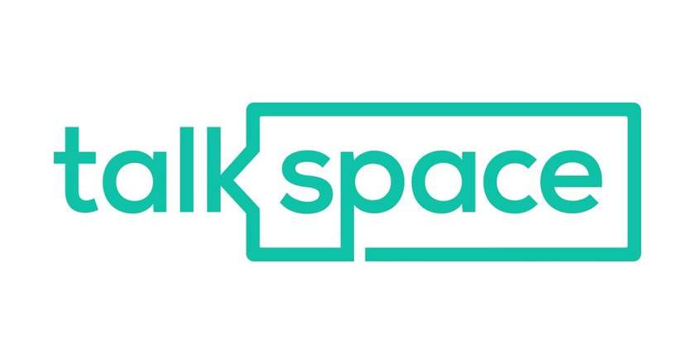



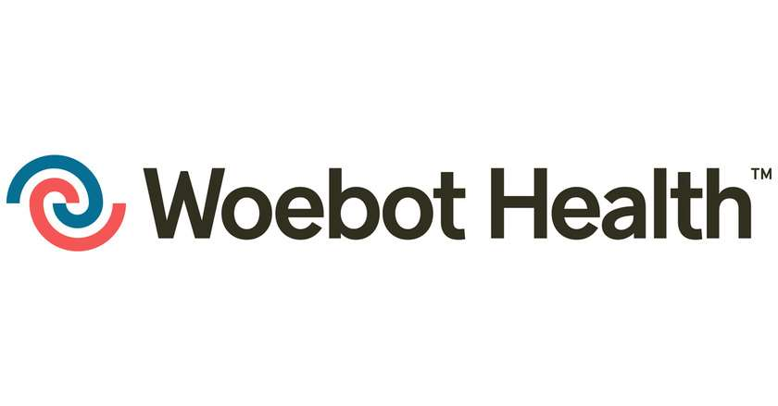
KEY PLAYERS

Slide 9


For Full Report
Contact us
COGNITIVE MARKET RESEARCH
Tel: +1 312-376-8303 | +44 020-8123-0732
India: (+91) 983-496-8611
sales@cognitivemarketresearch.com
Access the Full Report : http://tinyurl.com/26ysp762
Please visit our website:
https://www.cognitivemarketresearch.com

