Slide 1
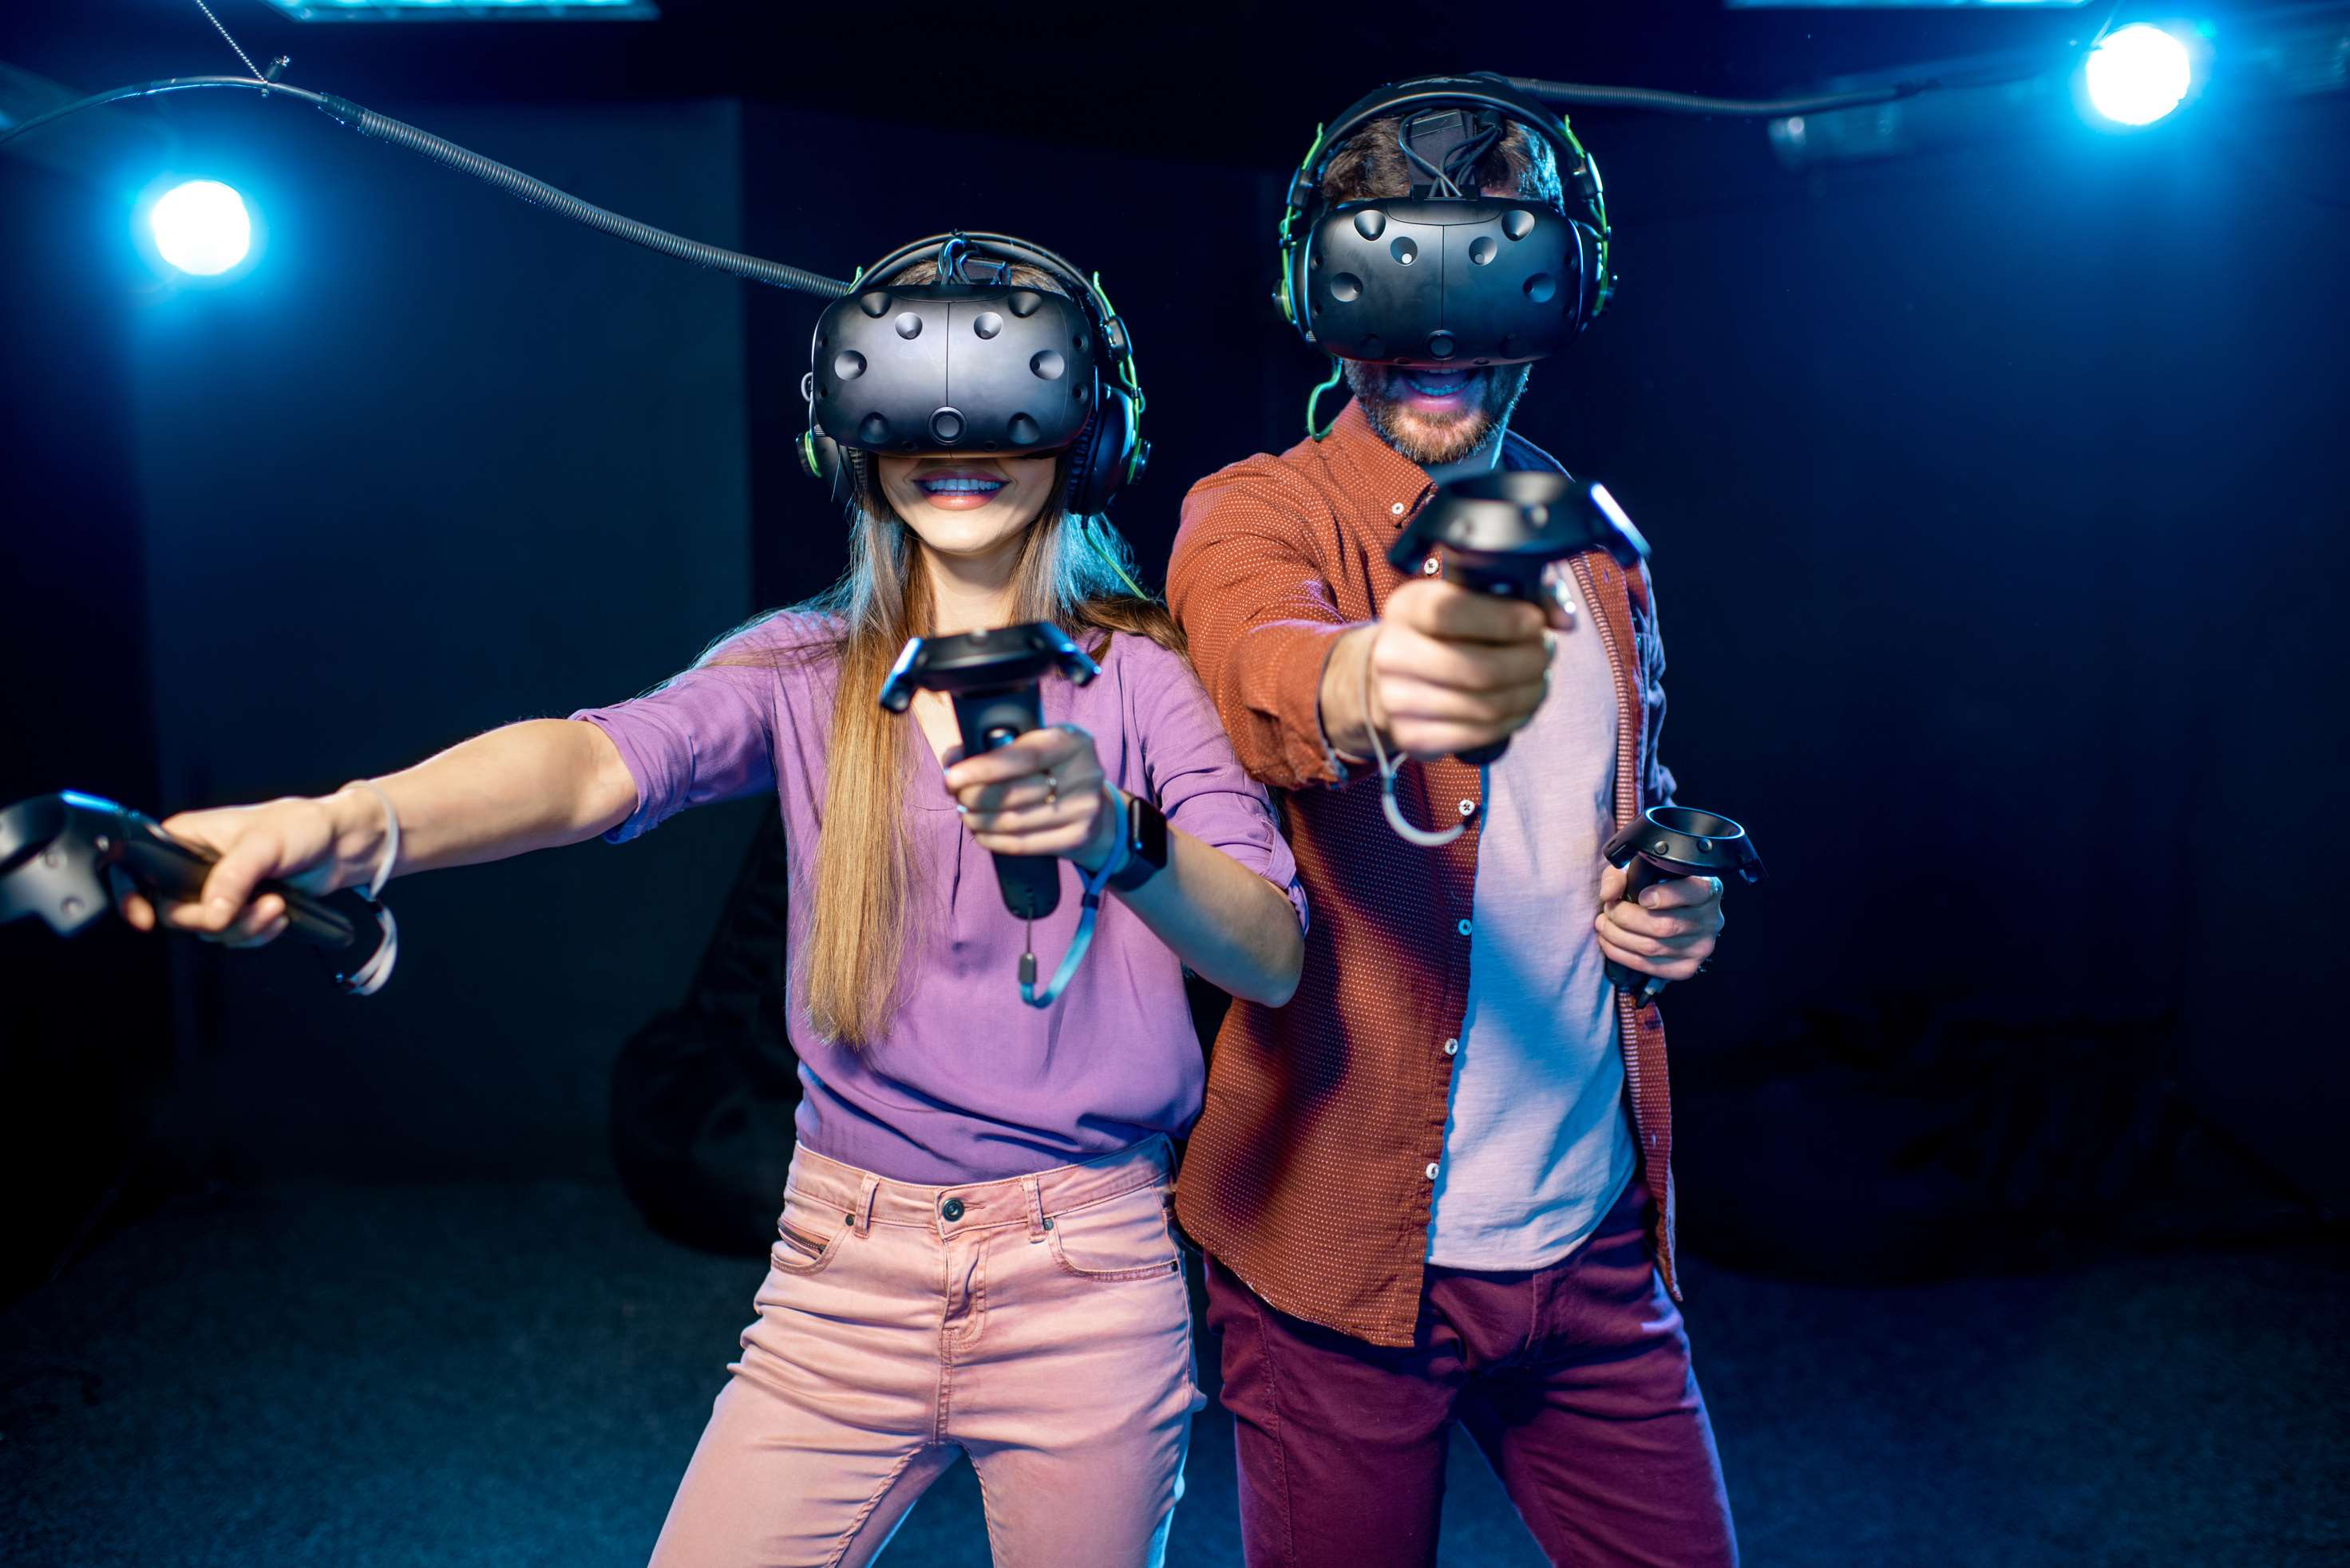
GLOBAL
AI IN GAMES
MARKET REPORT
2024
Global,Regional,CountryAnalysis

Slide 2

INTRODUCTION
AI in Games refers to the integration and utilization of artificial intelligence technologies within the gaming industry to enhance various aspects of game development, gameplay, and overall gaming experiences the advanced In-Game AI and personalized gaming experiences fuels the market growth.

Slide 3


KEY INSIGHTS
CAGR
27.20%
2024- 2031

Slide 4
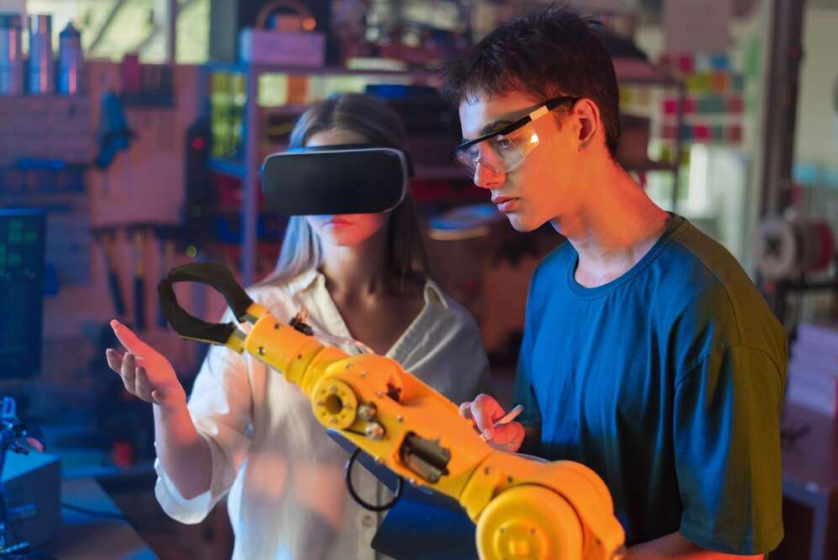
REVENUE MARKET SHARE BY SEGMENTS 2022
  On-Premise
  Cloud-based
Type Segment
  Hardware
  Software
  Service
Component Segment
  PC Gaming
  TV Gaming
  Smartphone & Tablet Gaming
Application Segment
  Machine Learning
  Natural Language Processing
  Computer Vision
  Gesture Control
Technology Segment
  Action
  Adventure
  Puzzle
  Simulation
  Role-playing
Genre Segment

Slide 5

Global AI in Games Market Revenue share for 2024
North America
40%

Slide 6

Procedural Content Generation and Game Customization to Propel Market Growth
Drivers
Development Complexity and Cost Constraints to Restrict Market Growth
Restraints

Slide 7

AUTHOR'S PERSPECTIVE
  The Global AI in Games market will expand significantly by 27.20% CAGR between 2023 and 2030.
  North America AI in Games held the major market of more than 40% of the global revenue and will grow at a compound annual growth rate (CAGR) of 25.4% from 2023 to 2030.
  Europe AI in Games market of more than 30% of the global revenue and will grow at a compound annual growth rate (CAGR) of 25.7% from 2023 to 2030.
  The demand for AI in Games is rising due to the advanced In-Game AI and personalized gaming experiences.
  Demand for On-Premise remains higher in the AI in Games market.

Slide 8









KEY PLAYERS

Slide 9


For Full Report
Contact us
COGNITIVE MARKET RESEARCH
Tel: +1 312-376-8303 | +44 020-8123-0732
India: (+91) 983-496-8611
sales@cognitivemarketresearch.com
Access the Full Report : https://tinyurl.com/53btxjuk
Please visit our website:
https://www.cognitivemarketresearch.com

