Slide 1
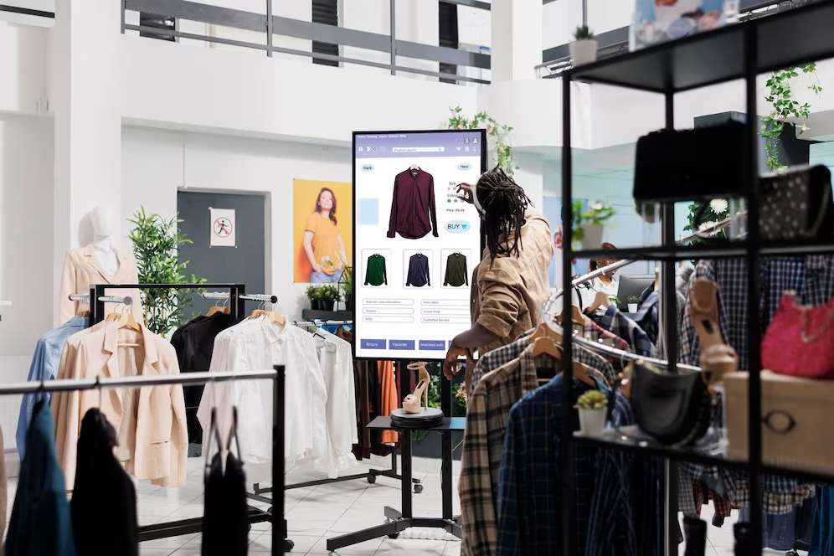
GLOBAL
AI IN FASHION
MARKET REPORT
2024
Global,Regional,CountryAnalysis

Slide 2
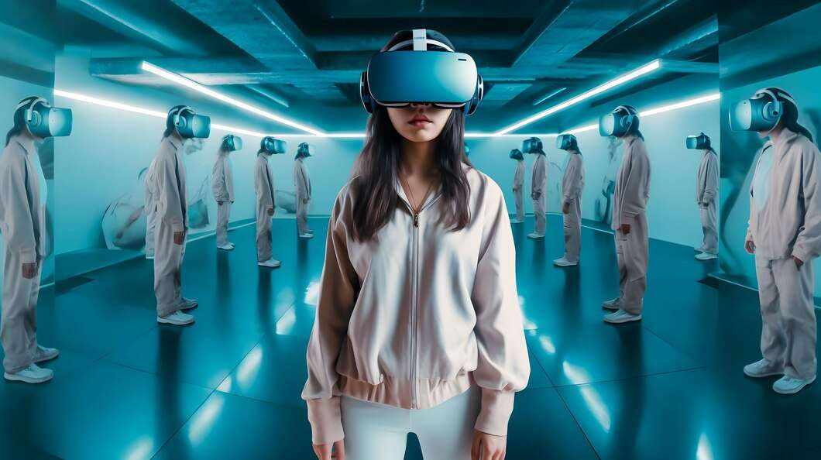
INTRODUCTION
AI in the fashion market refers to the application of artificial intelligence technologies, such as machine learning and computer vision, to various aspects of the fashion industry. This includes the use of AI algorithms to enhance processes related to design, production, supply chain management, retail, and customer experience. Growth is fuelled by personalized customer experiences and supply chain optimization.

Slide 3


KEY INSIGHTS
MARKET SIZE
USD 1125.2 million
2023
CAGR
41.50%
2023- 2030

Slide 4
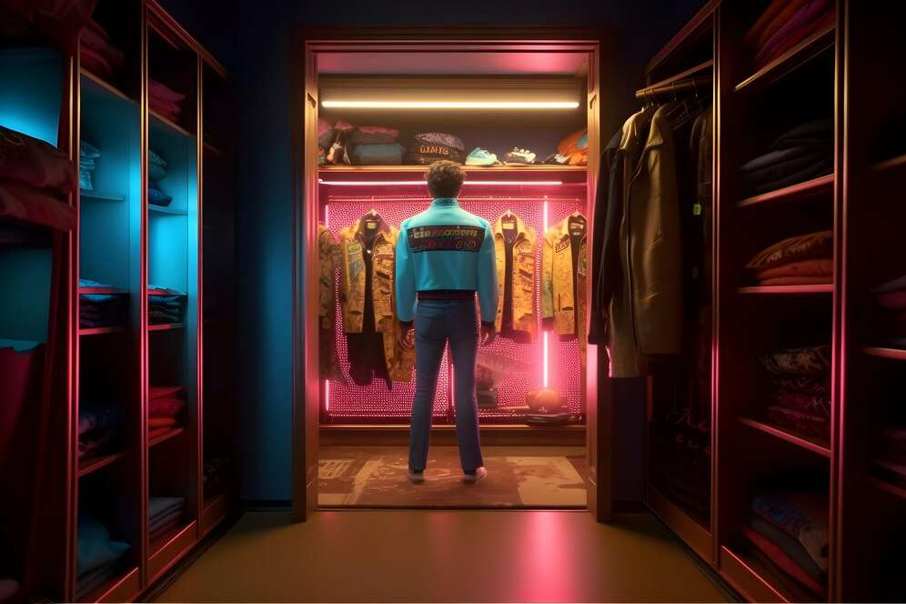
REVENUE MARKET SHARE BY SEGMENTS 2022
  Apparel
  Accessories
  Footwear
  Beauty and Cosmetics
  Jewelry and Watches
  Software Tools
  Platforms
Component Segment
Category Segment
  Product Recommendation
  Product Search and Discovery
  Supply Chain Management and Demand Forecasting
  Creative Designing and Trend Forecasting
  Fashion Designers
  Fashion Stores
Application Segment
End-User Segment

Slide 5

Global AI in Fashion Market Revenue share for 2024
North America
40%

Slide 6

Optimized Supply Chain Management to Propel Market Growth
Drivers
Data Privacy Concerns to Restrict Market Growth
Restraints

Slide 7
AUTHOR'S PERSPECTIVE
  The global AI in Fashion market will expand significantly by 41.50% CAGR between 2023 and 2030.
  North American AI in Fashion held the major market of more than 40% of the global revenue with a market size of USD 450.08 million in 2023 and will grow at a compound annual growth rate (CAGR) of 3.7% from 2023 to 2030.
  Europe AI in Fashion market has more than 30% of the global revenue with a market size of USD 337.56 million in 2023 and will grow at a compound annual growth rate (CAGR) of 40.0% from 2023 to 2030.
  The demand for Ai in Fashions is rising due to personalized customer experiences and supply chain optimization.
  Demand for solutions remains higher in the AI Fashion market.

Slide 8










KEY PLAYERS

Slide 9


For Full Report
Contact us
COGNITIVE MARKET RESEARCH
Tel: +1 312-376-8303 | +44 020-8123-0732
India: (+91) 983-496-8611
sales@cognitivemarketresearch.com
Access the Full Report : https://tinyurl.com/3tpumv9e
Please visit our website:
https://www.cognitivemarketresearch.com

