Slide 1

GLOBAL
AI BASED CAMERA MARKET REPORT
2024
Global,Regional,CountryAnalysis

Slide 2

INTRODUCTION
AI cameras enhance photography by automating complex tasks and introducing new capabilities. They can recognize and track objects, adjust settings based on the scene, and improve image quality through noise reduction and enhanced sharpness.

Slide 3
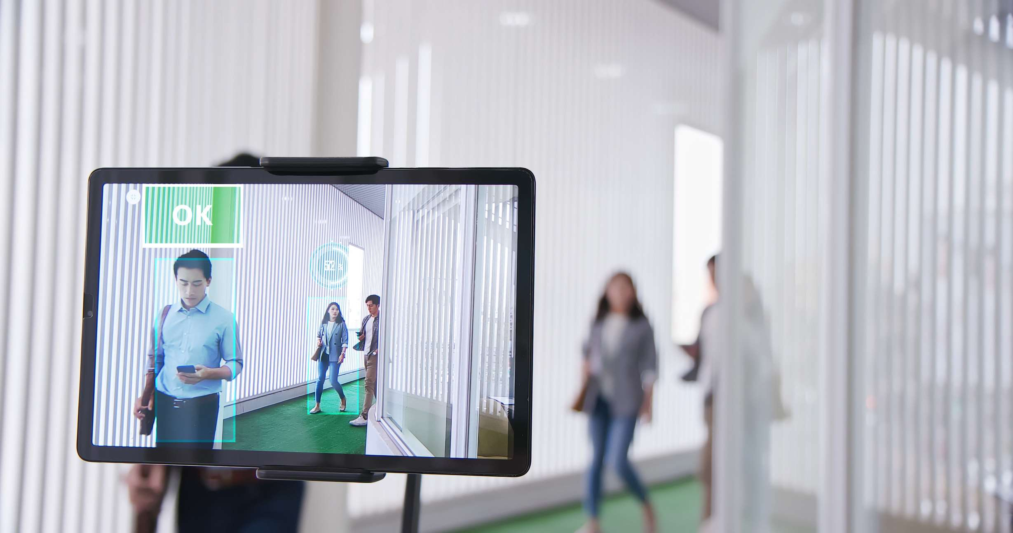

KEY INSIGHTS
MARKET SIZE
7.45 billion
2022
FORECAST
23.6 billion
2030
2023-
2030
CAGR
15.4%

Slide 4




REVENUE MARKET SHARE BY SEGMENTS 2022
  Type: Surveillance Camera: 31.4%
Technology: DSLR Camera:
  24.2%
  End-user: Consumer Electronics: 19.2%

Slide 5

GLOBAL AI BASED CAMERA MARKET REVENUE SHARE FOR 2022
North America
36.2%

Slide 6
Growing demand of cameras based on AI technology in smartphones and tablets
Rising adoption of AI cameras in consumer electronics and rising sales of smartphones with advanced technology
Drivers
The value of an AI camera contains embedding cost of AI platform, integrating cost of the AI camera, and services required to run AI platform.
Restraints

Slide 7
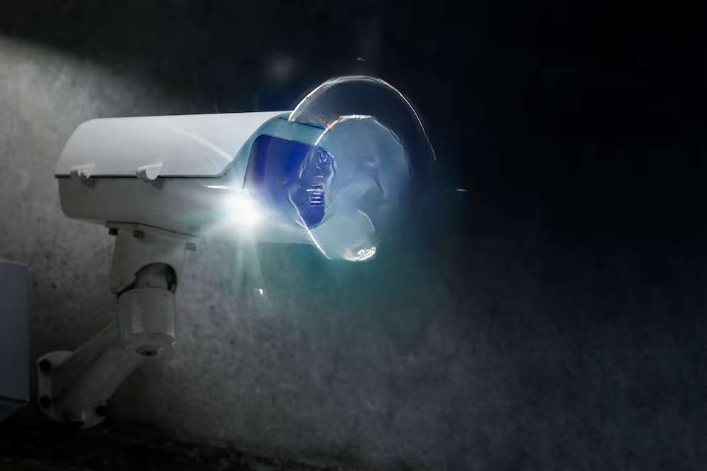
AUTHOR'S PERSPECTIVE
  The major firms employ a number of techniques, including alliances and acquisitions, to increase their AI camera market share and profitability.
  Due to the existence of significant suppliers on the international market, the industry is fragmented.

Slide 8







KEY PLAYERS

Slide 9


For Full Report
Contact us
COGNITIVE MARKET RESEARCH
Tel: +1 312-376-8303 | +44 020-8123-0732
India: (+91) 983-496-8611
sales@cognitivemarketresearch.com
Access the Full Report : http://tinyurl.com/2p8kvbz2
Please visit our website:
https://www.cognitivemarketresearch.com

