Slide 1



AI ENHANCED HPC
MARKET REPORT
2024
Qualitative Analysis + Quantitative Analysis

Slide 2

INTRODUCTION
The global market for AI-enhanced High-Performance Computing (HPC) was experiencing significant growth, driven by the increasing demand for advanced computing capabilities in various industries. The integration of artificial intelligence (AI) technology has had a major impact on high-performance computing (HPC), which entails using powerful computing systems to handle complicated and data-intensive activities.

Slide 3


KEY INSIGHTS
MARKET SIZE
$2,183.06 Million
2024
FORECAST
$4,092.77 Million
2030
CAGR
9.39%
2024- 2031

Slide 4

REVENUE MARKET SHARE BY SEGMENTS 2024
  Hardware Accelerated
  Software Accelerated
  Parallel Computing
  Distributed Computing
  Exascale computing
Type Segment
Computation Type
  Analytics for Financial Services
  Earth Sciences
  Visualization & Simulation
  Biological & Medical
Application
Segment
  Cloud
  On-Premises
Deployment Segment
  Small and Medium-Sized Enterprises (MSME)
  Large Enterprises
  Solutions
  Services
Component Segment
Organisation Size

Slide 5


North America
41.26%
North America AI Enhanced HPC Market Revenue share for 2024 is 41.26%

Slide 6

Growing adoption of cloud computing is driving the demand for global AI enhanced HPC market.
Drivers
High cost of implementation is restraining the growth of global AI enhanced HPC market
Restraints

Slide 7
AUTHOR'S PERSPECTIVE
  The Global AI Enhanced HPC Market is witnessing significant growth in the near future.
  The AI accelerators and software integrate into HPC for its use in financial analytics services.
  The adoption of AI-enhanced high-performance computing solutions in financial services organizations assists in preventing fraud, optimizes profits, predicts outcomes, and enhances customer experiences.
  The utilization of high-performance computing with computer-aided engineering software for high-fidelity modeling and simulation is expanding in the automotive, aerospace, healthcare robotics industries, and others.
  Major companies such as Intel Corporation, NVIDIA, Lenovo, and IBM offer GPU accelerated, FPGA, HPC-based cloud platforms and other solutions in high-performance computing, to leverage the business operation, and optimize the operational capability of business organizations and the industrial sector

Slide 8
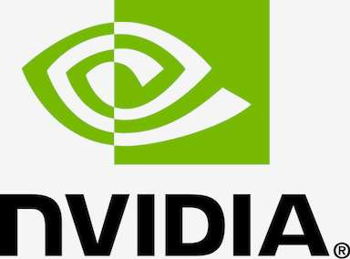
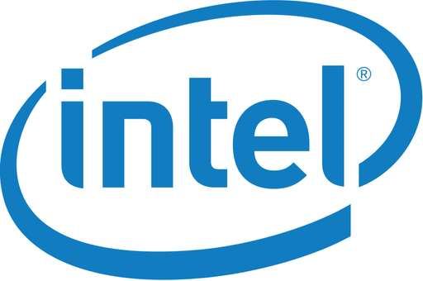



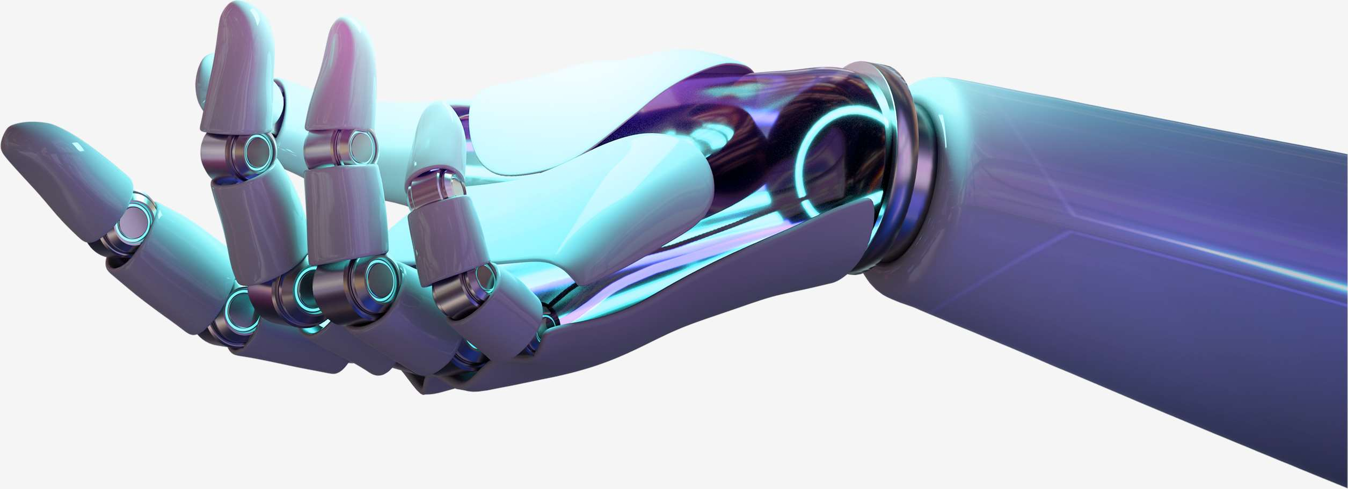
KEY PLAYERS

Slide 9


For Full Report
Contact us
COGNITIVE MARKET RESEARCH
Tel: +1 312-376-8303 | +44 020-8123-0732
India: (+91) 983-496-8611
sales@cognitivemarketresearch.com
Access the Full Report : https://tinyurl.com/yc3af4ru
Please visit our website:
https://www.cognitivemarketresearch.com

