Slide 1
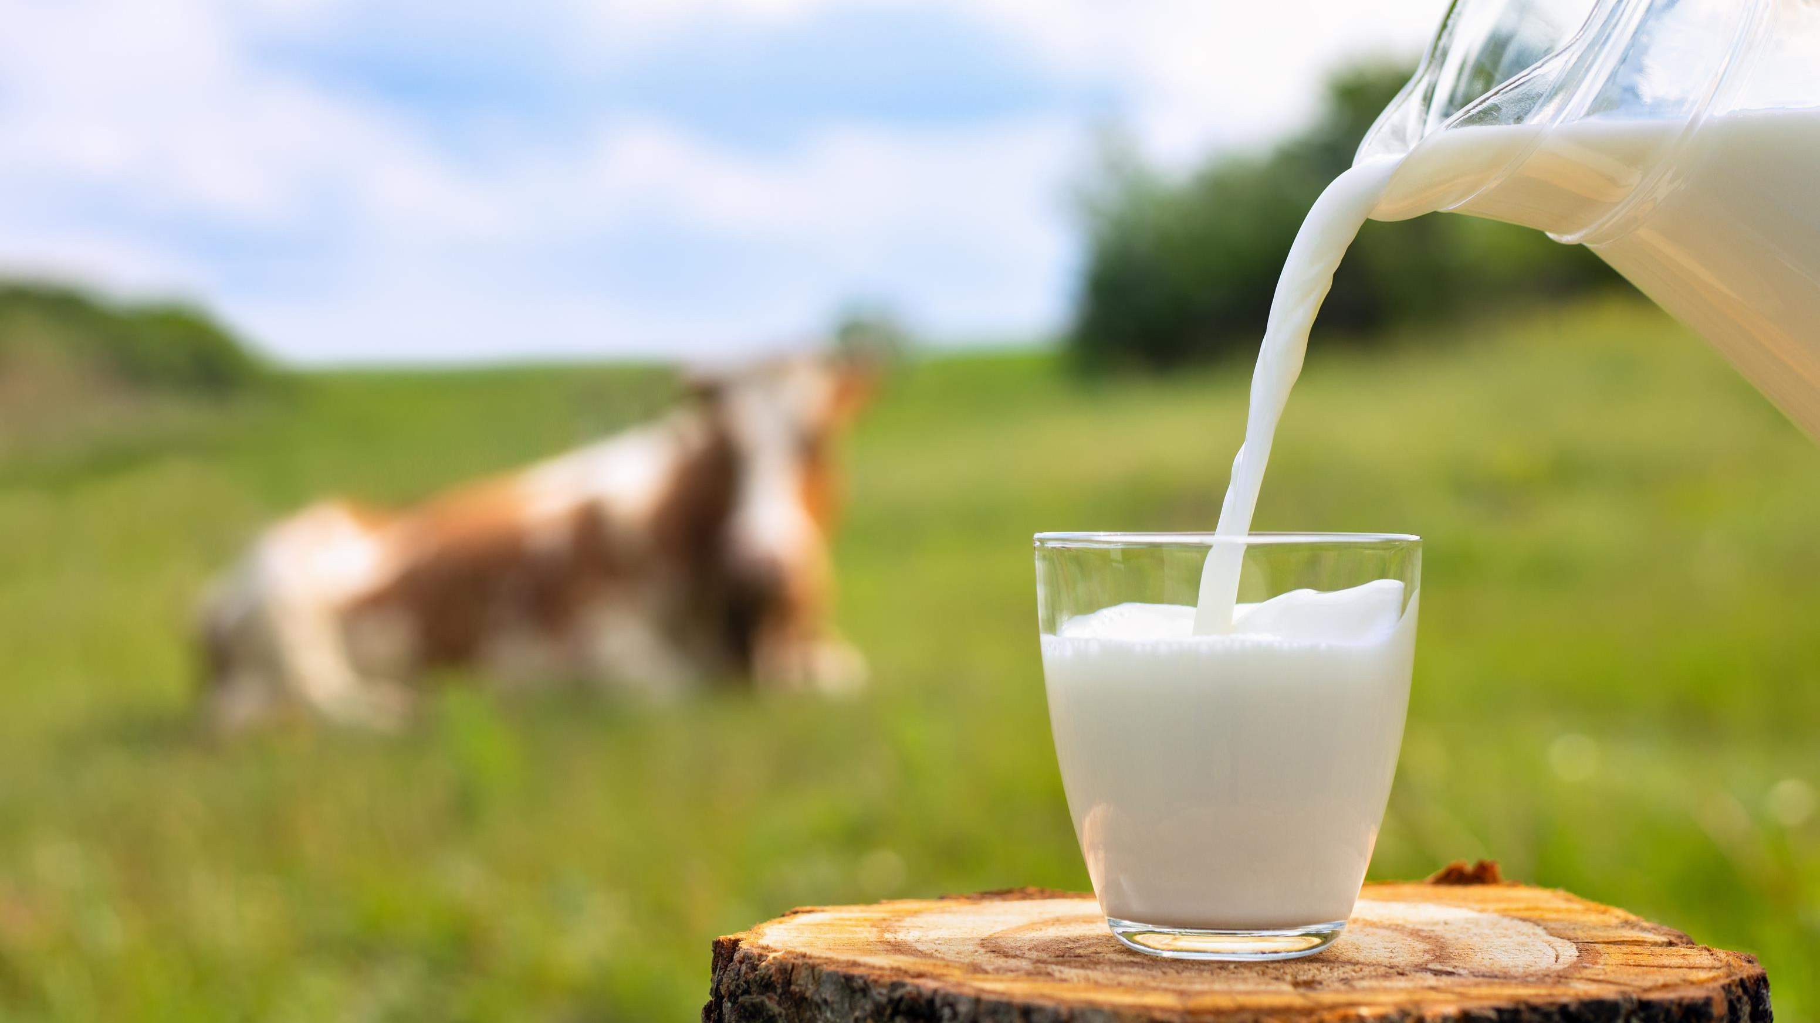
GLOBAL A2 MILK
MARKET REPORT 2024
Global,Regional,CountryAnalysis

Slide 2

INTRODUCTION
A2 Milk refers to a type of cow's milk that contains only the A2 beta- casein protein, as opposed to conventional milk that contains both A1 and A2 proteins. The A2 Milk market has gained popularity due to claims that it may be easier to digest for some individuals compared to traditional milk containing A1 protein. Growth is fuelled by the perceived digestive benefits and health and wellness trends.

Slide 3
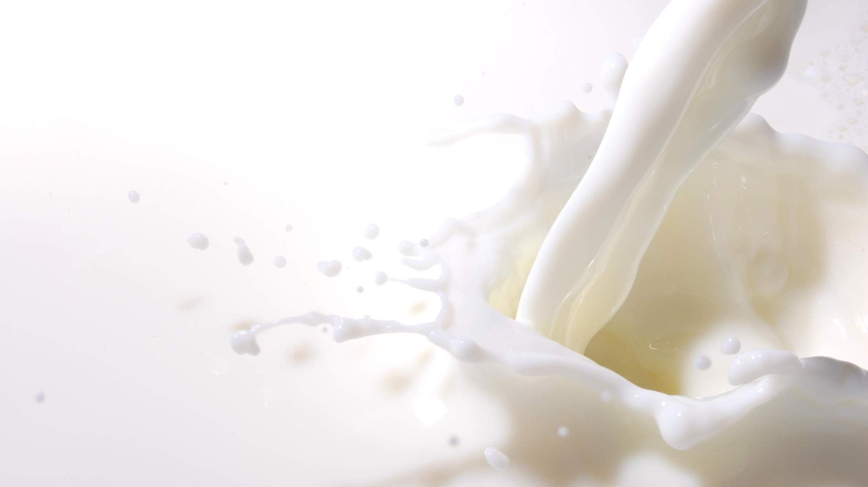

KEY INSIGHTS
MARKET SIZE
USD 2315.2 million
2024
CAGR 9.80%
2024
-
2031

Slide 4
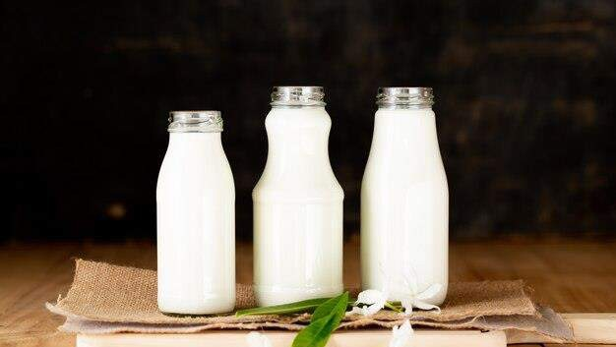
REVENUE MARKET SHARE BY SEGMENTS 2022
101-250ml/Gm
250-500ml/Gm
501-1000ml/Gm
Above 1000ml/Gm
Powder
Liquid
Form Segment
Packaging Size
Bottles
Cartons
Can
Jars
Organic
Conventional
Nature Segment
Packaging Form
No fat
Low fat
Reduced fat
Whole fat
Stored based retailers
Non-store retailers
Content Segment
Distribution Channel

Slide 5
Global A2 Milk Market Revenue share for 2024
North America 40%

Slide 6


Expansion of the Global Confectionery Industry to Propel Market Growth
High Cost of Jet Surfboats to Hinder Market Growth

Slide 7
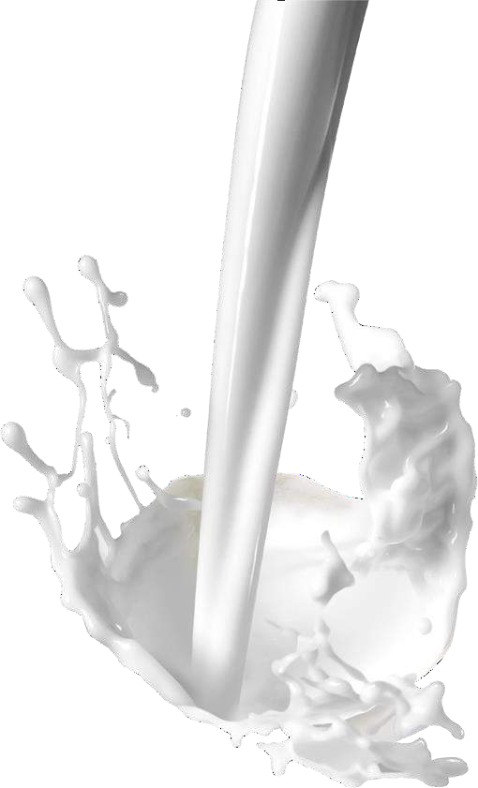
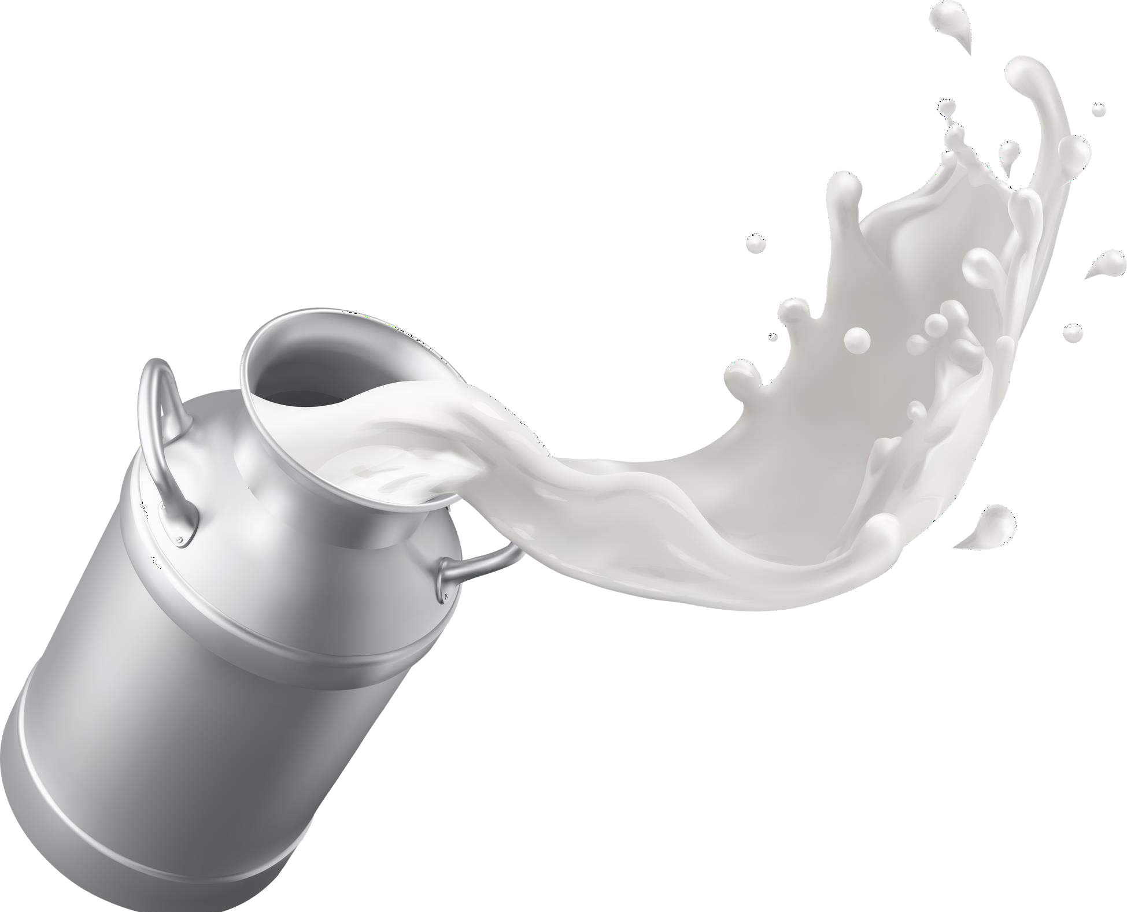
AUTHOR'S PERSPECTIVE
The global A2 Milk market will expand significantly by 9.80% CAGR between 2023 and 2030.
The demand for A2 Milk is rising due to the perceived digestive benefits and health and wellness trends.
Demand for A2 liquid milkremains higher in the A2 Milk market.
The Conventional category held the highest A2 Milk market revenue share in 2023.
North American A2 Milkwill continue to lead,
whereas the Asia-Pacific A2 Milk market will
experience the most substantial growth until 2030.

Slide 8
KEY PLAYERS

Slide 9


Contact us
For Full Report
COGNITIVE MARKET RESEARCH
Tel: + 1 312 - 376 - 8303 | + 44 020 - 8123 - 0732
India: ( + 91 ) 983 - 496 - 8611
sales@ cognitivemarketresearch. com
Access the Full Report : http://tinyurl.com/336254f8
Please visit our website:
https://www.cognitivemarketresearch.com

